Slide 1
Formaldehyde Awareness and Training
Environmental Health and Safety
Forchheimer 800
Einstein-Safety@einsteinmed.edu
https://www.einsteinmed.edu/administration/environmental-health-safety/

Slide 2
Health & Safety Hazards of Formaldehyde
Formaldehyde is classified as a human carcinogen.
It is listed in the International Agency for Research on Cancer (IARC) Group 2A as a probable human carcinogen.
Formaldehyde is a colorless, strong-smelling gas often found in aqueous (water-based) solutions.
Commonly used as a preservative in medical laboratories and mortuaries, formaldehyde is also found in many products such as chemicals, particle board, household products, glues, permanent press fabrics, paper product coatings, fiberboard, and plywood.

Slide 3
Health & Safety Hazards of Formaldehyde…continued
It is also widely used as an industrial fungicide, germicide, and disinfectant. Short-term exposure to formaldehyde can be fatal.
Formaldehyde is moderately toxic by skin contact and inhalation. Long-term exposure to low levels of formaldehyde may cause respiratory difficulty, eczema, and sensitization.
Chronic exposure to formaldehyde can cause dermatitis and sensitization of the skin and respiratory tract. After contact with the skin, a symptom-free period may follow in sensitized individuals.

Slide 4
Health & Safety Hazards of Formaldehyde…continued
Subsequent exposures can then lead to itching, redness, and the formation of blisters. Ingestion of formaldehyde can result in irritation of the mouth, throat and stomach, nausea, vomiting, convulsions and coma.
Exposure to formaldehyde gas can cause irritation of the eyes and respiratory tract, coughing, dry throat, tightening of the chest, headache, a sensation of pressure in the head, and palpitations of the heart. The OSHA standard for formaldehyde is found in the 29 CFR 1910.1048.

Slide 5
Health & Safety Hazards of Formaldehyde…continued
The permissible exposure limit (PEL) for formaldehyde in the workplace is 0.75 parts formaldehyde per million parts of air (0.75 ppm) measured as an 8-hour time-weighted average (TWA).
The standard includes a second PEL in the form of a short-term exposure limit (STEL) of 2 ppm which is the maximum exposure allowed during a 15-minute period.
The action level – which is the standard’s trigger for increased industrial hygiene monitoring and initiation of worker medical surveillance – is 0.5 ppm when calculated as an 8-hour TWA.)

Slide 6
Health & Safety Hazards of Formaldehyde…continued
Exposure to 0.1 to 5 ppm causes irritation of the eyes, nose, and throat.
Exposure to above 20 ppm can cause severe lacrimation, burning in the nose and throat, and breathing becomes difficult. Acute exposure to concentrations above 25 ppm can cause serious injury, including fatal pulmonary edema.

Slide 7
Additional Information on Formaldehyde
OSHA Fact Sheet: Occupational Exposure to Formaldehyde (PDF Format)
OSHA Standard 29CFR1910.1048, Formaldehyde (PDF Format)
OSHA Standard 29CFR1910.1048 App. C, Medical Surveillance - Formaldehyde (PDF Format)

Slide 8
Safety Data Sheets (SDS)
The Occupational Safety and Health Administration (OSHA) has issued standards requiring employers to provide employees with safety information of the hazardous materials and chemicals to which they are exposed while conducting their job duties.
The intent of these regulations enacted by OSHA is to ensure chemical safety in the workplace, to communicate and provide information to workers on how to safely handle chemicals by using the information provided by chemical manufacturers in the Safety Data Sheet (SDS).

Slide 9
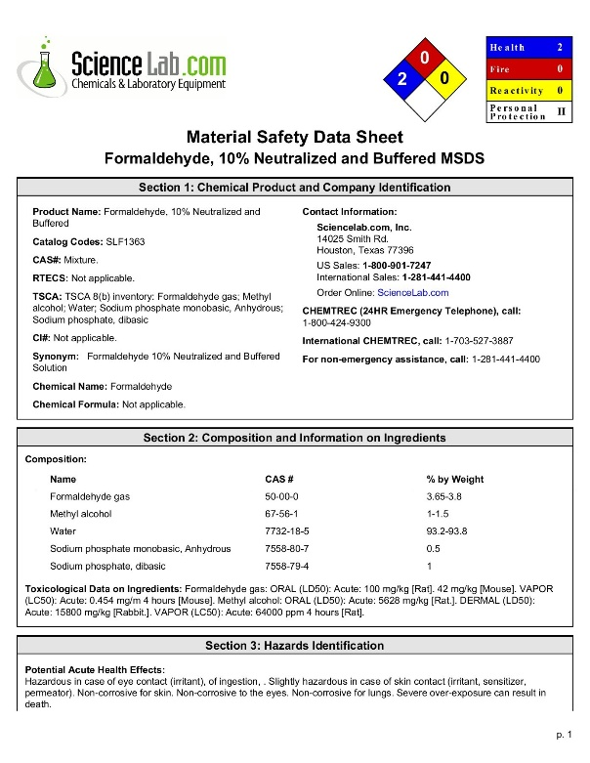
What is an SDS?
A Safety Data Sheet (SDS) is a 16-section document that important information such as the properties of each chemical; the physical, health (melting point, boiling point, flash point, etc.), and environmental health hazards; protective measures; and safety precautions for handling, storing, and transporting the chemical, and spill/leak cleanup procedures. It is designed to provide workers and emergency personnel with the proper procedures for handling or working with a potentially hazardous substance to understand the hazardous properties of a material BEFORE you work with it.
Feel free to review and retain this SDS for your records. Formaldehyde.

Slide 10
How May I Obtain an SDS?
Ask your supervisor.
Supervisors should keep a list and a file of the SDS for each chemical regularly used by the laboratory employees.
If you need help in setting up a file, please contact EH&S. You can also request an SDS from the manufacturer of the product, or from the Montefiore Safety Data Sheet database (SDS Online).

Slide 11
Other Means of Acquiring an SDS are:
SDSs come with the chemical products you order. You should save these in a binder in your laboratory for reference and training. If you need an SDS in an emergency, contact EH&S at X4150 or visit the EH&S Office located on the 8th floor of the Forchheimer Building. SDSs are also available 24 hours at our SDS Centers located on the 4th floor and the Lobby of the Forchheimer Building; the 3rd floor of the Kennedy Building; the basement, 1st, 4th, and 5th floors of the Price Building; and in the basement of the Van Etten Building.

Slide 12
Testing Your Knowledge
Please click the link below or scan the QR code to take a short, one-time quiz regarding the safety information on Formaldehyde:
https://einsteinmed.co1.qualtrics.com/jfe/form/SV_3ekaK7BfohCAKk6

