Slide 1
Data Management and Sharing (DMS) Plan Supplemental information
Indranil Basu, PhD, MBA
Assistant Director, Office of Grant Support
Research Assistant Professor of Radiation Oncology
January 24, 2023

Slide 2
When does the DMS Policy go into Effect?
The effective date of the DMS Policy is January 25, 2023;
Competing grant applications that are submitted to NIH for the January 25, 2023, and subsequent receipt dates;
Proposals for contracts that are submitted to NIH on or after January 25, 2023;
Other funding agreements (e.g., Other Transactions) that are executed on or after January 25, 2023.
Office of Grant Support

Slide 3
When the Data Must be Shared?
Data must be shared no later than the publication of the associated publication;
By the end of the award period (project period) for unpublished data whichever comes first.
Please see frequently asked questions, click here: https://sharing.nih.gov/faqs#/data-management-and-sharing-policy.htm?anchor=56773
NIH Institute and Center Data Sharing Policies

Slide 4
What does the Policy Require?
Investigators must develop a plan for managing and sharing scientific data as part of a funding application or proposal, addressing six (6) elements;
For applications also subject to the Genomic Data Sharing (GDS) Policy;
DMS Plans should address genomic data sharing considerations;
NIH program staff will review the plan for completeness and acceptability and must be approved prior to award;
Office of Grant Support

Slide 5
What does the Policy Require?...
Recipients must follow through with the approved Plan and report on progress;
This plan is reviewed by the Program Officials, not by the member of the study sections/review panel unless this plan is a part of the grant strategy.
DMPTool
                Sample Plans
Office of Grant Support

Slide 6
Who Needs to Comply?
Anyone receiving NIH funds to generate scientific data;
Scientific Data is defined as “recorded factual material commonly accepted in the scientific community as of sufficient quality to validate and replicate research findings, regardless of whether the data are used to support scholarly publications;”
All most all applications are subject to this policy except NIH activity codes Ts, Fs, C06, R13, Gs, and S06s.
Office of Grant Support

Slide 7
Where can Data be Shared?
NIH strongly encourages investigators to use an established repository to maximize the sharing of scientific data;
Some funding opportunities or programs may require the use of a specific repository;
If you need help identifying a repository for your data, browse through the list of NIH-supported Scientific Data Repositories;
There are many NIH-approved repositories. Select one that best fits your need;
Most of them are free; for some you may have to pay;
The site must assign Digital Object Identifier (DOI).
Repositories for Sharing Scientific Data

Slide 8
Some Points to Remember
DMS plan document cannot be more than two pages;
Hyperlinks or hypertexts are not allowed in the plan document;
Please work with the OHRA if your work/data involves human subjects;
An ORCID ID will be needed - ORCiD Sign in

Slide 9
Some Points to Remember…
Our interim understanding is that we would keep the data at least for three years and a maximum of 10 years;
You can budget the costs in the first year or spread it over the entire period of the grant;
You can withhold information if it is proprietary, however, you must indicate this in your plan;
NDA Data Submission Cost Estimation Tool

Slide 10
Some Points to Remember…
The plan is a non-scoreable item;
It will be reviewed by the program officials; however, it the data sharing is a part of the research strategy, it would be reviewed by the study section members;
Prior approval would be needed the similar way if scope of the project is changed such
  Changes in data design
  Timeline revision

Slide 11
Some Points to Remember…
The proposed costs amount must be added to the Section F of the R&R Budget page in Cayuse 424:
  One line only, DMS Plan (add all costs and enter the amount)
  Cannot be zero even if are not asking any $, just put $1
  Must add a narrative justification in the budget justification page. Just write a line if you are not asking for it.
  If you have a person who is doing your data management, use the additional $ amount here, which would be required to comply with the regulations; our understanding is that we should not add these efforts in the efforts section (?)

Slide 12
DMS: Allowable Costs
Curating data
Developing supporting documentation
Formatting data according to accepted community standards, or for transmission to and storage at a selected repository for long-term preservation and access
De-identifying data
Preparing metadata to foster discoverability, interpretation, and reuse
Local data management considerations, such as unique and specialized information infrastructure necessary to provide local management and preservation (for example, before deposit into an established repository).
Preserving and sharing data through established repositories, such as data deposit fees (If the Data Management & Sharing (DMS) plan proposes deposition to multiple repositories, costs associated with each proposed repository may be included).
Office of Grant Support

Slide 13
DMS: Unallowable Costs
Infrastructure costs that are included in institutional overhead (for instance, Facilities and Administrative costs)
Costs associated with the routine conduct of research, including costs associated with collecting or gaining access to research data
Costs that are double charged or inconsistently charged as both direct and indirect costs
Office of Grant Support

Slide 14
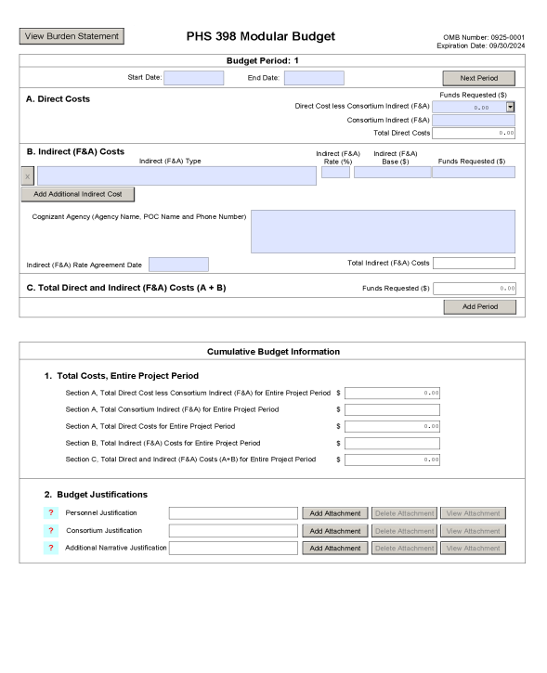
PHS 398 Modular Budget Form
Please click here to find the special instructions for applicants submitting Data Management and Sharing (DMS) Plans and the detailed guidance to fill out each section of the form.
Office of Grant Support

Slide 15
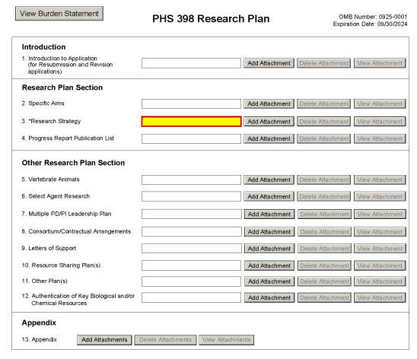
PHS 398 Research Plan Form
The DMS Plan will now be attached in the new item 11, Other Plan(s). Please click here to find the detailed guidance to fill out each section of the form.
Office of Grant Support

Slide 16
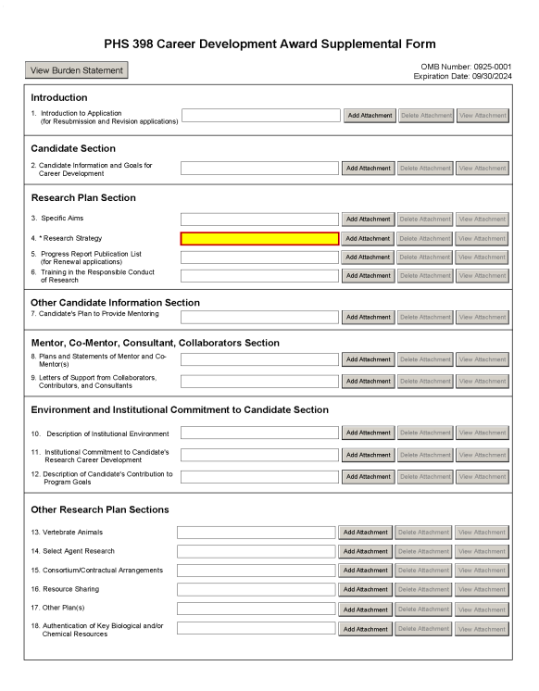
PHS 398 Career Development Award Supplemental Form
The DMS Plan will now be attached in the new item 17, Other Plan(s). Please click here to find the detailed guidance to fill out each section of the form.
Office of Grant Support

Slide 17
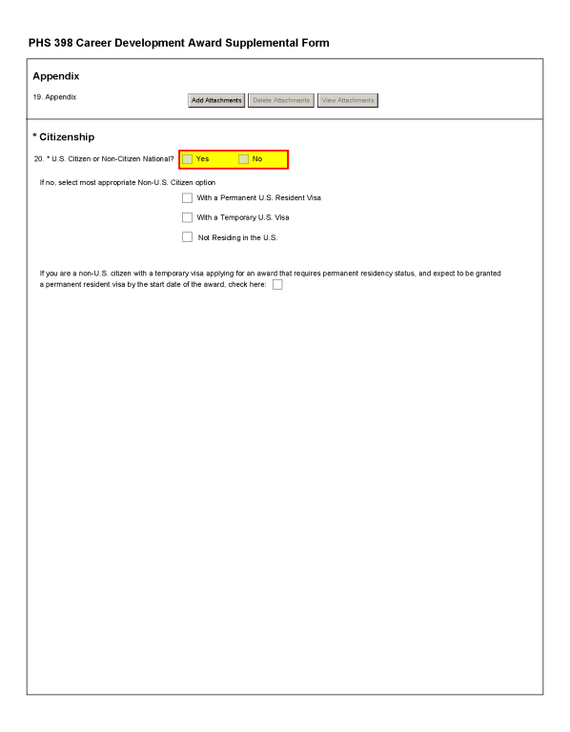
PHS 398 Career Development Award Supplemental Form…
Please click here to find the the detailed guidance to fill out each section of the form.
Office of Grant Support

Slide 18
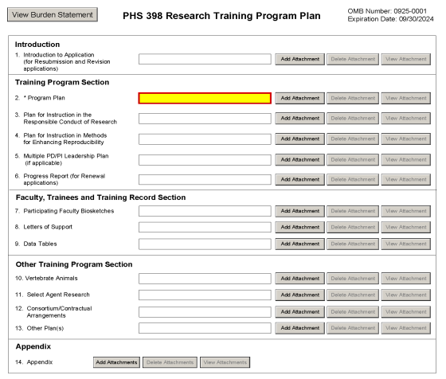
PHS 398 Research Training Program Plan Form
The potential future use with other plans will now be attached in the new item 13, Other Plan(s).
Please click here to find the the detailed guidance to fill out each section of the form.
Office of Grant Support

Slide 19
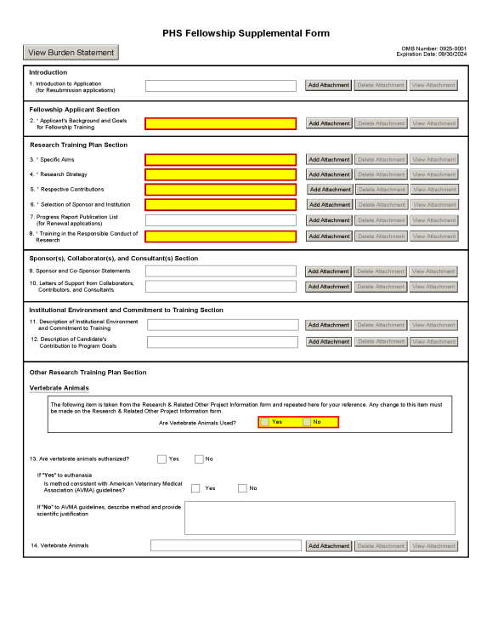
PHS Fellowship Supplemental Form
Please click here to find the the detailed guidance to fill out each section of the form.
Office of Grant Support

Slide 20
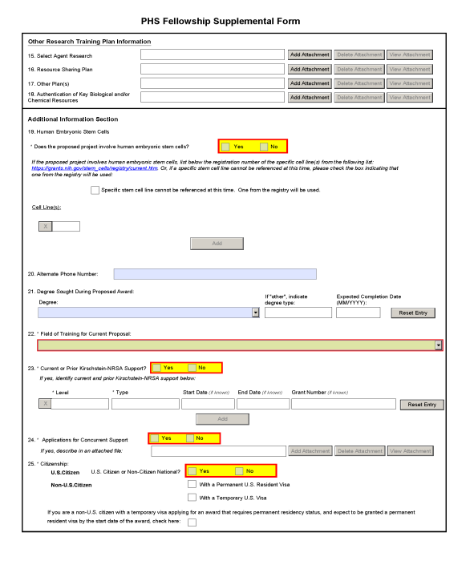
PHS Fellowship Supplemental Form...
The potential future use with other plans will now be attached in the new item 17, Other Plan(s).
Please click here to find the the detailed guidance to fill out each section of the form.
Office of Grant Support

Slide 21
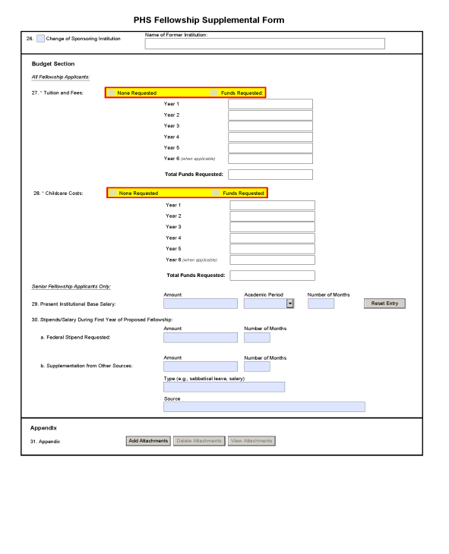
PHS Fellowship Supplemental Form….
Please click here to find the the detailed guidance to fill out each section of the form.
Office of Grant Support

Slide 22


