Slide 1
F30/F31 NRSA Fellowship 101 Workshop
Indranil Basu, PhD, MBA - Assistant Director
Office of Grant Support
February 9, 2023

Slide 2
What is the Office of Grant Support?
The Office of Grant Support (OGS) is comprised of only four individuals who provide pre-award administrative assistance to the entire Einstein community.
Our goal is to enable faculty and scholars to submit grant proposals and to manage subsequent non-financial responsibilities of the award, resubmission, and renewal processes.
https://www.einsteinmed.edu/administration/grant-support/
Office of Grant Support

Slide 3
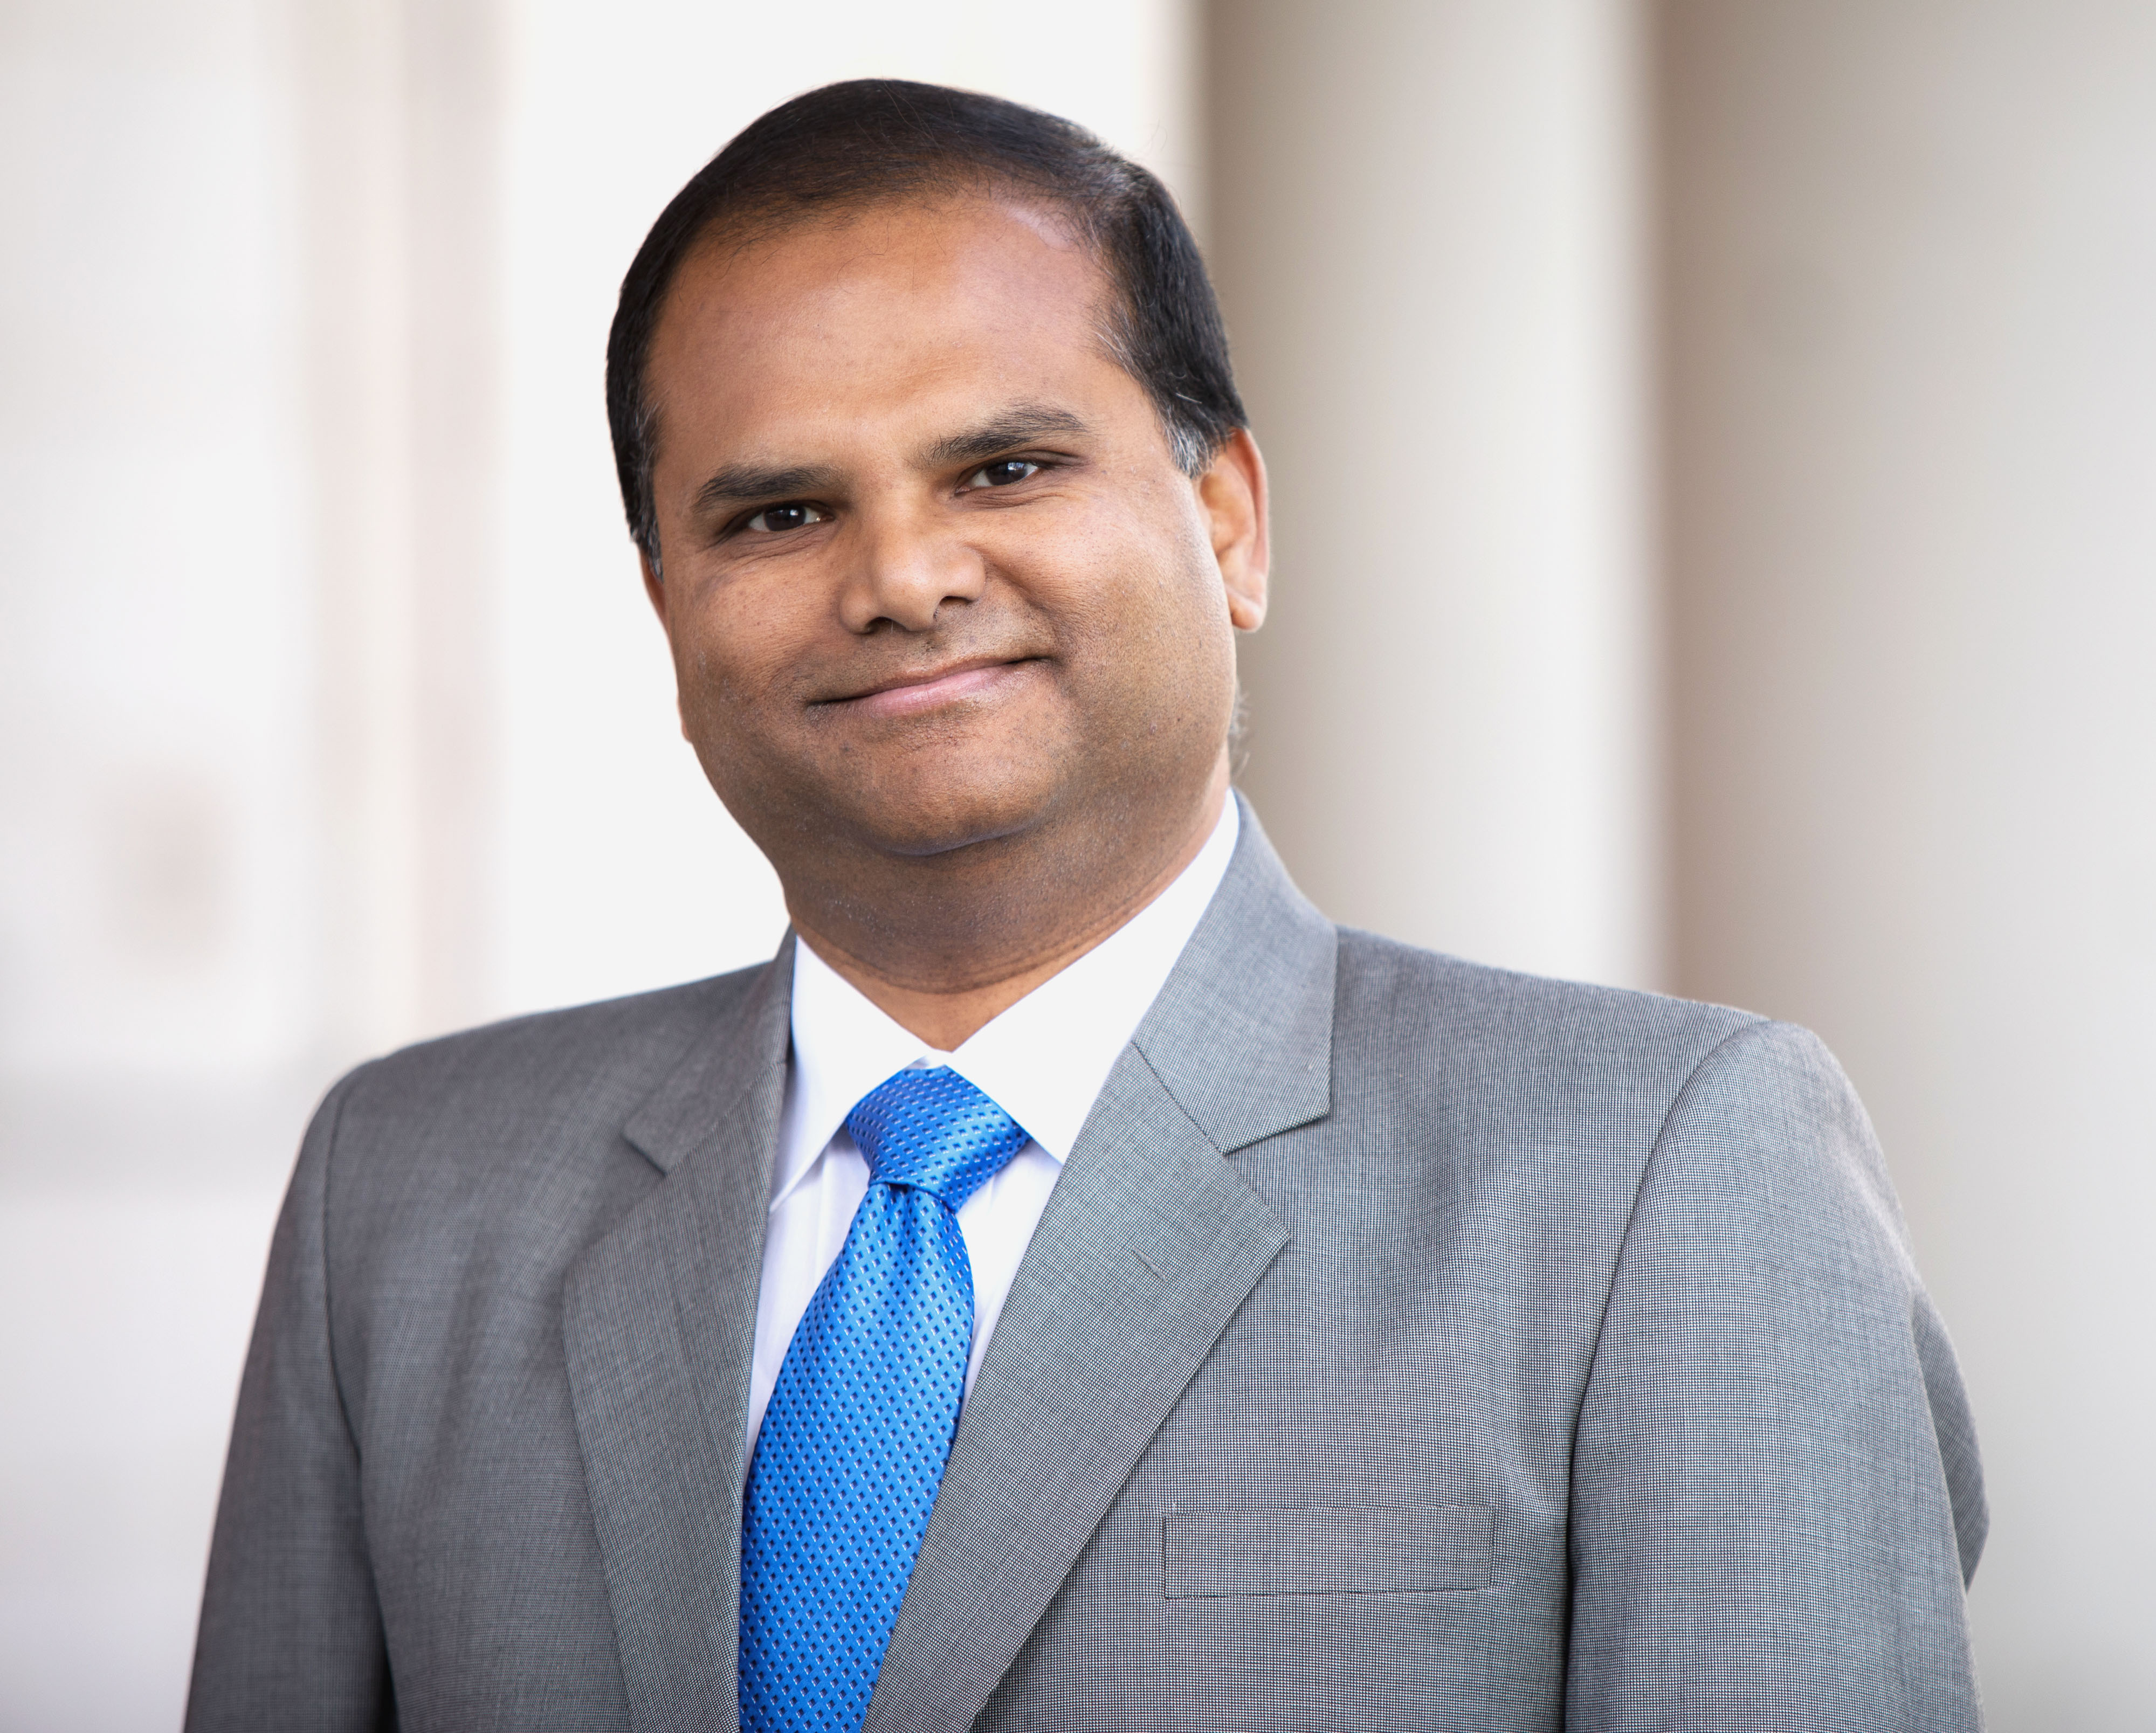
Team OGS – Who we are?…
AOR, SO, and Business Official (BO)
Assisting with day-to-day operations of the office. Training and workshops for funding/grant development
Finding funding and OGS updates – SPIN Portal. One-on-one consultation for strategizing grant development
Faculty profile in “PURE” research portal (for networking and communication). Templates for grant applications, and DMS issues
Limited submission application management. Contacting the sponsors/agencies
All non-federal grant processes, including NYS grants. IACUC, IRB, OCI liaison, NCE, RS, FIS, and JIT submissions
Indranil Basu, PhD, MBA – Assistant Director: Belfer 1106
Phone: (718) 430-2238
Email: indranil.basu@einsteinmed.edu
Office of Grant Support

Slide 4

Team OGS – Who we are?…
AOR (Authorized Organizational Representative), SO (Signing Official)
Budget development, review and budget revisions (pre-award only)
Collaboration letter review and preparation for signature
Face page review and processing for signature
Indirect cost reduction/waiver, no salary support request processing
Letter of Intent (LOI) and Statement of Work (SOW) review and processing
Gerard McMorrow, MBA – Pre-Award Analyst: Belfer 1106
Phone: (718) 430-3580
Email: gerard.mcmorrow@einsteinmed.edu
Office of Grant Support

Slide 5
Our Role in Expanding Funding & Research
Find funding opportunities: State, federal, private, foundation
Targeted dissemination of funding opportunities to interested trainees and faculty members
Interpret proposal guidelines and help with building application materials—eligibility, forms, institutional data, ePortals
Demystify DoD, NIH, NSF and other federal and non-federal policies, procedures, and jargons
Grantsmanship: Assist with team-building, writing, editing, proofreading, proposal review and critique and creating more competitive proposals
https://www.einsteinmed.edu/administration/grant-support/
Office of Grant Support

Slide 6
Grant Advisory Service
We provide Grant Advisory Service that includes assistance with editing, proof-reading, reviewing and critiquing grant proposals. Please see our Grant Advisory Service page.
We also provide assistance/help with manuscript enhancement services—editing, proof-reading, reviewing and critiquing to enhance publications. Please contact OGS at (718) 430-3642 or OGS@Einsteinmed.edu
4
Office of Grant Support

Slide 7
Grant Submission Process
Need to find a funding
opportunity?
Grant Development
Application is developed in Cayuse
Need help writing the grant?
Writing/editing
Contact OGS to search for funding opportunities
Opportunity found
Routing chain: Verify requirements and systems access
Need study design assistance?
Boistatistics support
Application is submitted
Non-Federal application submission steps vary
“Just-in-Time” materials/additional materials required
Grant application is routed through Cayuse for internal review/approval
Budget is developed
Federal applications submitted through Cayuse
Award acceptance & negotiations if applicable
“Notice of Award” arrives
Post-Award process begins
Notes:
JIT materials: IRB approval, IUCAC approval, IUCAC and IRB training/certificate, Budget and other supporting material

Slide 8
NIH Definitions of Minority and Diversity
Individuals from racial and ethnic groups such as Blacks or African Americans, Hispanics or Latinos, American Indians or Alaska Natives, Native Hawaiians, and other Pacific Islanders
Individuals with disabilities
Individuals from disadvantaged backgrounds (as defined in the Guide notice linked below)
Women from the above backgrounds at the graduate level and beyond in scientific fields
https://www.niaid.nih.gov/grants-contracts/underrepresented-person-definition#:~:text=NIH%20considers%20the%20following%20groups,Individuals%20with%20disabilities

Slide 9
Minority and Diversity Workforce
The following racial and ethnic groups have been shown to be underrepresented in biomedical research: Blacks or African Americans, Hispanics or Latinos, American Indians or Alaska Natives, Native Hawaiians and other Pacific Islanders.
In addition, it is recognized that underrepresentation can vary from setting to setting; individuals from racial or ethnic groups that can be demonstrated convincingly to be underrepresented by the grantee institution should be encouraged to participate in NIH programs to enhance diversity.
https://grants.nih.gov/grants/guide/notice-files/NOT-OD-20-031.html

Slide 10
NSF Definition of Underrepresented Groups
“Underrepresented minorities include individuals of races or ethnicities whose representation in STEM employment and S&E education is smaller than their representation in the U.S. population. This includes Blacks or African Americans, Hispanics or Latinos, and American Indians or Alaska Natives.”
Among many fields of STEM, the definition may vary by discipline (e.g., women are underrepresented in some STEM fields, Asian Americans in social science and humanities fields). This NSF resource link provides information/ overview (statistical data) of the underrepresented groups in different fields of study.
Office of Grant Support

Slide 11
Definition of Disability
Rehabilitation Act of 1973, the Education for All Handicapped Children Act of 1975 (now known as the Individuals with Disabilities Education Act)
The Americans with Disabilities Act (ADA) is a federal law that prohibits discrimination on the basis of disability. Now it is called the Americans with Disabilities Act (ADA) 1990.
Total deafness in both ears, visual acuity less than 20/200 with corrective lenses, speech impairment, missing extremities, partial paralysis, complete paralysis, convulsive disorders, mental or emotional illness, learning disabilities, kidney dialysis, and severe distortion of limbs and/or spine….
Office of Grant Support

Slide 12
NIH Funding Pathways
Individuals pursuing MD/PhD or other dual-degree training programs (https://researchtraining.nih.gov/programs/fellowships/F30)
Individual Pre-doctoral Fellowships to Promote Diversity (F31-NRSA)
Training in Drug-abuse Research: NIDA's Office of Diversity and Health Disparities (ODHD) encourages new and minority/ women researchers to enter the substance abuse research field.
Diversity Supplements (https://grants.nih.gov/grants/guide/contacts/Diversity-Supp_contacts.html
Office of Grant Support

Slide 13
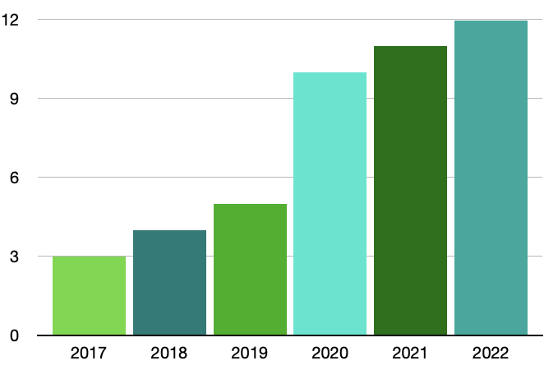
NIH Diversity Supplements Awarded to Einstein
Office of Grant Support

Slide 14
NIH F30 Application and Award
The Ruth L. Kirschstein National Research service F30 Award supports promising doctoral candidates who will perform dissertation research and training for an M.D./Ph.D. degree in a scientific health-related field during the tenure of the award. Applicants for the F30 must be within 48 months of matriculation into an accredited MD/PhD program at the time of application (for applicants pursuing an MD/PhD)
You (the applicant) are the PI, and your advisor is your sponsor
In Cayuse and eRA Commons these must reflect
Office of Grant Support

Slide 15
NIH F30 Application and Award…
NCI requires a clear cancer focus in graduate research training and gives funding priority to applications whose sponsor and/or co-sponsor have active cancer-related R01, or R01-like, peer-reviewed research grants. For the NCI F30 Award, R01-like research funding includes peer-reviewed research grants from other federal sources and private foundations with a duration of at least 3 years with a minimum of $150,000 direct costs per year. Grants under a no-cost extension do not qualify.
(https://www.cancer.gov/grants-training/training/funding/f30#:~:text=The%20NCI%20Ruth%20L.,the%20tenure%20of%20the%20award.)
Office of Grant Support

Slide 16
NIH F31 Application and Award…
F31: Individual Predoctoral Fellowship (https://researchtraining.nih.gov/programs/fellowships/F31)
F31 (diversity): Individual Predoctoral Fellowship to promote diversity in Health-Related Research (https://grants.nih.gov/grants/guide/pa-files/PA-21-052.html).
The F31 is intended for predoctoral students in PhD programs working on biomedical research without a direct clinical component.
Office of Grant Support

Slide 17
NIH F31 Application and Award…
MD/PhD students may also apply for an F31, especially in the case where the relevant NIH institute does not support F30s; contact the Program Officer from your target institute for advice if you’re an MD/PhD deciding whether you should apply for an F31
Applicants will receive up to five years (but typically 2-3 years) of support for research training, including: stipend, tuition and fees, and institutional allowance to defray costs like research supplies and conference travel.
Office of Grant Support

Slide 18
NIH F31 Application and Award…
Ideally after qualifying exam;
If rejected, can resubmit (6-9 months turnover);
If rejected, can apply to other foundational (not just NIH) funding fellowships;
Can use data from diversity supplemented as preliminary data for another project
Office of Grant Support

Slide 19
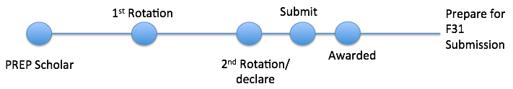
Timeline: F31 Application and Award…
Office of Grant Support

Slide 20
NIH F32 Application and Award
NRSA F32 fellowships provide up to three years of support for promising postdoctoral researchers who have the potential to become productive, independent investigators within the broad scope of biomedical, behavioral, or clinical research.
(https://www.niehs.nih.gov/research/supported/training/fellowships/f32/index.cfm#:~:text=NRSA%20F32%20fellowships%20provide%20up,%2C%20behavioral%2C%20or%20clinical%20research.)
Office of Grant Support

Slide 21
Steps to Follow for Diversity Fellows
The Fellow contacts the Office of Grant Support (OGS@einsteinmed.edu) and lets us know about his/her intention to submit an application (and the deadline). It should be done at least 1.5 months prior to the deadline;
The Fellow works with their departmental administrator, and creates a Cayuse application;
The Fellow works with their mentor(s) to draft the diversity eligibility or support letter. We can supply them with a sample letter if needed;
The draft letter must be sent (by the Mentor/Fellow) to the OGS at least a month prior to the deadline (addressing to indranil.basu@einsteinmed.edu);

Slide 22
Steps to Follow for Diversity Fellows….
The OGS sends the draft letter to the Senior Associate Dean for Diversity and Inclusion for review and processing;
Once finalized, the letter will be signed by Dr. Lynne M. Holden (Senior Associate Dean for Diversity and Inclusion), and returned to the Fellow/Mentor a few days prior to the application deadline;
The completed application must reach the OGS a few days before the deadline (the letter may not need to be attached at this time);
The Fellow submits the application after the application is routed and approved by the OGS.

Slide 23
Sample Letter Request
Please contact Dr. Indranil Basu at indranil.basu@einsteinmed.edu
Sample letter for Ruth L. Kirschstein National Research Service Awards for Individual Predoctoral Fellowship to Promote Diversity in Health-Related Research (Parent F31 – Diversity)
Sample candidate eligibility statement for diversity

Slide 24
Cayuse: Application Development and Submission
Cayuse 424 is a Web application portal created to simplify the creation, review, routing, approval, and electronic submission of grant proposals, i.e., S2S (system-to-system) submission of proposals.
Username and password: Contact Rayard (Ray) Hosein at rhosein@montefiore.org
For urgent help (when we are not available) you may call (503) 297- 2108 Ex. 201 or email at https://einstein.cayuse424.com/
| 23
Office of Grant Support

Slide 25
Pre-requisites for Submitting Application Using Cayuse
Existence of a profile in Cayuse
PIs and administrators register with NIH eRA Commons (contact Indranil.basu@einsteinmed.edu)
Existing agency accounts must be “affiliated” with Einstein
Individuals must have role as a PI or Trainee
| 24
Office of Grant Support

Slide 26

Questions?
Please reach out to us at OGS@einsteinmed.edu**
  ** note the new email address
Office of Grant Support

