Slide 1
Preparing Ahead for the New FORMS-H Grant Applications Indranil Basu, Assistant Director Office of Grant Support December 16, 2022

Slide 2
Team OGS – Who we are?…
AOR, SO, and Business Official (BO)
Assisting with day-to-day operations of the office. Training and workshops for funding/grant development
Finding funding and OGS updates – SPIN Portal. One-on-one consultation for strategizing grant development
Faculty profile in “PURE” research portal (for networking and communication). Templates for grant applications, and DMS issues
Limited submission application management. Contacting the sponsors/agencies
All non-federal grant processes, including NYS grants. IACUC, IRB, OCI liaison, NCE, RS, FIS, and JIT submissions
Indranil Basu, PhD, MBA – Assistant Director Belfer 1106 – Phone: (718) 430-2238
Email: indranil.basu@einsteinmed.edu
Office of Grant Support

Slide 3
Team OGS – Who we are?…
AOR (Authorized Organizational Representative), SO (Signing Official)
Budget development, review and budget revisions (pre-award only)
Collaboration letter review and preparation for signature
Face page review and processing for signature
Indirect cost reduction/waiver, no salary support request processing
Letter of Intent (LOI) and Statement of Work (SOW) review and processing
Gerard McMorrow, MBA – Pre-Award Analyst: Belfer 1106
Phone: (718) 430-3580
Email: gerard.mcmorrow@einsteinmed.edu
Office of Grant Support

Slide 4
FORMS-H starting on January 25, 2023
FORMS-H Coming for January 2023 Due Dates
FORMS-H grant application forms & instructions must be used for due dates on or after January 25, 2023 – New grant application instructions are now available. Applicants must use updated application forms and instructions identified with a Competition ID of “FORMS-H” on or after January 25, 2023.
Office of Grant Support

Slide 5
How to ensure that you have used the right forms (Forms-H) in Cayuse?
Cayuse has already downloaded the opportunity packages. As long as Grants.gov has FORMS-H available, you should be able to use it.
Please ensure the opportunity package is the FORMS-H. You can see the FORMS-H on the third column. In addition, you would see the word FORMS-H on the upper left corner of the Cayuse 424 page (next to “Proposal List”) when you start developing the application.
Steps to follow in Cayuse
Go to Cayuse 424
Scroll down to Electronic Submission tab (left panel). Click on it
Click on the Opportunity Details on the new page
You will see on the new page Competition ID: FORMS-H
Office of Grant Support

Slide 6
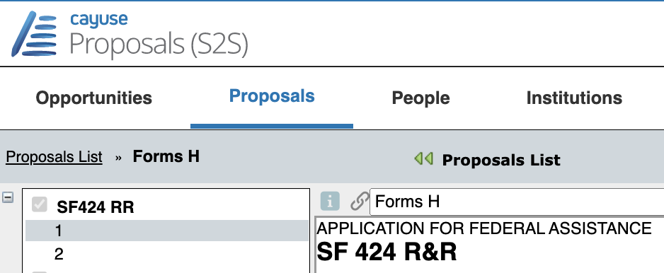
FORMS-H is already enabled in Cayuse
Office of Grant Support

Slide 7
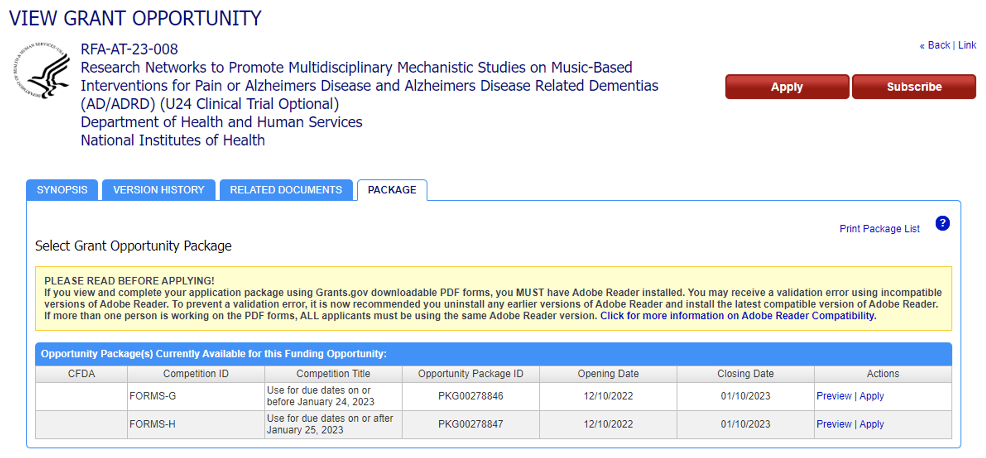
If you are unable to find the opportunity in Cayuse
Please check on Grants.gov for the opportunity package, CFDA (If applicable) as well as which version of the forms are in use.
Office of Grant Support

Slide 8
How to download the opportunities in Cayuse
Steps to follow
Locate the opportunity number, CFDA number, or package ID of your opportunity. You can always find this information on the opportunity page at Grants.gov.
From your Cayuse Proposals dashboard, click on the Opportunities tab.
Office of Grant Support

Slide 9
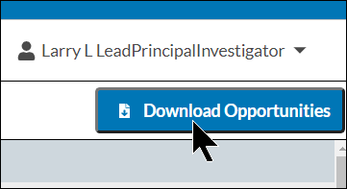
How to download the opportunities in Cayuse….
Click the Download Opportunities button at the top of the page.
In the new window, enter the opportunity number, CFDA Number, or package ID, Click Download Opportunities.
Office of Grant Support

Slide 10
FORMS-H in Cayuse
Copy and paste the opportunity number in the text box on the upper left. Click filter next to it. The opportunity number will appear. Then click on the plus sign on the left. Now, a new page will appear to develop the application.
Office of Grant Support

Slide 11
Transform a Proposal to the Latest Version (FORMS-H) if you used FORMS-G by Mistake
When you transform a proposal, information will only be copied between forms that are the same in each opportunity.
If you are replacing an expired opportunity with a new one, the forms will generally be the same, but if it is a different opportunity, some forms may be different, and that information will not transfer.
Office of Grant Support

Slide 12
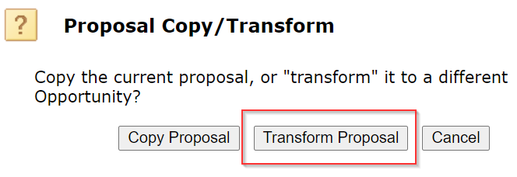
Transforming a proposal
Steps to follow
Select the icon on your proposal which is still using FORMS-G.
Once you select the icon, a new window will populate with prompts that you need to select. In this case, you need to select “Transform Proposal.”
Office of Grant Support

Slide 13
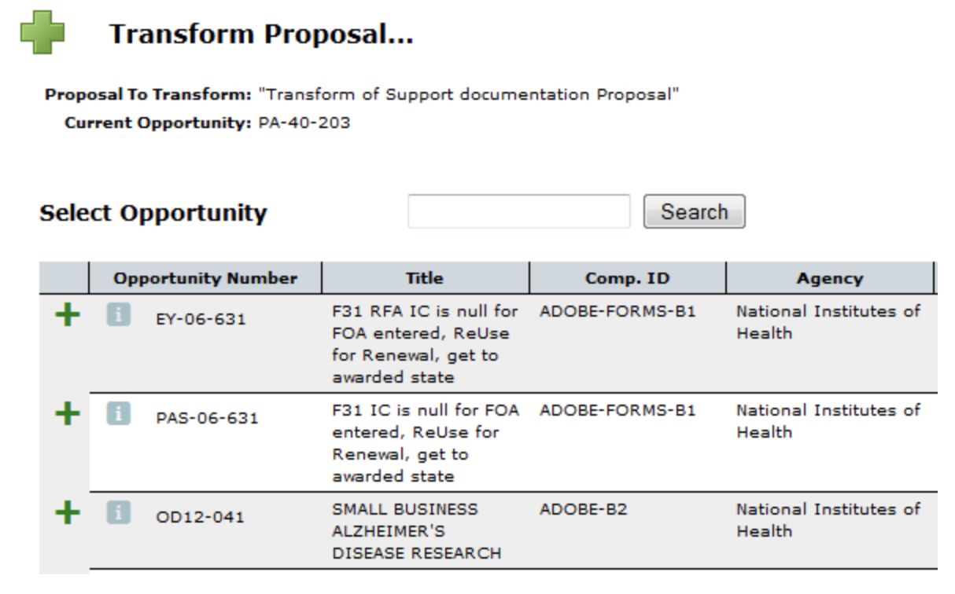
Transforming a proposal…
Select the new opportunity from the list by clicking on the green plus icon to the left of the opportunity icon on your proposal which is still using FORMS-G. This process is similar to selecting an opportunity.
Office of Grant Support

Slide 14
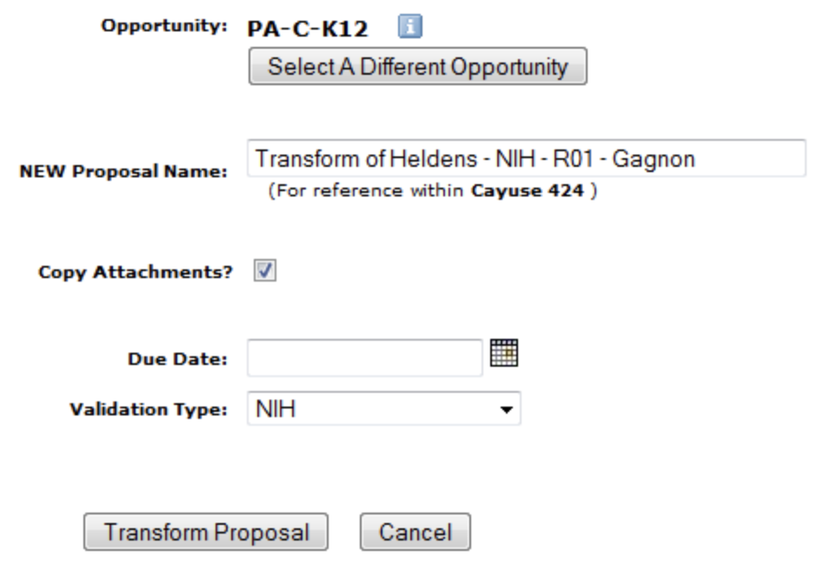
Transforming a Proposal….
Edit the Proposal Name for the new proposal as desired.
If you do not want to copy the attached documents, uncheck the Copy Attachments checkbox. Select the Validation Type if a different type is required.
Fill out the due date. Click Transform Proposal.
Your new proposal will appear in the Proposals List.
Office of Grant Support

Slide 15
FORMS-H Checklist
NIH forms and instructions have been updated to support the new sharing requirements. The FORMS-H application instructions are posted. Please click here to find the updated instructions.
It is time to get to work on your applications now following the FORMS-H checklist, which will help you navigate the changes.
Office of Grant Support

Slide 16
FORMS-H Checklist…
1. | Use an application form package with a Competition ID that includes “FORMS-H”. Please click here if you are not sure how to identify the correct form.
2. | Use the SF424 (R&R) – Version H application form instructions on the How to Apply – Application Guide page.
3. | Determine if your proposed research is subject to the DMS policy.
4. | Identify appropriate methods/approaches and repositories for managing and sharing scientific data.
Office of Grant Support

Slide 17
FORMS-H Checklist….
5. | Develop a Plan for managing and sharing scientific data and submit this Plan within the funding application or proposal.
6. | Estimate and request funds for data management and sharing activities if not already covered by the institution or other sources.
7. | Upon submission check all applicable application files in eRA Commons (e-Application; Data Management and Sharing (DMS) Plan; e-Submission-PHS Assignment Request Form; cover letter)
Office of Grant Support

Slide 18
Additional Resources
FORMS-H Forms & Instructions
How to Apply – Application Guide
Annotated Forms Sets
High-level Summary of Form Changes in FORMS-H Application Packages
Do I Have the Right Form Version For My Application?
Applying Electronically FAQs
Office of Grant Support

Slide 19
FORMS-H: Significant Changes
FORMS-H application packages incorporate the latest versions of the PHS forms managed by NIH (OMB Number: 0925-0001 and 0925-0770, Expiration Date: 09/30/2024). OMB approval for FORMS-H changes are underway and the updated expiration dates will be provided and incorporated once they are finalized on the NIH website.
Office of Grant Support

Slide 20
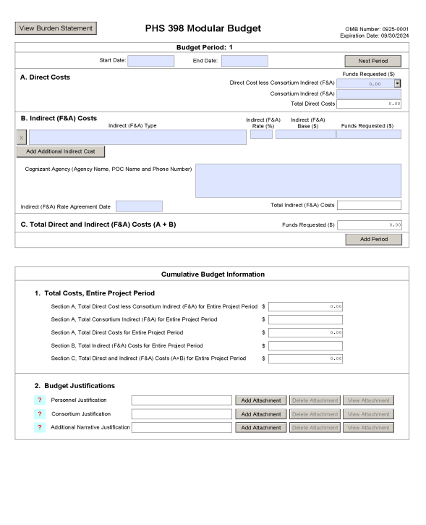
Screenshot: PHS 398 Modular Budget Form
Please click here to find the special instructions for applicants submitting Data Management and Sharing (DMS) Plans and the detailed guidance to fill out each section of the form.
Office of Grant Support

Slide 21
FORMS-H: Significant Changes
FORMS-H application packages incorporate the latest versions of the PHS forms managed by NIH (OMB Number: 0925-0001 and 0925-0770, Expiration Date: 09/30/2024). OMB approval for FORMS-H changes are underway and the updated expiration dates will be provided and incorporated once they are finalized on the NIH website.
Office of Grant Support

Slide 22
DMS: Allowable Costs
Curating data
Developing supporting documentation
Formatting data according to accepted community standards, or for transmission to and storage at a selected repository for long-term preservation and access
De-identifying data
Preparing metadata to foster discoverability, interpretation, and reuse
Local data management considerations, such as unique and specialized information infrastructure necessary to provide local management and preservation (for example, before deposit into an established repository).
Preserving and sharing data through established repositories, such as data deposit fees (If the Data Management & Sharing (DMS) plan proposes deposition to multiple repositories, costs associated with each proposed repository may be included).
Office of Grant Support

Slide 23
DMS: Unallowable Costs
Infrastructure costs that are included in institutional overhead (for instance, Facilities and Administrative costs)
Costs associated with the routine conduct of research, including costs associated with collecting or gaining access to research data
Costs that are double charged or inconsistently charged as both direct and indirect costs
Office of Grant Support

Slide 24
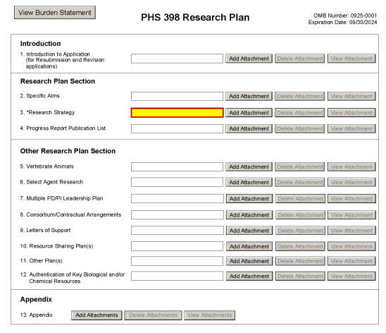
Screenshot: PHS 398 Research Plan Form
The DMS Plan will now be attached in the new item 11, Other Plan(s). Please click here to find the detailed guidance to fill out each section of the form.
Office of Grant Support

Slide 25
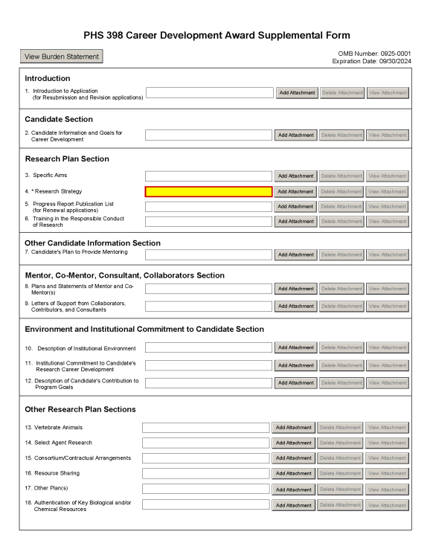
Screenshot: PHS 398 Career Development Award Supplemental Form
The DMS Plan will now be attached in the new item 17, Other Plan(s). Please click here to find the detailed guidance to fill out each section of the form.
Office of Grant Support

Slide 26
Screenshot: PHS 398 Career Development Award Supplemental Form….
Please click here to find the the detailed guidance to fill out each section of the form.
Office of Grant Support

Slide 27
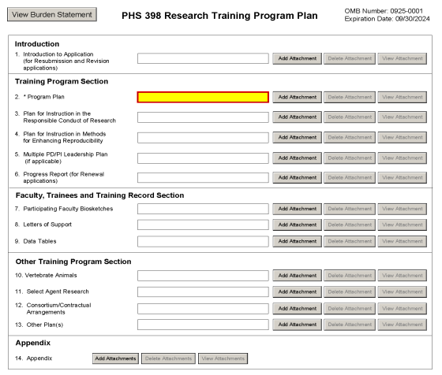
Screenshot: PHS 398 Research Training Program Plan Form
The potential future use with other plans will now be attached in the new item 13, Other Plan(s).
Please click here to find the the detailed guidance to fill out each section of the form.
Office of Grant Support

Slide 28
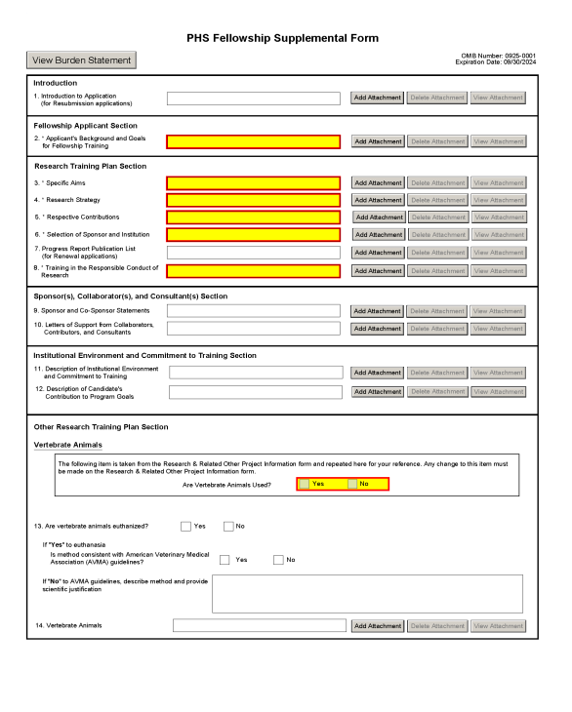
Screenshot: PHS Fellowship Supplemental Form
Please click here to find the the detailed guidance to fill out each section of the form.
Office of Grant Support

Slide 29
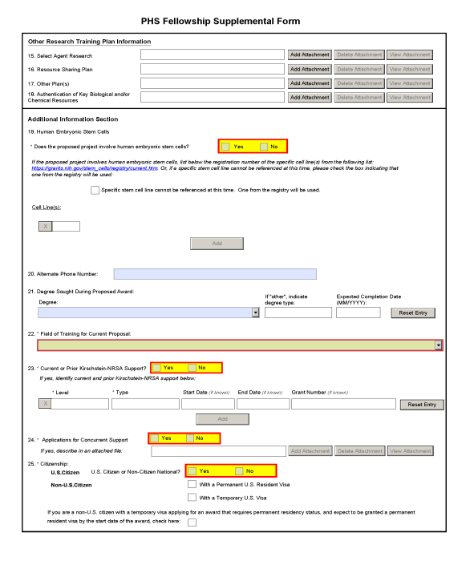
Screenshot: PHS Fellowship Supplemental Form
The potential future use with other plans will now be attached in the new item 17, Other Plan(s).
Please click here to find the the detailed guidance to fill out each section of the form.
Office of Grant Support

Slide 30
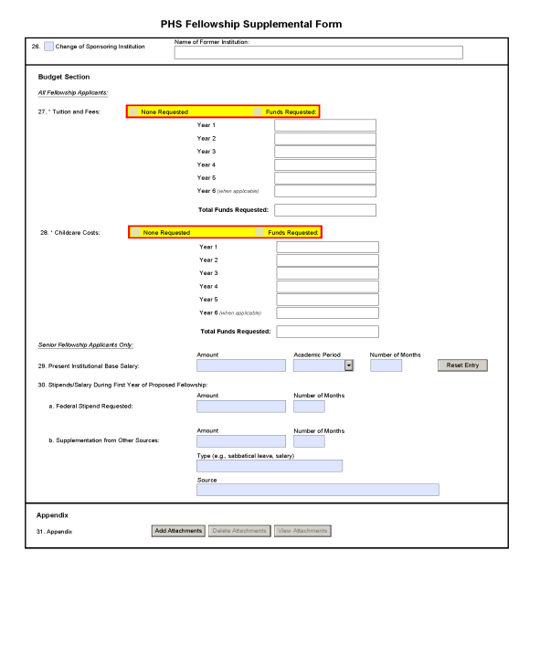
Screenshot: PHS Fellowship Supplemental Form
Please click here to find the the detailed guidance to fill out each section of the form.
Office of Grant Support

Slide 31
Next OGS Presentation
This is the last presentation for this year on behalf of OGS.
Please wait for the announcements regarding the OGS presentation dates for January 2023.
Please reach out to us at OGS@einsteinmed.edu**
** Please note the new email address
Office of Grant Support

Slide 32
Questions?
Office of Grant Support

Slide 33
Office of Grant Support

