Slide 1
Jorge Duchicela, MD FAAFP,
Texas Academy of Family Physicians (TAFP) 2017 Physician of the Year
DIRECTOR
jduchicela@ydclinic.com
www.cachamsi.com

Slide 2
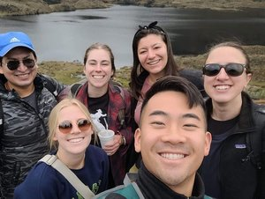
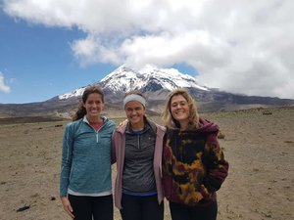
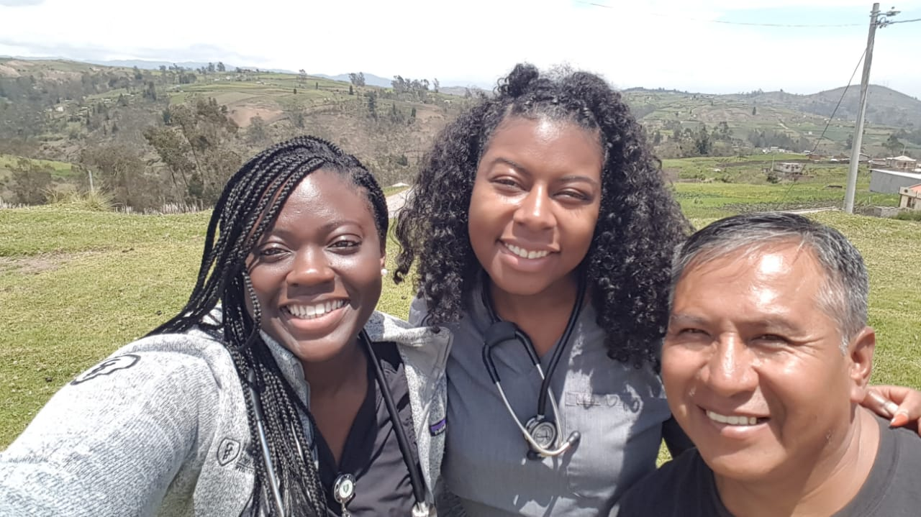
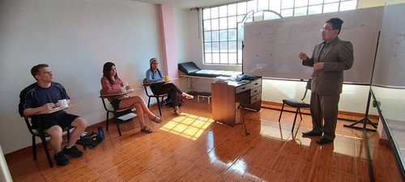
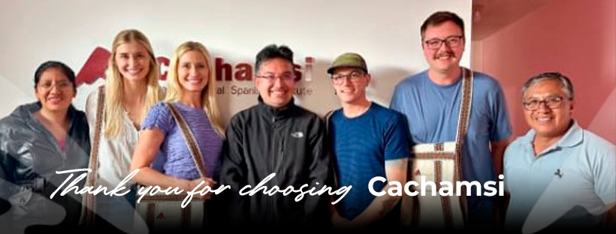
Cachamsi Medical Spanish Immersion Program - Proudly Executed in Ecuador
WWW.CACHAMSI.COM

Slide 3
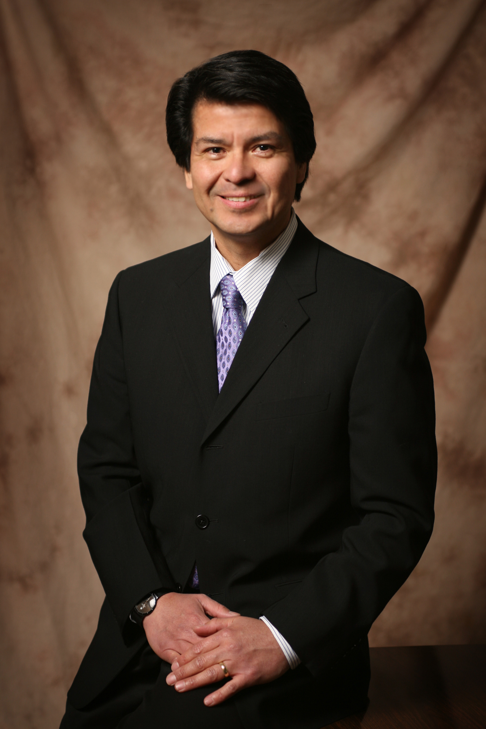
Founder and Program Director, Jorge Duchicela M.D.
Jorge Duchicela Santa Cruz, M.D., our founder, was born in Ecuador. He received his medical degree from the University of Wisconsin Medical School, is board certified in Family Medicine. He was Co-Director Rural Medicine University of Houston College of Medicine. 2018 Texas Family Medicine Physician of the Year. In rural private practice for thirty-four years. Serving a multi-county area of central Texas and is a Clinical Associate Professor of Family Medicine at UTMB in Galveston, Texas. Co-founder of the Youens and Duchicela Clinic in Weimar, Texas. The Youens and Duchicela Clinic serves a patient population of approximately 12,000 patients from several surrounding communities in south central Texas.
MAIN CONTACT
JORGE DUCHICELA, DIRECTOR
402 Youens Drive
Weimar, TX 78962
T 979 725 8545
C 979 561 6319
E jduchicela@ydclinic.com
WWW.CACHAMSI.COM

Slide 4
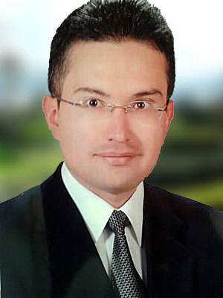
Pablo Martínez
Professor of Linguistics, CACHAMSI MANAGER IN ECUADOR
TEACHING AREAS
Medical Spanish. Linguistics (General and Applied). Intercultural Communication. Contrastive Rhetoric. Contrastive Linguistics. Academic Writing, Business Communication, Public Speaking.
EDUCATION
Specialist in Applied Linguistics & Translation, ESPE University, 2002-2008
PROFESSIONAL EXPERIENCE
Chief Language Professor and General Manager at CACHAMSI (Medical Spanish Institute) Ecuador 2009-2024
Academic Director at SECAP (Professional Training Institute) 2006-2008
WWW.CACHAMSI.COM

Slide 5
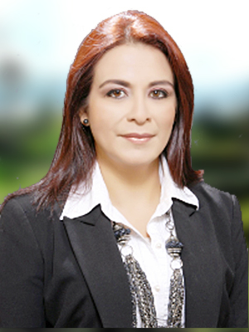
Professor Valeria Cisneros
Mastery of Integral Spanish
TEACHING AREAS
Medical Spanish. Linguistics (General and Applied). Intercultural Communication. Contrastive Rhetoric. Contrastive Linguistics. Communication, Public Speaking.
PROFESSIONAL EXPERIENCE
Language teacher since 2000.
ESL and ELE Instructor.
WWW.CACHAMSI.COM

Slide 6
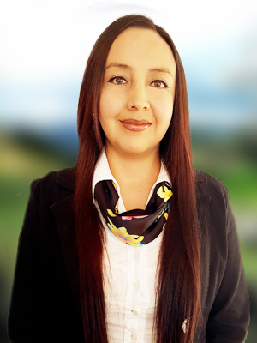
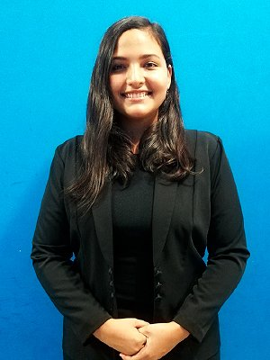
Professor Eliana Valle
Spanish Professor
PROFESSIONAL EXPERIENCE
Language teacher since 2015.
Instructor of educational centers
Professor Damaris Jimenez
Spanish Professor
EDUCATION
- Certification in English B2 in Cambridge English Language Assessment, OXFORD Test of English and ILE Instituto de Lenguas Extranjeras
PROFESSIONAL EXPERIENCE
Language teacher since 2014.
Instructor of educational centers
WWW.CACHAMSI.COM

Slide 7
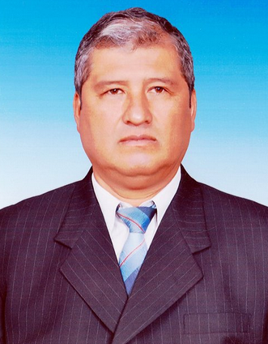
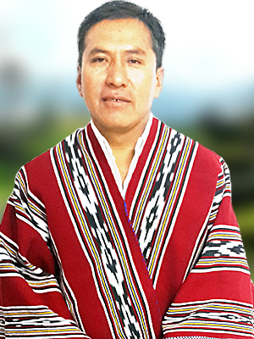
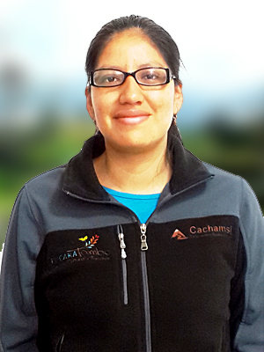
Jorge Amanta
Chief Driver for Cachamsi, since 2007
Segundo Sucuy
Transportation and Logistics
Since 2004 in Cachamsi
María Inés Auquilla
Accounting and Administrative, since 2013
WWW.CACHAMSI.COM

Slide 8
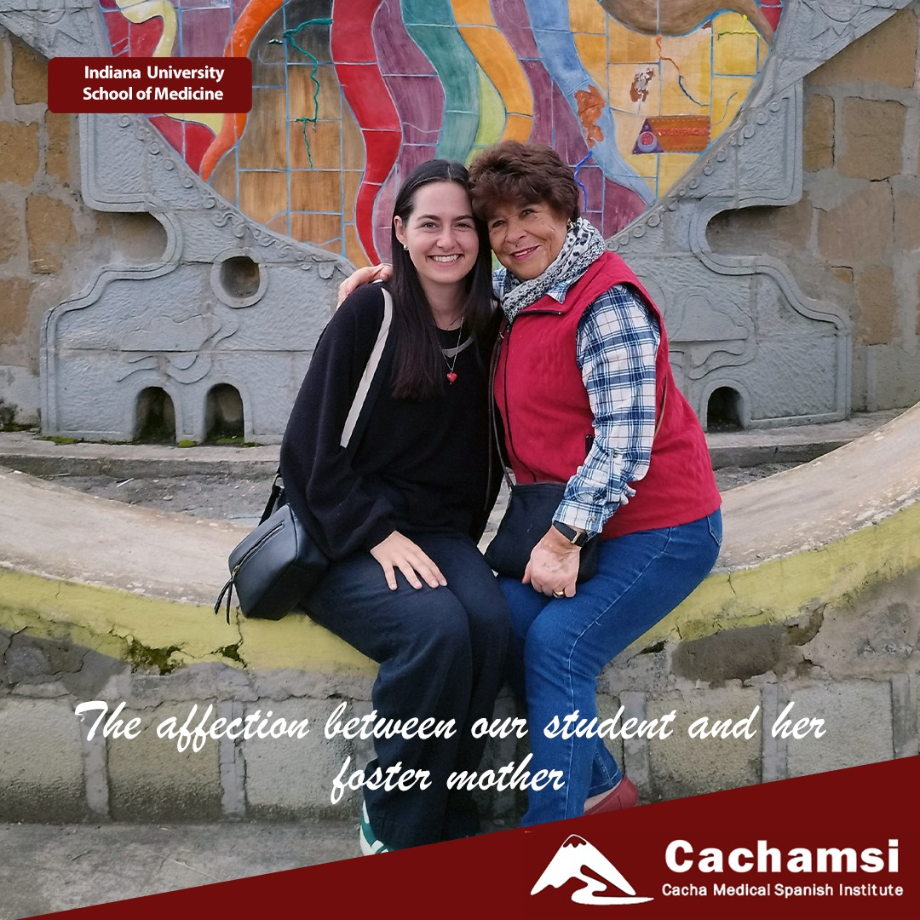
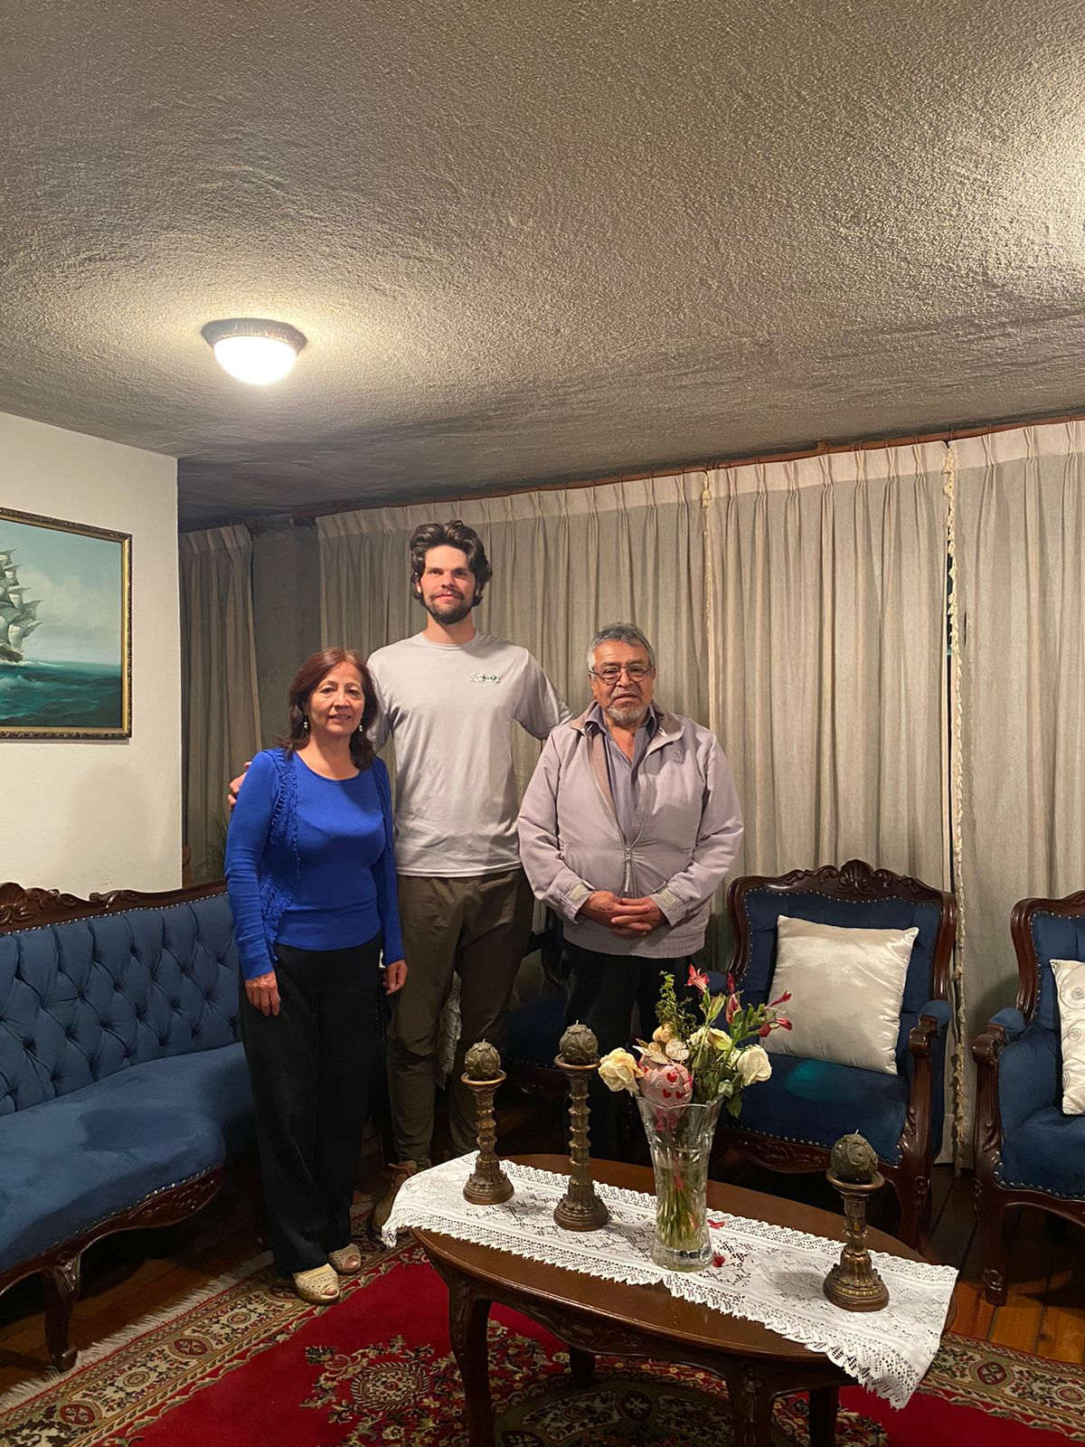
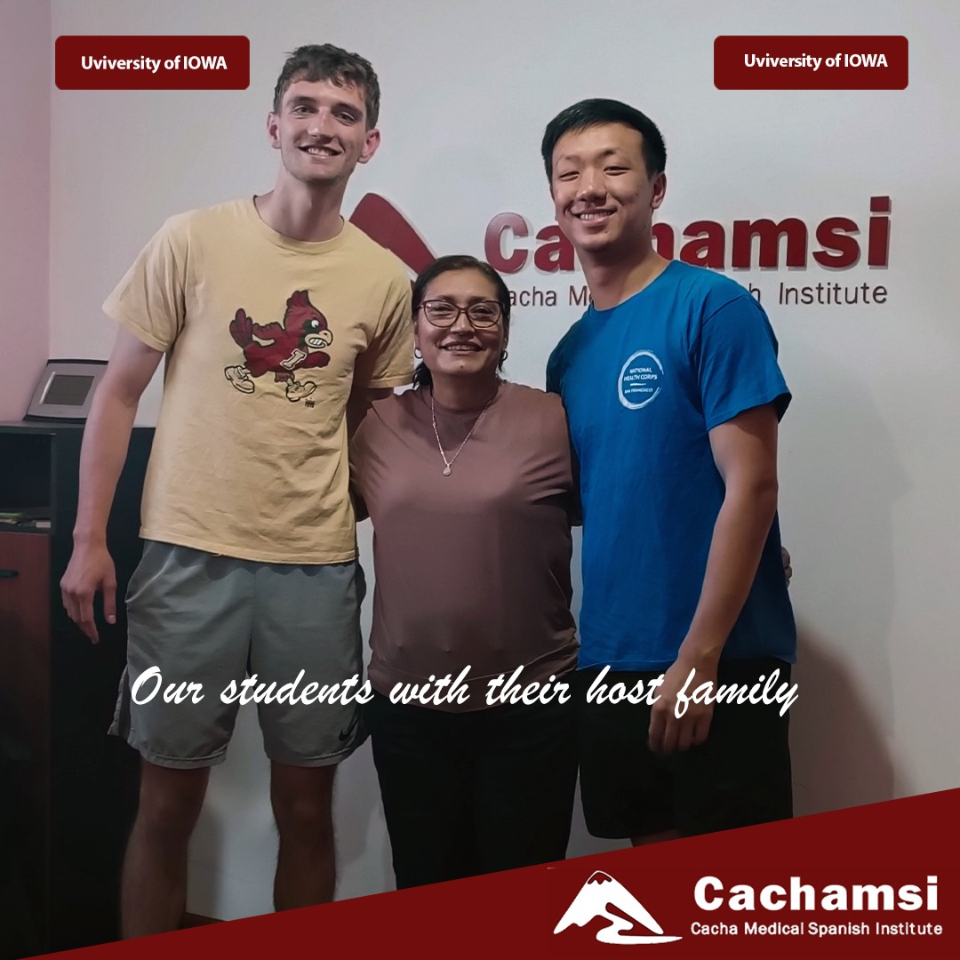
Our Host Families
WWW.CACHAMSI.COM

Slide 9
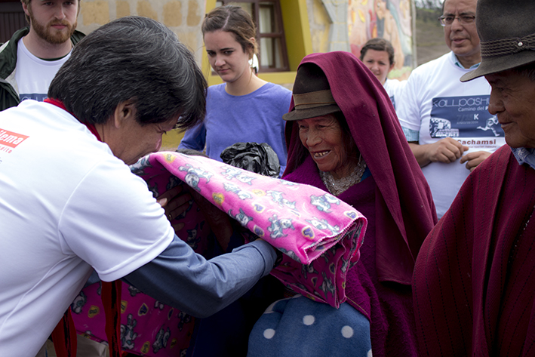
We are a non-profit international Medical Spanish immersion program located in the Andean highlands of Ecuador.
Texas nonprofit corporation
  Federal Tax Identification number 74-3254673 https://apps.irs.gov/app/eos/pub78Search.do?ein1=743254673&names=&city=&state=All...&country=US&deductibility=all&dispatchMethod=searchCharities&submitName=Search
  All proceeds obtained through fees are reinvested for
    Social and educational programs,
    Medical equipment, curriculum improvements, and
    Salaries for the educators and employees.
Directors of Cachamsi are not salaried, rather they work on a volunteer basis. 1

Slide 10
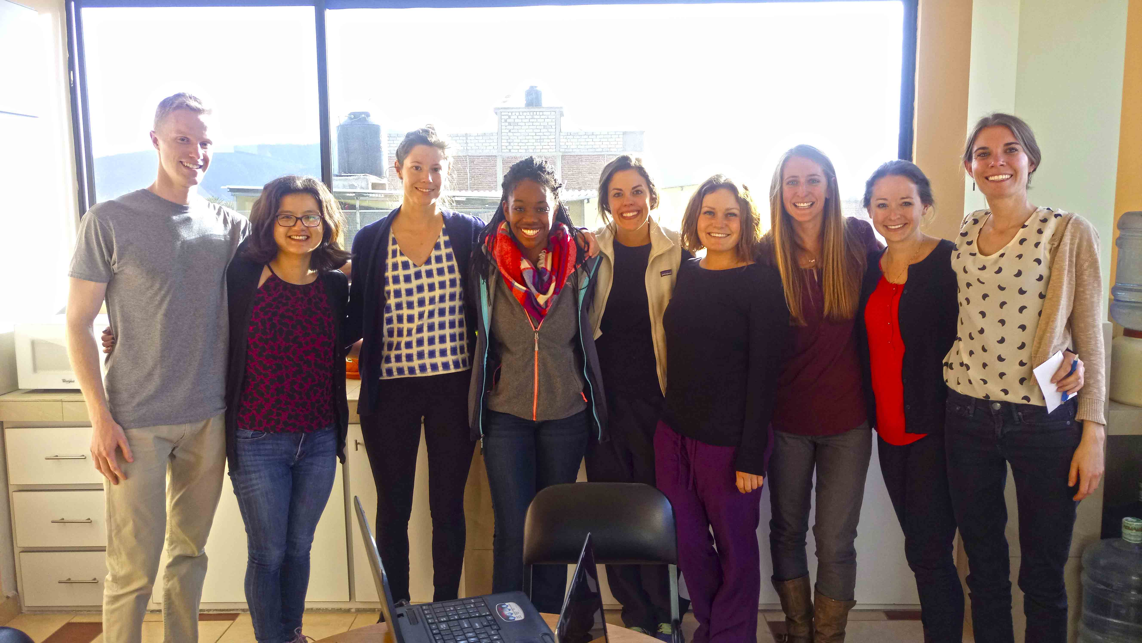
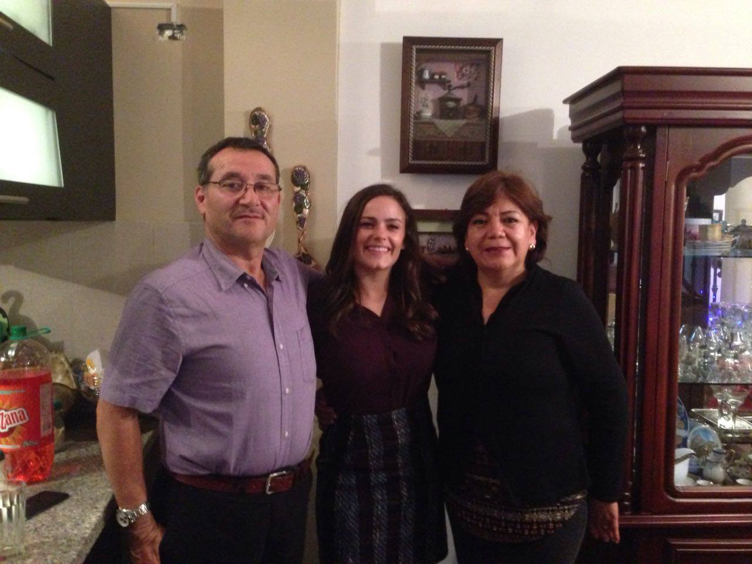
Our mission is to improve the medical Spanish communication skills of health professionals to better care for the Spanish speaking population in the United States.
Our Value Proposition:
  We offer structured medical Spanish classes as well as volunteer opportunities among a unique indigenous population.
Our participants:
Medical students,
Resident doctors,
Physicians, nurses, health care workers
Physician Assistants
Outstanding premed students

Slide 11
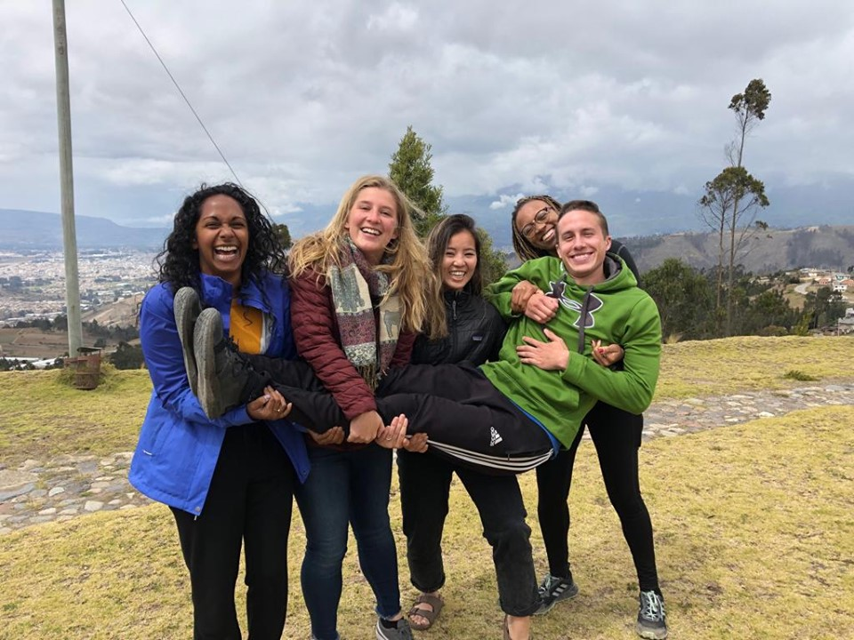
We have dedicated and specialized medical Spanish teachers, strong relations with the public health system in Riobamba and committed host families and lodging partners.
Our Track Record:
2000+ participants since 2004
20 years
100+ medical schools and programs represented
20 host families

Slide 12
Our program fees include 10 hours of medical Spanish classes, up to 30 weekly hours of clinical experience, ground roundtrip transportation from Quito or Guayaquil airport and Family Stays.
4 week Family Stay
  Host Family
  Fee: USD 2,393
  10 weekly hours of medical Spanish
  Up to 30 weekly hours of clinical experience
  3 meals a day, 7 days a week
  Laundry, cleaning
  Internet-equipped
  Private room

Slide 13
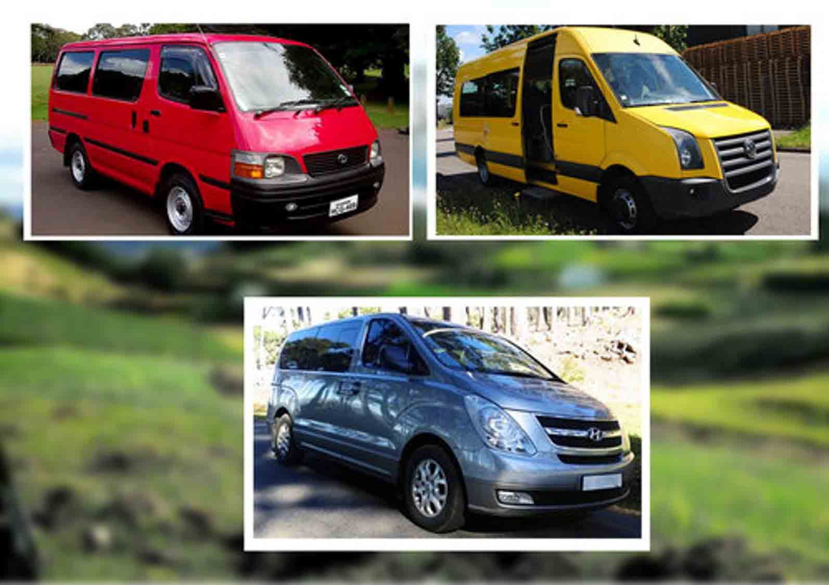
SAFE RELIABLE TRANSPORTATION
Our TRANSPORATION PARTNERS:
- JORGE AMANTA - jorge luis amanta
13 years of experience with Cachamsi
Professional Licence type ¨E¨
16 and 10 passanger capacity, vans with individual seats, seatbelts
4 -door sedan for 4 participants
4-door SUV for 4 participants.

Slide 14
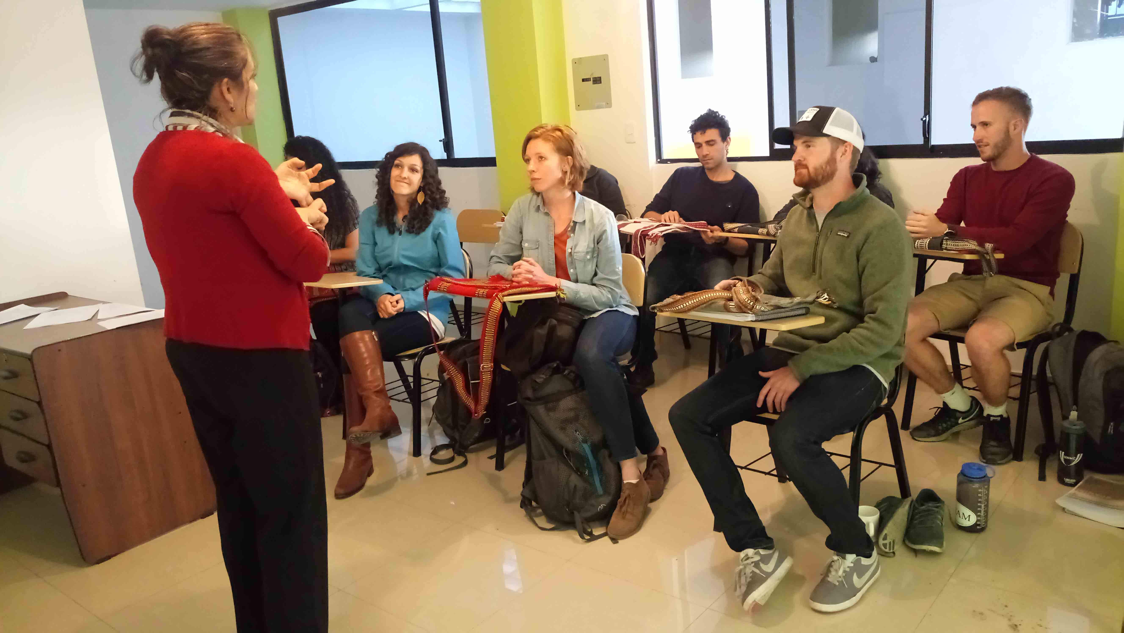
The Plan (from 1 week to 52 weeks)
10 weekly hours medical Spanish lessons
Up to 30 weekly hours clinical rotations
Intake diagnostic evaluation
Clinical history
Medical and anatomical vocabulary and terminology.
Doctor-patient relationship and cultural appropriateness.
Troubleshooting clinical experience cases and feedback
Final exam
(Visiting beautiful Ecuador)

Slide 15
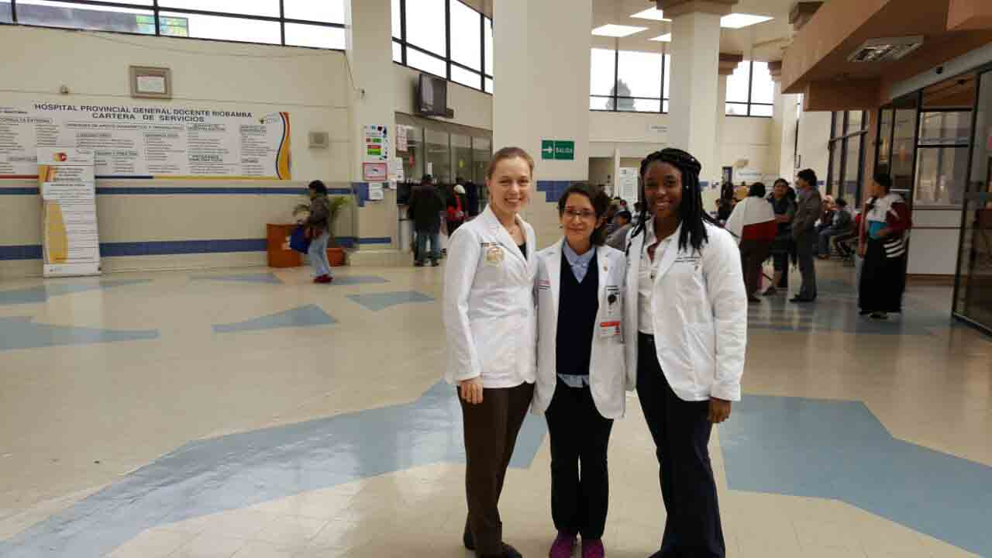
CLINICAL EXPERIENCE
Up to 30 weekly hours of clinical experience. Participants will have the opportunity to shadow various physician preceptors in different hospitals and clinics in Riobamba and Cacha.

Slide 16
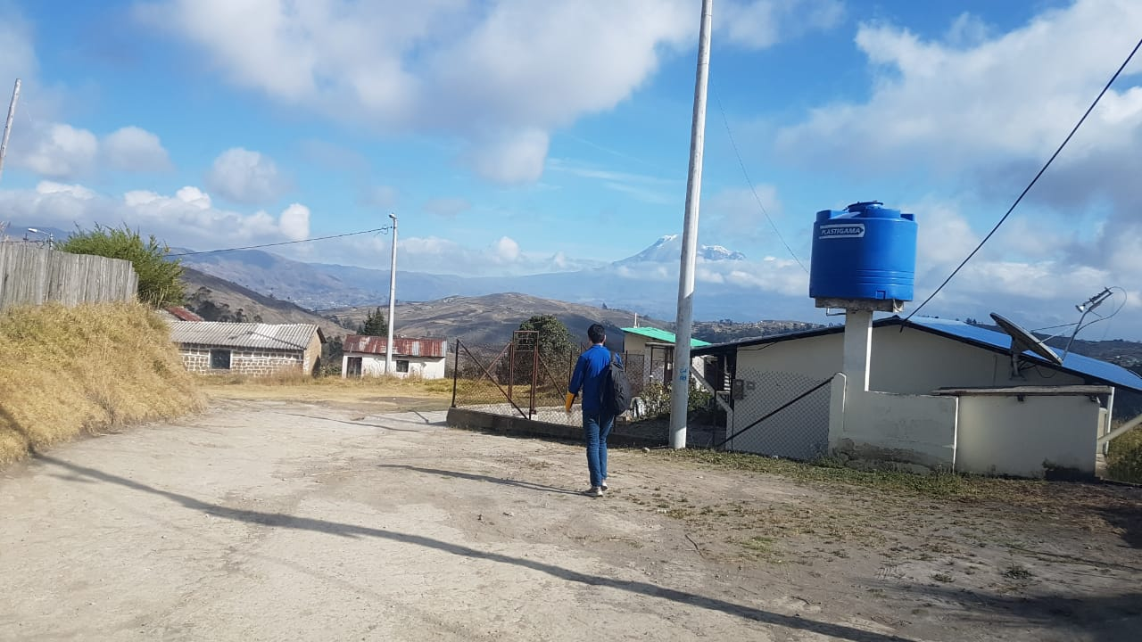
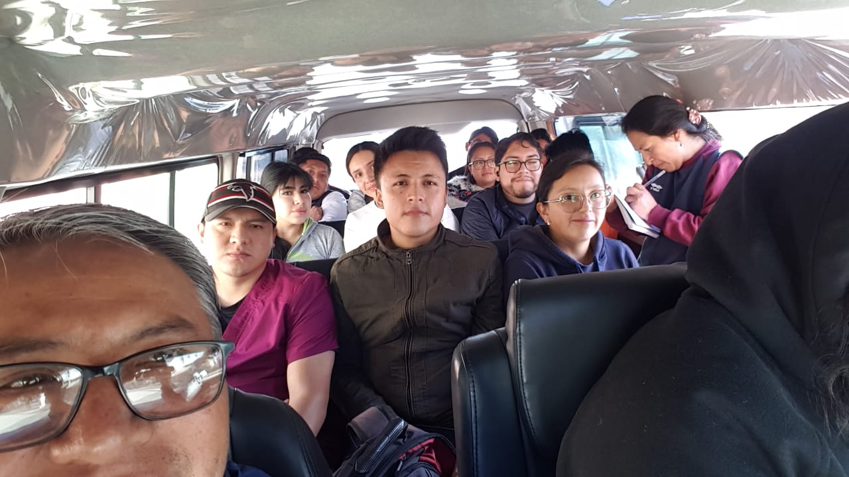
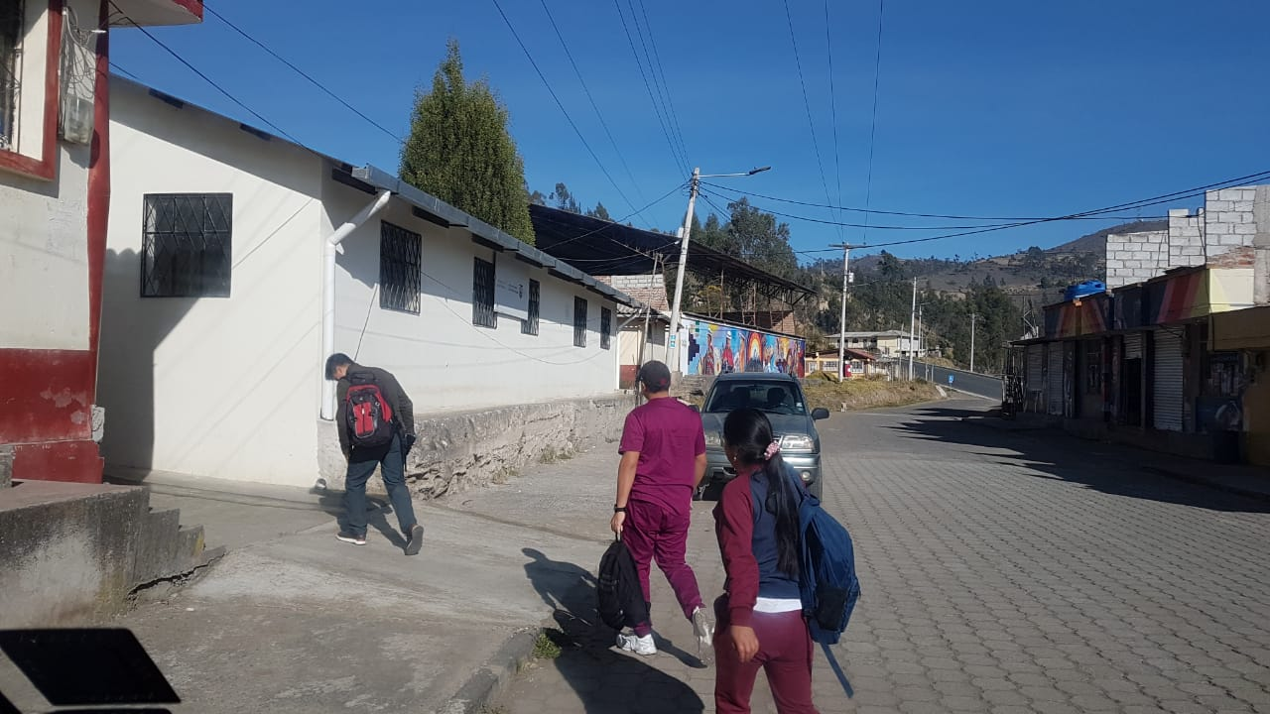
Community Engagement and Support
ROUNDTRIP SHUTTLE SERVICE FROM RIOBAMBA TO CACHA CLINICS
Provide shuttle service to rural doctors and health personnel from Riobamba to Cacha clinics. Cacha clinics are located between 15 minutes to 30 minutes from Riobamba, where there is no public transportation. Cachamsi participants through their fees enable year round service so that doctors, nurses, dentists serve a 3000 population. We do this with memorandum of understanding with Ecuadors Ministry of Health

Slide 17
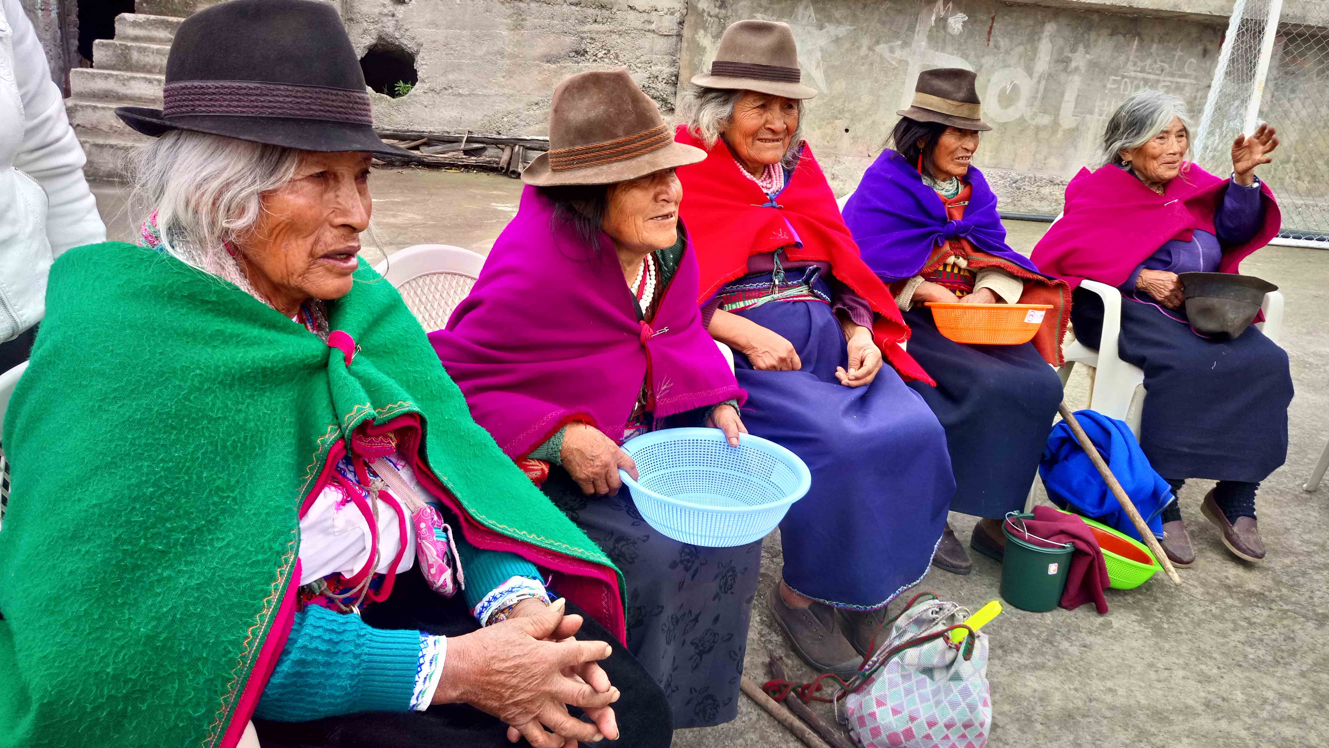
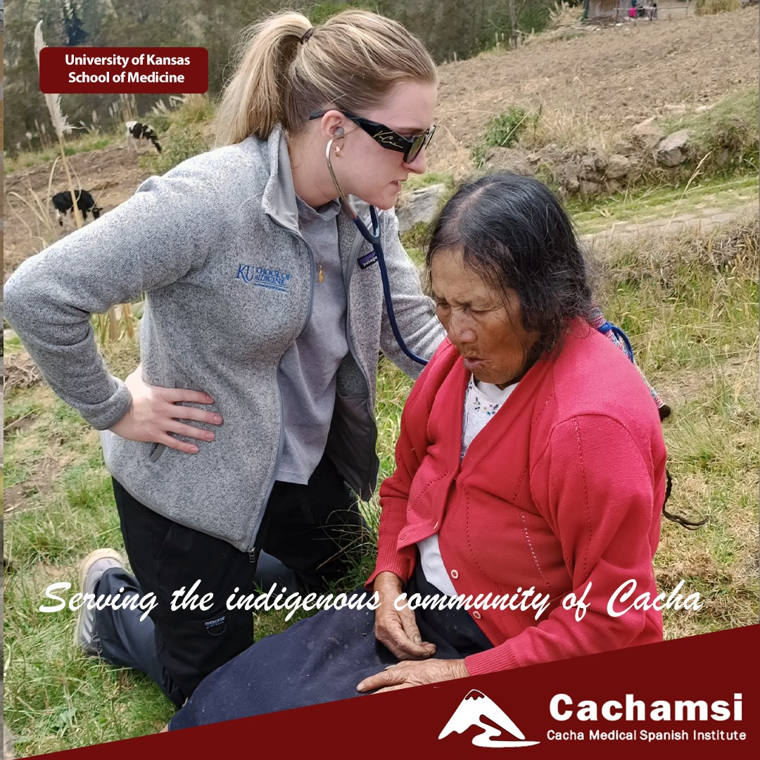
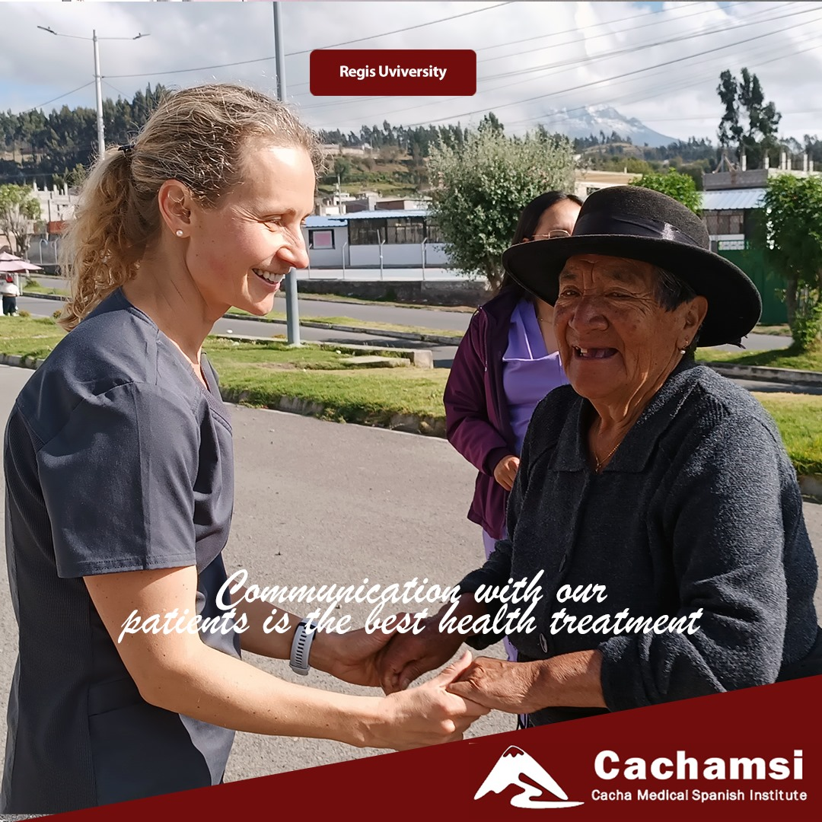
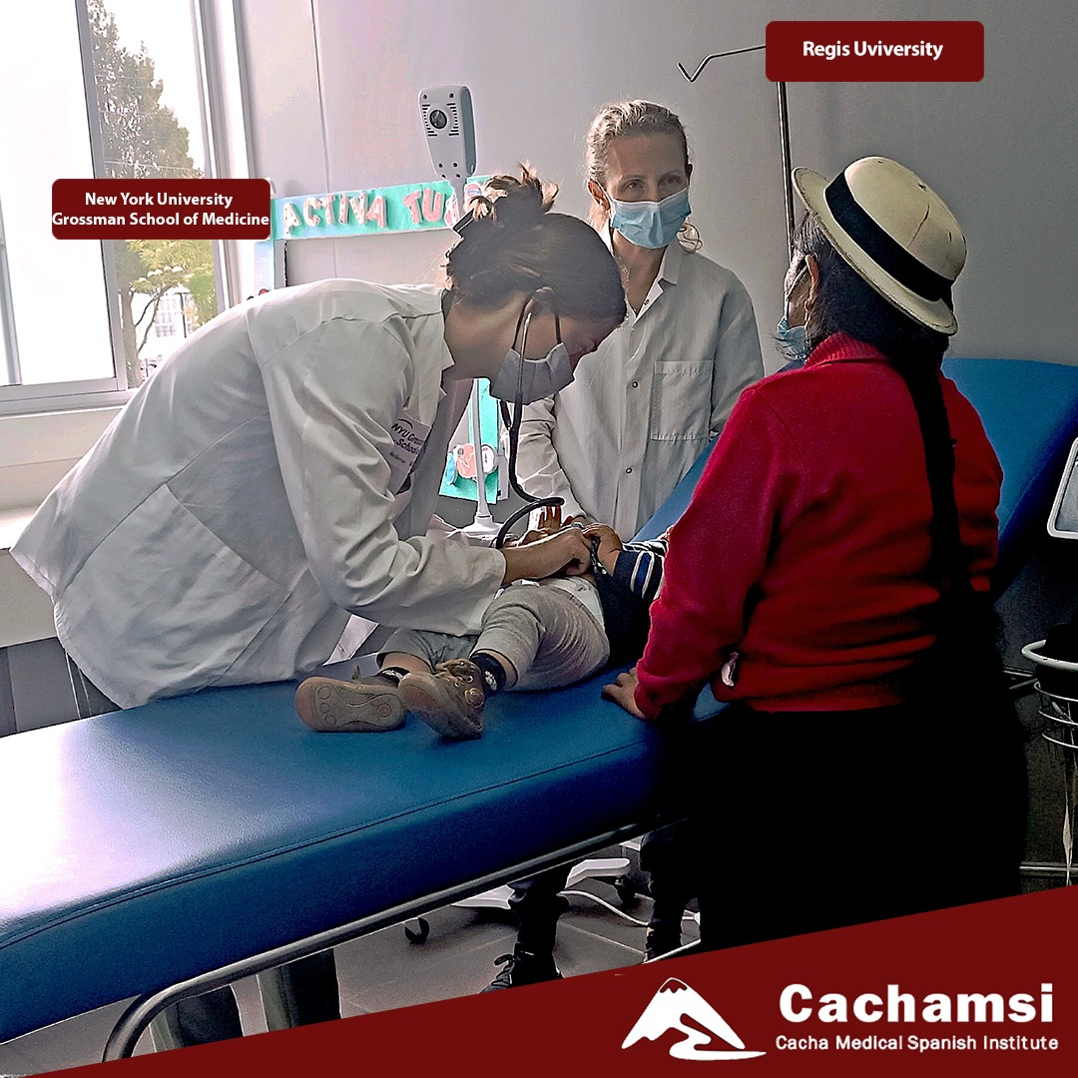
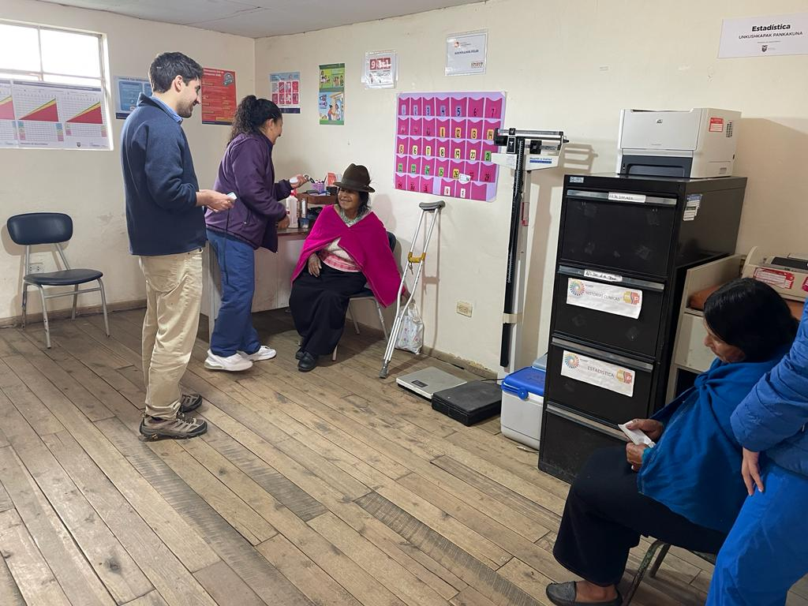
Community Outreach, visits and Health Fairs for senior citizens
Execution of home and clinic visits for senior citizens
Cacha health center medical staff organizes 13 fairs per year.
Over 300 Cacha seniors enjoy a great social event which includes meals, practical items such as quilts, dancing, exercises and workshops.

Slide 18
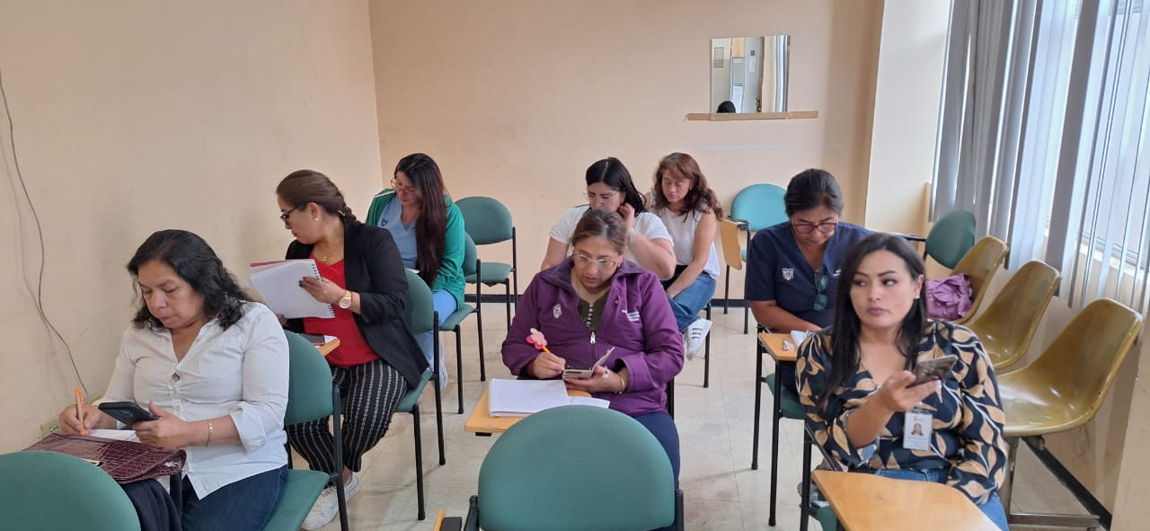
Community Engagement and Support
Provide medical English lessons to personnel of public hospitals and clinics as part of the memorandum of understanding between Cachamsi and the Ministry of Health of Ecuador. Pictured here are healthcare personnel of the General Hospital of Riobamba, Chimborazo.

Slide 19

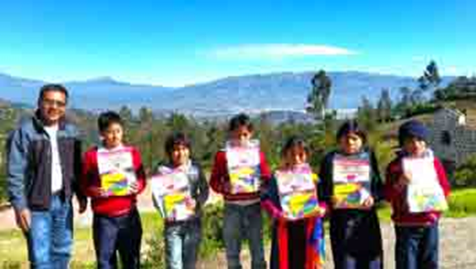
Summer Camps
Every July Cachamsi sponsors a summer camps for Cacha grade-schoolers
Pictured, Dartmouth participants lead the Summer Camps
Students bring donations and Cachamsi pitches the transportation, healthy snacks and tours to recreational parks.
Cachamsi sponsors a quality summer camp in Cacha, for children who might not be able to participate in one

Slide 20
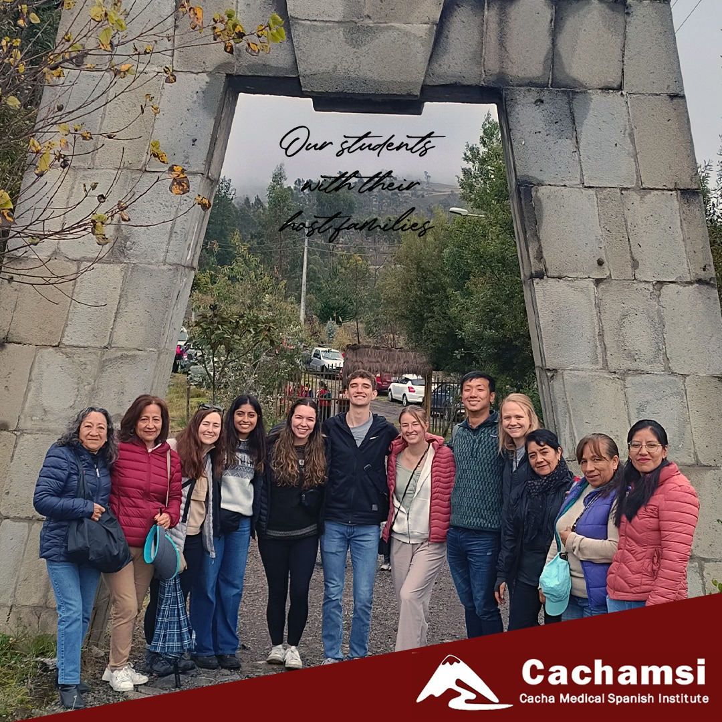
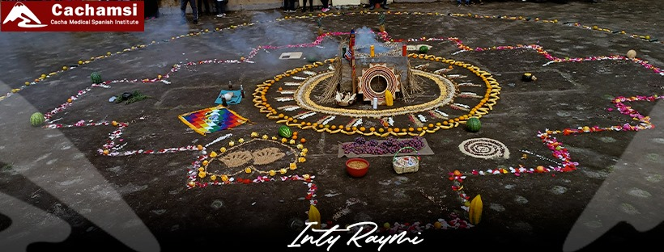
Inti Raymi and Kallpashun
Cachamsi sponsors the Inti Raymi (celebration of summer solstice) in Cacha and the emblematic Kallpashun (Let´s Run) race.

Slide 21
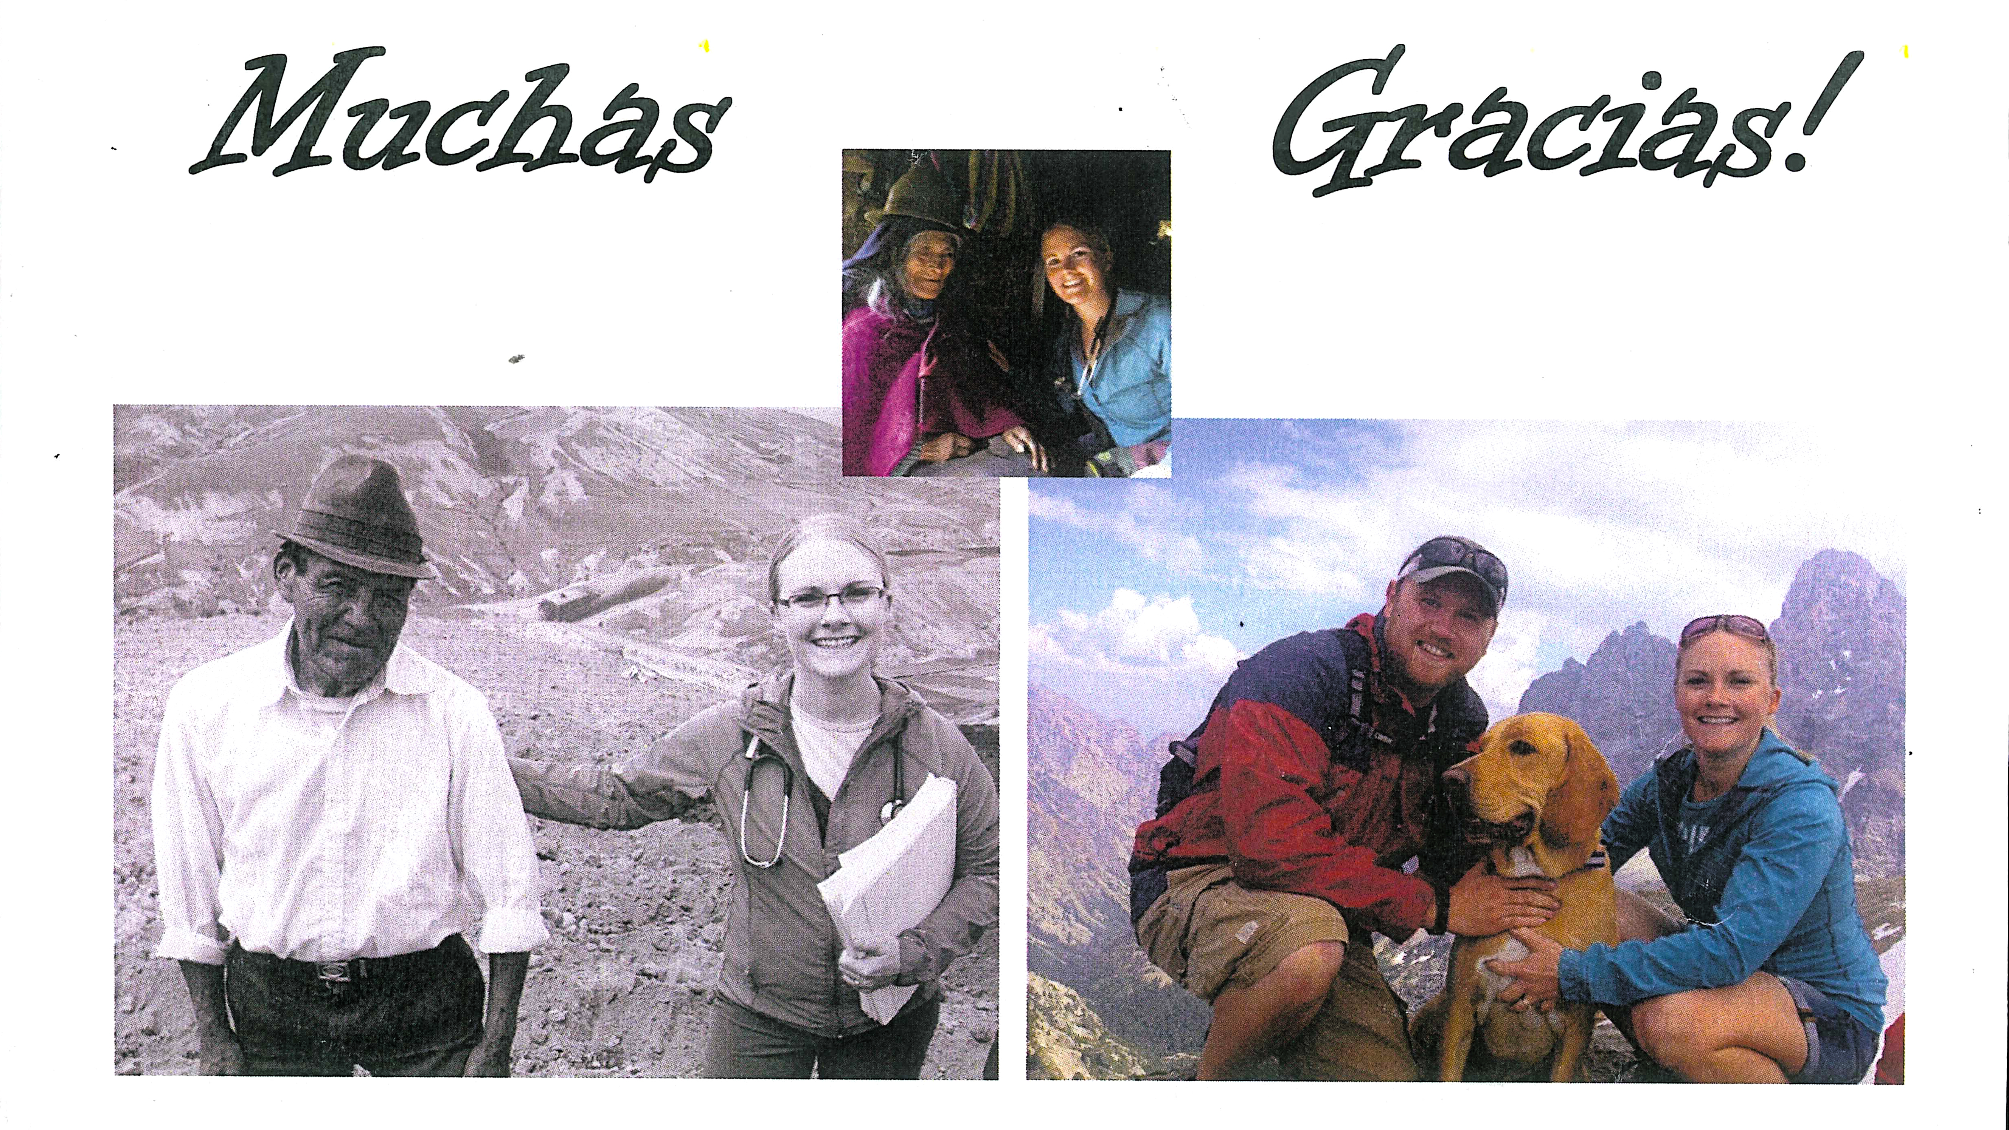
Valeria,
Thank you so much for your wonderful teaching, I really appreciate an of your parience and the extra time you gave to help me! Also, thanks so much for the help coordinating travel plans for my family and for me. I really enjoyed visiting the families in Cacha with you, thanks for taking me with you!. Your passion for helping the program and people in Cacha is very evident and I know you will do great things for the program.
Thank you!
Josie Syverson

Slide 22
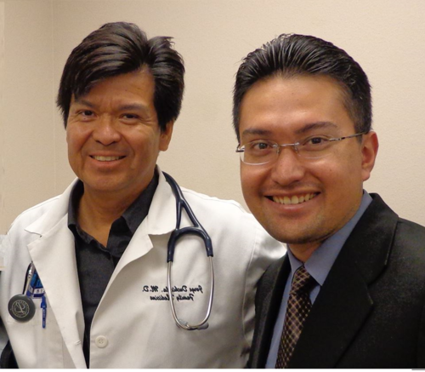
CONTACT
MAIN CONTACT
JORGE DUCHICELA, DIRECTOR
402 Youens Drive
Weimar, TX 78962
T 979 725 8545
C 979 561 6319
E jduchicela@ydclinic.com
ECUADORIAN CONTACT
PABLO MARTÍNEZ, MANAGER
Cachamsi office in Ecuador:
Address: Esmeraldas 16-06 and Espejo
T 011 (593) 3 296 1599
C 011 593 988725259 (cnt)
E coordinadorcachamsi@gmail.com
WWW.CACHAMSI.COM

