Slide 1
How to fill out the Cayuse Supplemental Form Version 3.1 Indranil Basu, Assistant Director, OGS Gerard McMorrow, Pre-Award Analyst. OGS Dhanonjoy Saha, Director, OGS Stefanie Juell, Executive Director, OHRA December 14, 2022

Slide 2
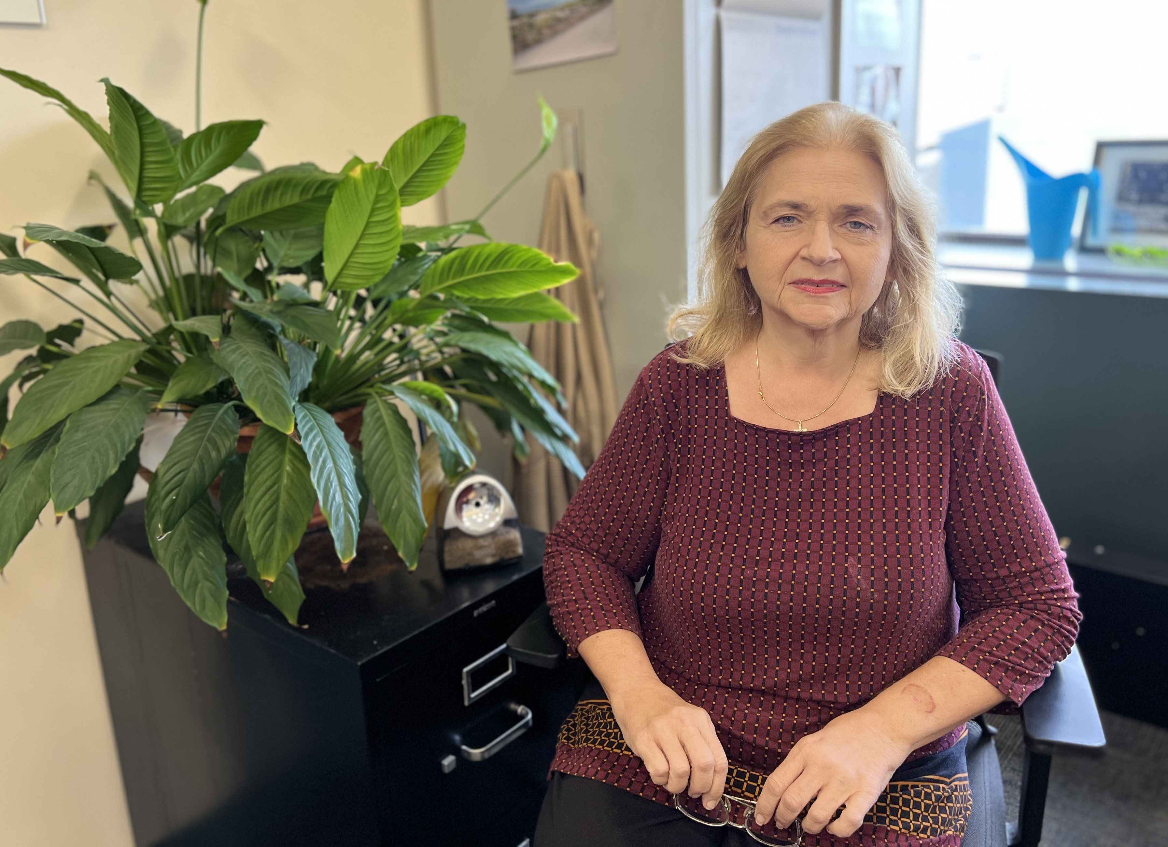
Team OGS – Who we are?
Authorized Organizational Representative (AOR), Signing Official (SO)
Application withdrawal request
Cayuse primary contact – User ID, password, application unlock
eRA Commons, eBRAP, FastLane issues related to submission
All Federal electronic submission portal User ID, password etc.
Post-submission material and communication
OPAS (Other Pre-Award Submissions)
Regina Janicki, CRA – eRA Manager: Belfer 1106
Phone: (718) 430-3643
Email: regina.janicki@einsteinmed.edu
Office of Grant Support

Slide 3
Team OGS – Who we are?…
AOR (Authorized Organizational Representative), SO (Signing Official)
Budget development, review and budget revisions (pre-award only)
Collaboration letter review and preparation for signature
Face page review and processing for signature
Indirect cost reduction/waiver, no salary support request processing
Letter of Intent (LOI) and Statement of Work (SOW) review and processing
Gerard McMorrow, MBA – Pre-Award Analyst: Belfer 1106
Phone: (718) 430-3580
Email: gerard.mcmorrow@einsteinmed.edu
Office of Grant Support

Slide 4
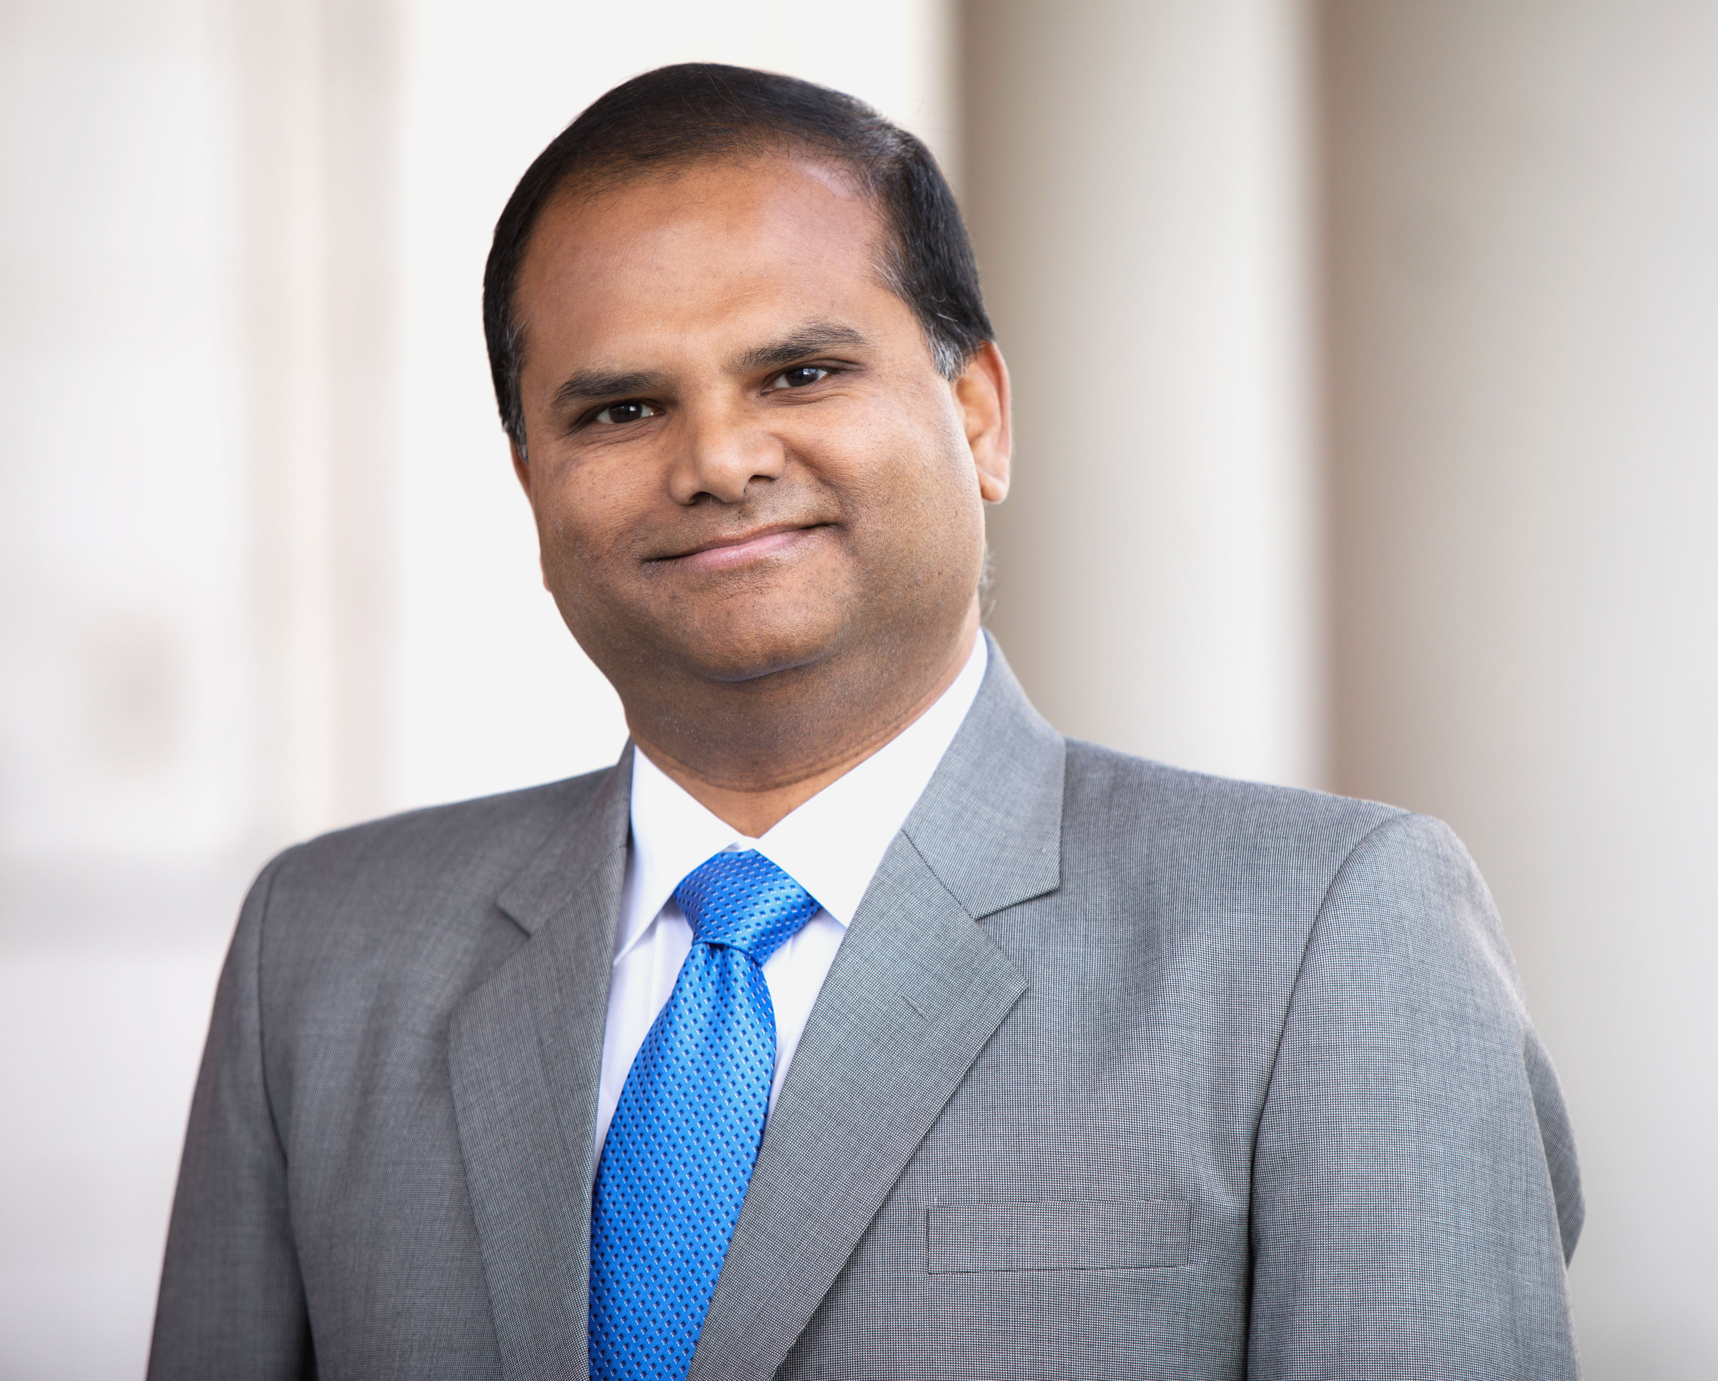
Team OGS – Who we are?…
AOR, SO, and Business Official (BO)
Assisting with day-to-day operations of the office. Training and workshops for funding/grant development
Finding funding and OGS updates – SPIN Portal. One-on-one consultation for strategizing grant development
Faculty profile in “PURE” research portal (for networking and communication). Templates for grant applications, and DMS issues
Limited submission application management. Contacting the sponsors/agencies
All non-federal grant processes, including NYS grants. IACUC, IRB, OCI liaison, NCE, RS, FIS, and JIT submissions
Indranil Basu, PhD, MBA – Assistant Director Belfer 1106 – Phone: (718) 430-2238
Email: indranil.basu@einsteinmed.edu
Office of Grant Support

Slide 5
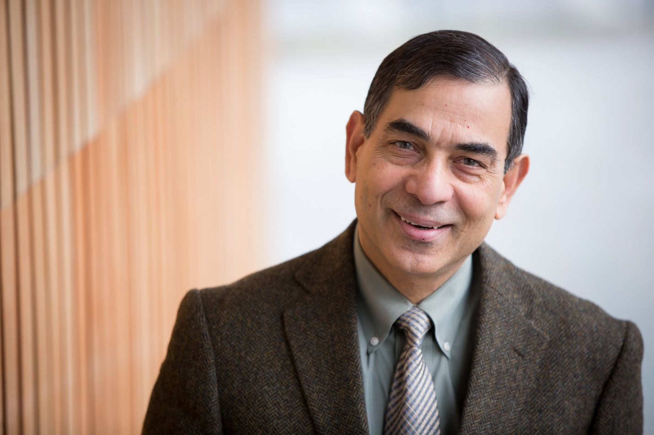
Team OGS – Who we are?….
AOR, SO, Business Official (BO), Grants Officer
Agreement and contract negotiation with sponsor
Unusual/special funding opportunities
Complex Grant Development
NYS Grants Gateway submission and approval
Communication with sponsors
COI reporting to NIH or other Federal entities
Any other tasks and items related to pre-award application management
Dhanonjoy C. Saha, PhD – Director: Belfer 1106 Phone: (718) 430-3642
Email: dhanonjoy.saha@einsteinmed.edu
Office of Grant Support

Slide 6
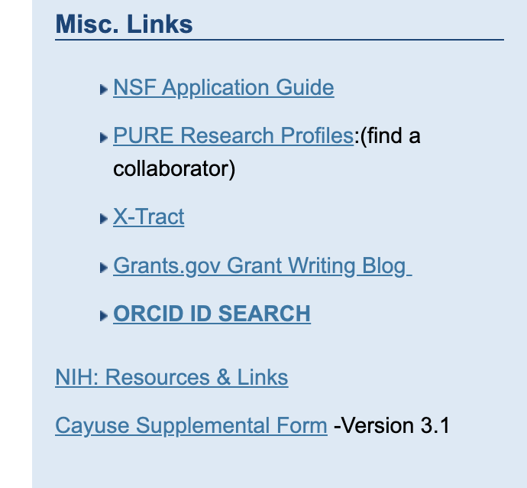
Supplemental form Version 3.1
When you need the form? The latest Cayuse Supplemental Questions V3.1 form must be uploaded addressing all the sections to Cayuse SP for all new, supplemental and competing renewal applications.
Where can you get the form? Go to the OGS website: https://www.einsteinmed.edu/administration/grant-support/
Under the Misc. Links column on the right side of the Webpage, you can find the link for the Cayuse Supplemental Form – Version 3.1 as shown here.
Office of Grant Support

Slide 7
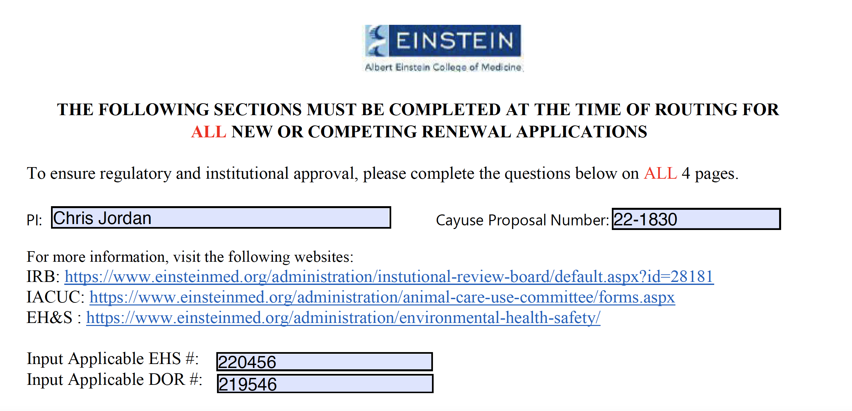
Supplemental form Version 3.1: How to fill out
(Not on the form) Please contact the biosafety officer, Delia Vieira-Cruz, for any EH&S issues related to the grant at delia.vieira-cruz@einsteinmed.edu
Office of Grant Support

Slide 8
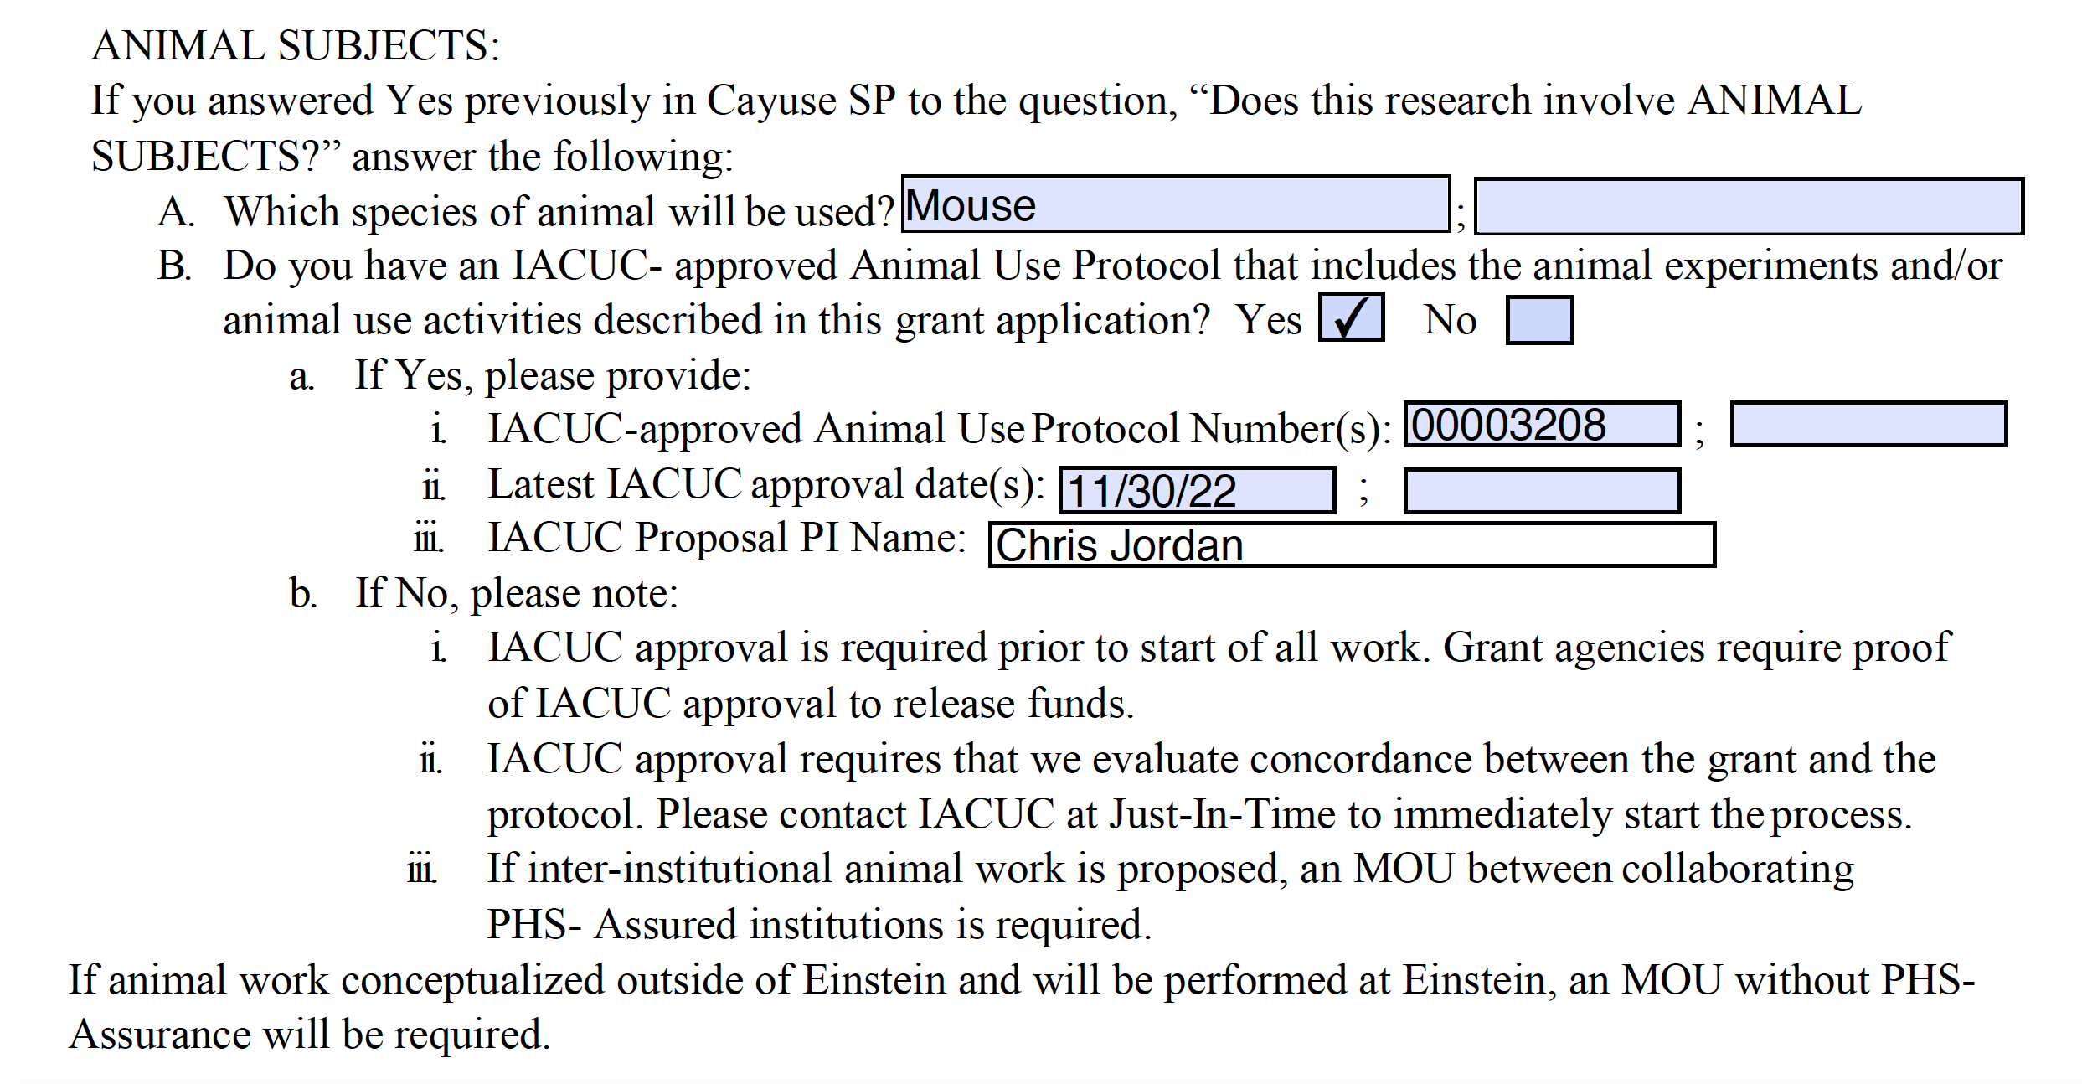
How to fill out: Animal Subjects
(Not on the form) Please contact Dr. Silvia Racedo for any IACUC protocol issues related to the grant at silvia.racedo@einsteinmed.edu
Office of Grant Support

Slide 9
How to fill out: Human Subjects
(Not on the form) If you are not sure, please contact OHRA at irb@einsteinmed.edu well in advance (https://www.einsteinmed.edu/administration/human-research-affairs/).
Office of Grant Support

Slide 10
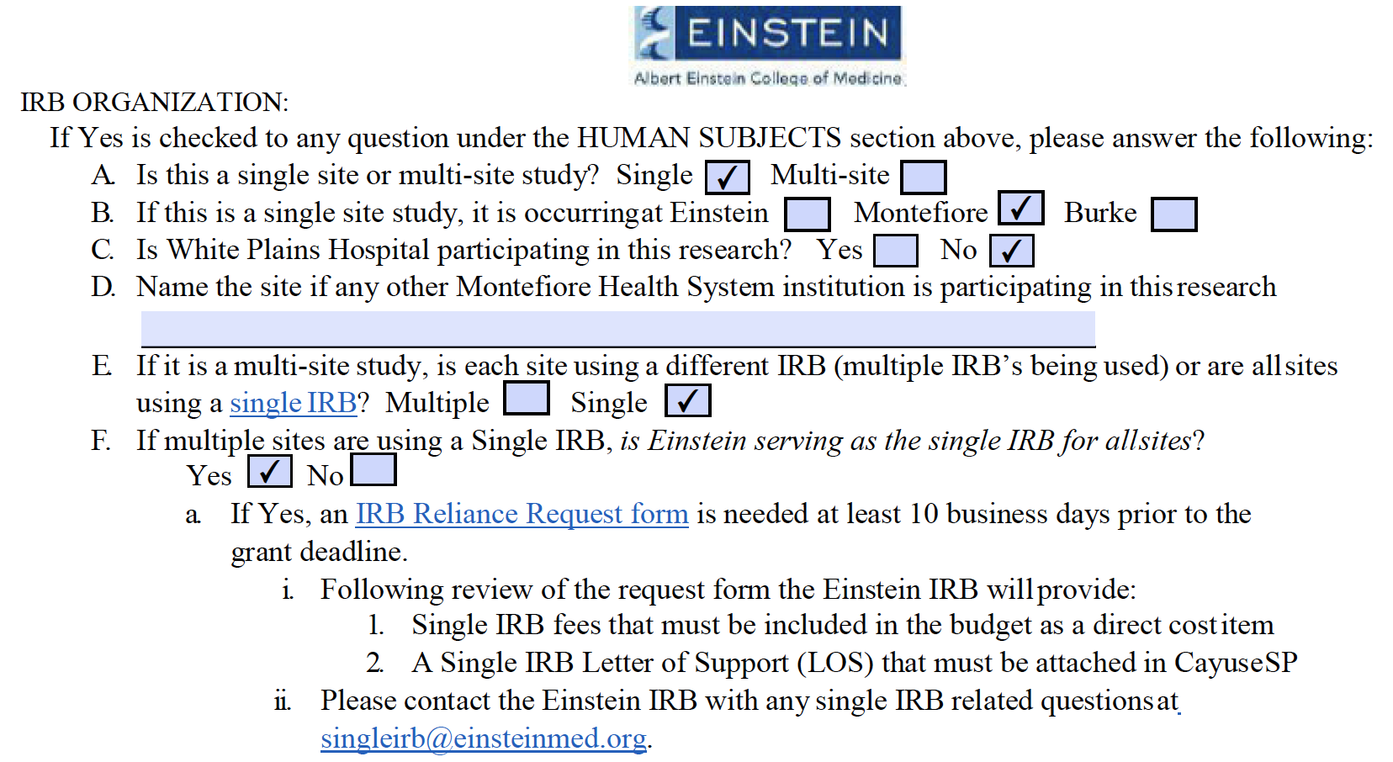
Human Subjects…
Office of Grant Support

Slide 11
Human Subjects...
Office of Grant Support
Notes:
The SIRB Letter of Support/Reliance Form(issued by Einstein IRB) is required if SIRB is used regardless of which institution is the IRB of record
On line G, fill in which outside institution is the IRB of Record.
On line b, fill in how much the outside IRB will bill us or none or $0.
If SIRB fees will be charged, they must be added as a direct cost on the budget.

Slide 12
Human Subjects....
Office of Grant Support

Slide 13
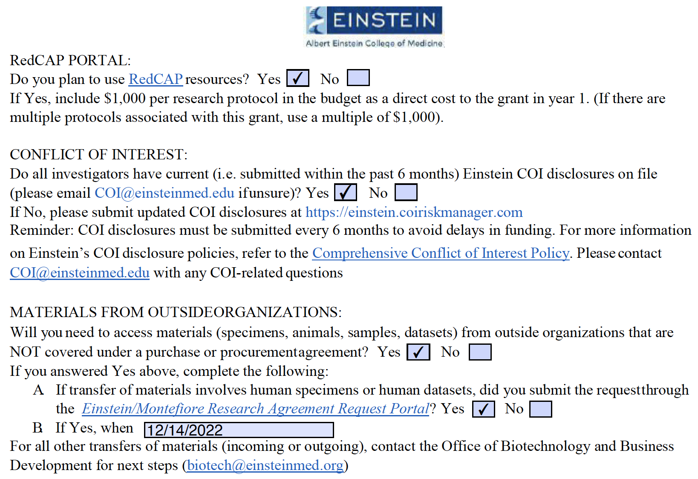
RedCAP and Conflict of Interest
(Not in the form) If RedCAP will be used but we won’t be charged, please explain with a note in Cayuse.
Office of Grant Support
Notes:
The $1,000 per protocol fee must be budgeted if Redcap is used.

Slide 14
Materials from Outside Organizations
**
** Please note the new email address: biotech@einsteinmed.edu
Office of Grant Support

Slide 15
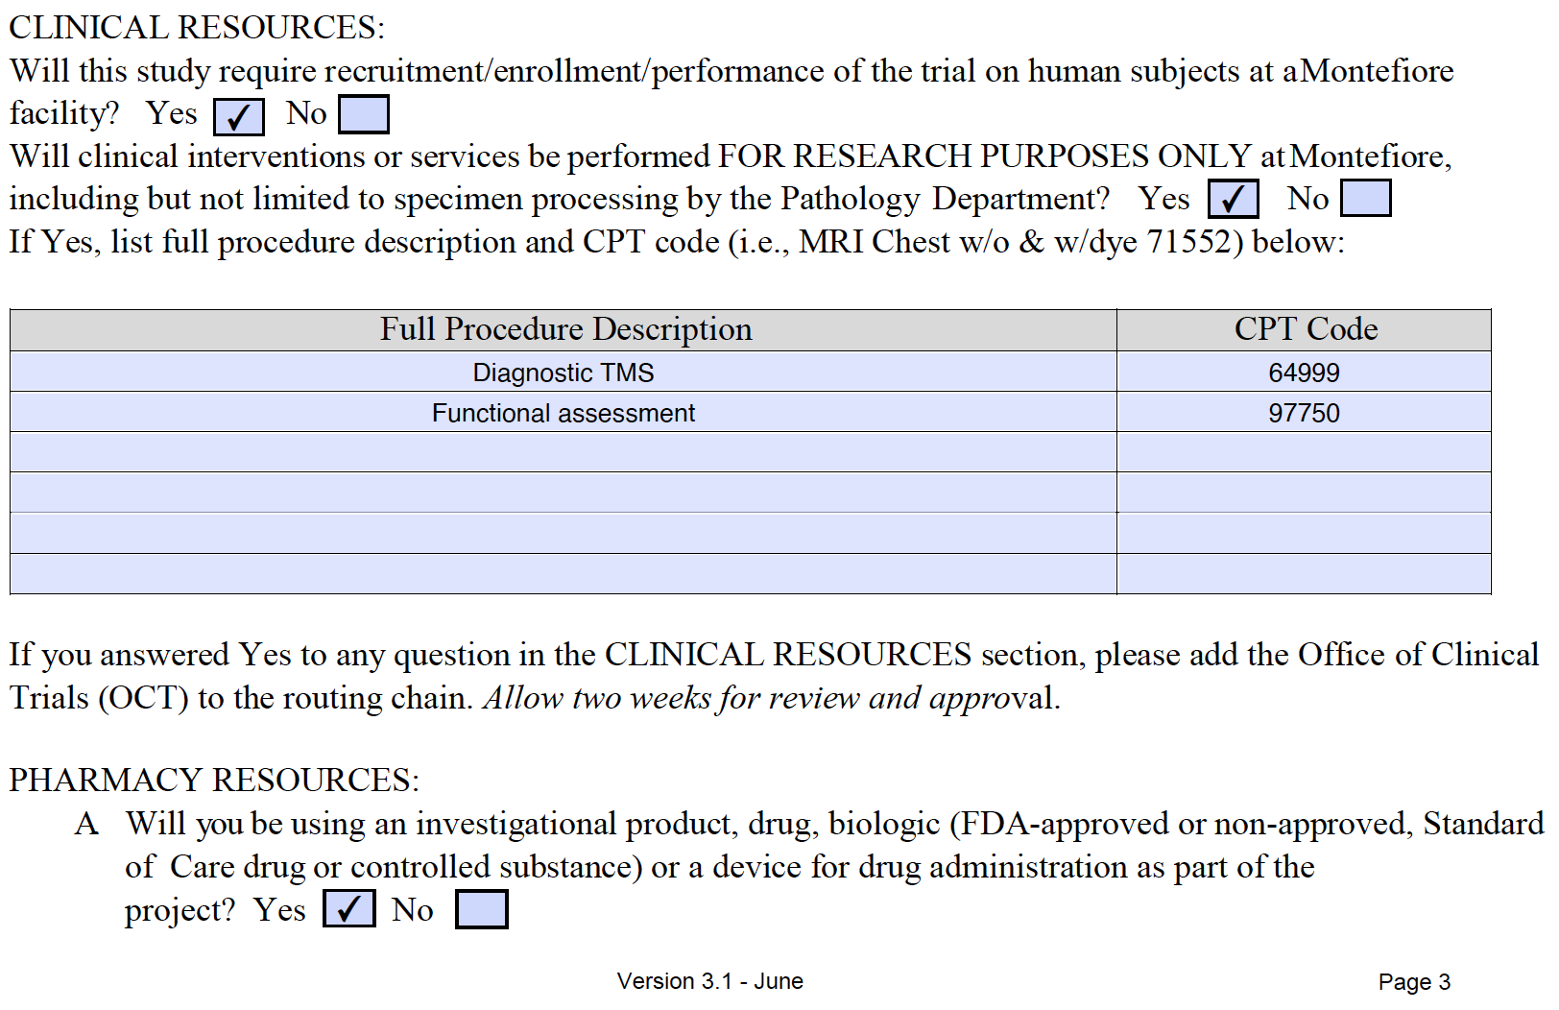
Clinical and Pharmacy Resources
Office of Grant Support
Notes:
Both Clinical Resources questions must be answered. If either one is Yes, Monte Office of Clinical Trials Must be added to the routing chain with two weeks lead time.

Slide 16
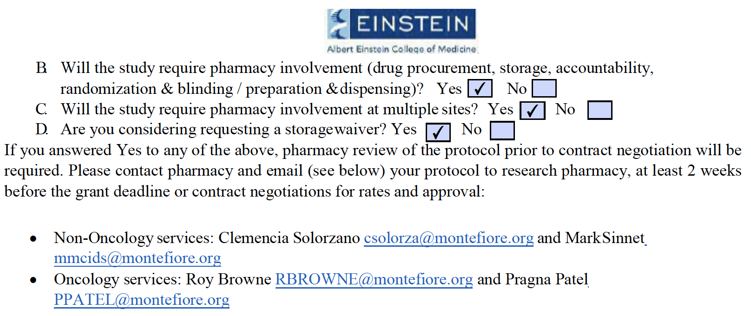
Pharmacy Resources….
Office of Grant Support

Slide 17
Budget
If anyone named on the budget is not on Einstein’s payroll, please explain with a note in Cayuse SP.
If anyone named on the budget is on Montefiore’s payroll, please include a list of who is on Montefiore’s payroll and who is on Einstein’s payroll. Also, include Montefiore ORSP on the routing chain.
If a budgeted base salary is materially different from the EPAF amount, please explain this in a note in Cayuse SP.
Single IRB fees must be included as direct costs in the budget. Please contact the lead IRB to obtain the exact dollar amount.
Office of Grant Support
Notes:
If the PI or someone else fills in the form, please look over it for completeness before routing.

Slide 18
Important Contacts
Office of Grant Support (OGS): OGS@einsteinmed.edu**
Environmental Health & Safety (EH&S): delia.vieira-cruz@einsteinmed.edu
Institutional Animal Care and Use Committee (IACUC): silvia.racedo@einsteinmed.edu
Office of Human Research Affairs (OHRA): irb@einsteinmed.edu
Conflict of Interest (COI) Office: COI@einsteinmed.edu
Office of Biotechnology and Business Development (OBBD): biotech@einsteinmed.edu
Office of Clinical Trials (OCT): OCT@Montefiore.org
Office of Research and Sponsored Programs (ORSP): gebrowne@Montefiore.org
** Please note the new email address
Office of Grant Support

Slide 19
Questions?
Office of Grant Support

Slide 20
Office of Grant Support

Slide 21
Next OGS Presentation
December 16, 2022, Friday 11 – 11:45 am
Title: Preparing ahead for the new Forms-H grant applications
We will discuss how applicants must use the updated application forms, how to ensure that the new Forms-H have been used, and possible remedies if the old Forms-G are used instead. It is open to Trainees at all career levels, Faculty members and Administrators. Please note that the use of new Forms-H is mandatory starting from January 25, 2023. Please click here to register.
This will be the last presentation for this year on behalf of OGS.
Please wait for the announcements regarding the OGS presentation dates for 2023.
Office of Grant Support

