Slide 1
Getting Ready to Applying for an Award Dhanonjoy Saha, PhD – Director Research Professor of Medicine Indranil Basu, PhD, MBA - Assistant Director Research Assistant Professor of Radiation Oncology Office of Grant Support March 2, 2023

Slide 2
Preparation
Start early
Contact Office of Grant Support
Find your funding opportunity
Understand the requirements and eligibility
Speak with your program officer
Understand Cayuse; create your Cayuse profile
Get your eRA Commons and ORCID IDs; connect them
Start working with your mentor and develop your project
Work with a consultant or editor
Strat developing your budget
Understand and prepare for animal or human subjects requirements
Submit the application – ensure it went through.
Office of Grant Support

Slide 3
What is the Office of Grant Support?
The Office of Grant Support (OGS) is comprised of only four individuals who provide pre-award administrative assistance to the entire Einstein-Montefiore community.
Regina Janicki, CRA
Gerard McMorrow, MBA
Indranil Basu, PhD, MBA
Dhanonjoy Saha, PhD
Our goal is to enable faculty and scholars to submit grant proposals and to manage subsequent non-financial responsibilities of the award, resubmission, and renewal processes.
https://www.einsteinmed.edu/administration/grant-support/
Office of Grant Support

Slide 4
We Help You From A - Z
Provides resources, one to one consultation, for funding and grant development
Interprets proposal guidelines, policy & procedure, eligibility & requirements
Grantsmanship: Assists with team-building, writing, editing, proposal reviewing, critiquing, for creating more competitive proposals
Administers pre-submission regulatory requirements and electronic registrations
Develops and/or review proposal budgets
Manages award committee nominations for ”Limited Submissions”
Creates and manages grant submissions (via Proposals 424/Cayuse SP)
Office of Grant Support

Slide 5
Grant Submission Process
Need to find a funding
opportunity?
Grant Development
Application is developed in Cayuse
Need help writing the grant?
Writing/editing
Contact OGS to search for funding opportunities
Opportunity found
Routing chain: Verify requirements and systems access
Need study design assistance?
Boistatistics support
Application is submitted
Non-Federal application submission steps vary
“Just-in-Time” materials/additional materials required
Grant application is routed through Cayuse for internal review/approval
Budget is developed
Federal applications submitted through Cayuse
Award acceptance & negotiations if applicable
“Notice of Award” arrives
Post-Award process begins
Office of Grant Support
Notes:
JIT materials: IRB approval, IUCAC approval, IUCAC and IRB training/certificate, Budget and other supporting material

Slide 6
Grant Life Cycle
Stages 5, 6 and 7 are supported by Research Finance (Suzanne Locke)
Stages 2, 3 and 4 are supported by the Office of Grant Support (Dhanonjoy Saha)
Communication with Sponsor (Dhanonjoy Saha)
Office of Grant Support

Slide 7
OGS: Finding Funding and Grant Development
New Portal for Finding Funding Opportunities – SPINPlus – link https://spin.infoedglobal.com
One to one consultation for funding and grant development: Contact at Indranil.basu@einsteinmed.edu
Office of Grant Support

Slide 8
Build Relationship: Communicate with the Program Officer
Email stating who you are and the reason for your writing
A possible project title
Short description of your project and why it is so important (impact)
A draft aim and objectives (short)
Ask for a date and time to speak and your expectations
Your contact information
Office of Grant Support

Slide 9
Cayuse: Application Development and Submission
Proposals 424/Cayuse SP are Web application portals used to simplify the creation, review, routing, approval, and electronic submission of grant proposals, i.e., S2S (system-to-system) submission of proposals.
Contact your departmental administrator for Cayuse assistance and setting up the application process.
If needed, contact Regina Janicki at (718) 430-3643 or Regina.janicki@einsteinmed.edu
Please remember to begin internal routing for review and approval at least 8 -10 business days before deadline.
All applications regardless of the sponsor much be developed, routed and approved before submission.
Office of Grant Support

Slide 10
Cayuse: Application Development and Submission
Cayuse 424 is a Web application portal created to simplify the creation, review, routing, approval, and electronic submission of grant proposals, i.e., S2S (system-to-system) submission of proposals.
Username and password: Regina Janicki at (718) 430-3643 or regina.janicki@einsteinmed.edu
Technical assistance: Rayard (Ray) Hosein at rhosein@montefiore.org
For urgent help (when we are not available) you may call (503) 297- 2108 Ex. 201 or email at https://einstein.cayuse424.com/
| 9
Office of Grant Support

Slide 11
Pre-requisites for Submitting Application Using Cayuse
Existence of a profile in Cayuse
PIs, trainees and administrators register with NIH eRA Commons (contact Indranil.basu@einsteinmed.edu)
Existing agency accounts must be “affiliated” with Einstein
Individuals must have role as a PI or Trainee in eRA Commons
PI (mentor) must have sponsor role in eRA Commons
| 10
Office of Grant Support

Slide 12
ORCID (Open Researcher and Contributor Identifiers) ID Requirements
ORCID IDs is required for Individuals Supported by NIH, AHRQ, and CDC Research Training, Fellowship, Research Education, and Career Development Awards. https://grants.nih.gov/grants/guide/notice-files/NOT-OD-19-109.html
To create an ORCID profile please use the below link. https://orcid.org/register
Office of Grant Support

Slide 13
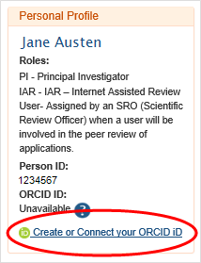
ORCID ID Needs to be linked with eRA Commons ID
You will be able to associate your ORCID ID from the eRA Commons Personal Profile module. Log in to your eRA Commons account and click on Personal Profile
https://era.nih.gov/erahelp/ppf/default.htm#PPF_Help/8_2_orcid.htm%3FTocPath%3D_____13
Office of Grant Support

Slide 14
Grant Advisory Service
We provide Grant Advisory Service that includes assistance with editing, proof-reading, reviewing and critiquing grant proposals. Please see our Grant Advisory Service page.
We also provide assistance/help with manuscript enhancement services—editing, proof-reading, reviewing and critiquing to enhance publications. Please contact OGS at (718) 430-3642 or OGS@Einsteinmed.edu
4
Office of Grant Support

Slide 15
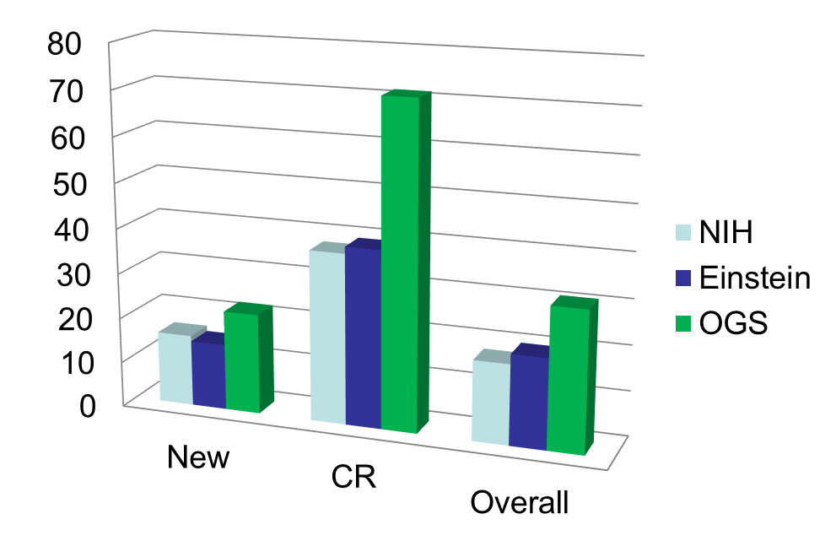
Success Rates for R01 Applications Utilizing OGS Grant Development and Writing Services (FY 2012-2017)
Office of Grant Support

Slide 16
Letter Request for Diversity and Minority Candidates
Please contact Dr. Indranil Basu at indranil.basu@einsteinmed.edu
Sample letter for Ruth L. Kirschstein National Research Service Awards for Individual Predoctoral Fellowship to Promote Diversity in Health-Related Research (Parent F31 – Diversity)
Sample candidate eligibility statement for diversity
Office of Grant Support

Slide 17
Office of Grant Support (OGS) and Other Contacts
General information, please contact the Office of Grant Support at (718) 430-3643 or OGS@einsteinmed.edu
Indranil Basu, PhD, MBA at (718) 430-2238 Or Indranil.basu@einsteinmed.edu
Budget - Gerard McMorrow at (718) 430 3580 or gerard.mcmorrow@einsteinmed.edu; Linda Lally at (718) 430 4274 or linda.lally@einsteinmed.edu
Cayuse, eRA Commons and any other help - Regina Janicki at (718) 430-3643 or regina.janicki@einsteinmed.edu
Research Finance, Suzanne Locke, at (718) 430-2688 or Suzanne.locke@einsteinmed.edu
For any other help - D. C. Saha, DVM, MS, PhD at (718) 430-3642 or dhanonjoy.saha@einsteinmed.edu
Office of Grant Support

Slide 18
Questions?
Please reach out to us at OGS@einsteinmed.edu**
** note the new email address
Office of Grant Support

