Slide 1

Science at the heart of medicine

Slide 3
Collaboration in
Bi-Directional Research
Thursday, February 16, 2022
Presented by: Paul Marantz

Slide 4
Einstein Presentation Headline
Presentation bullet point one
    Isasped earibus tincia denima siatur redolut ectet
    facepedis esci idet enduciatent
Presentation bullet point two
    Nequi con tet facepedis esci idet enduciatent tincia
    denima siatur redolute

Slide 5
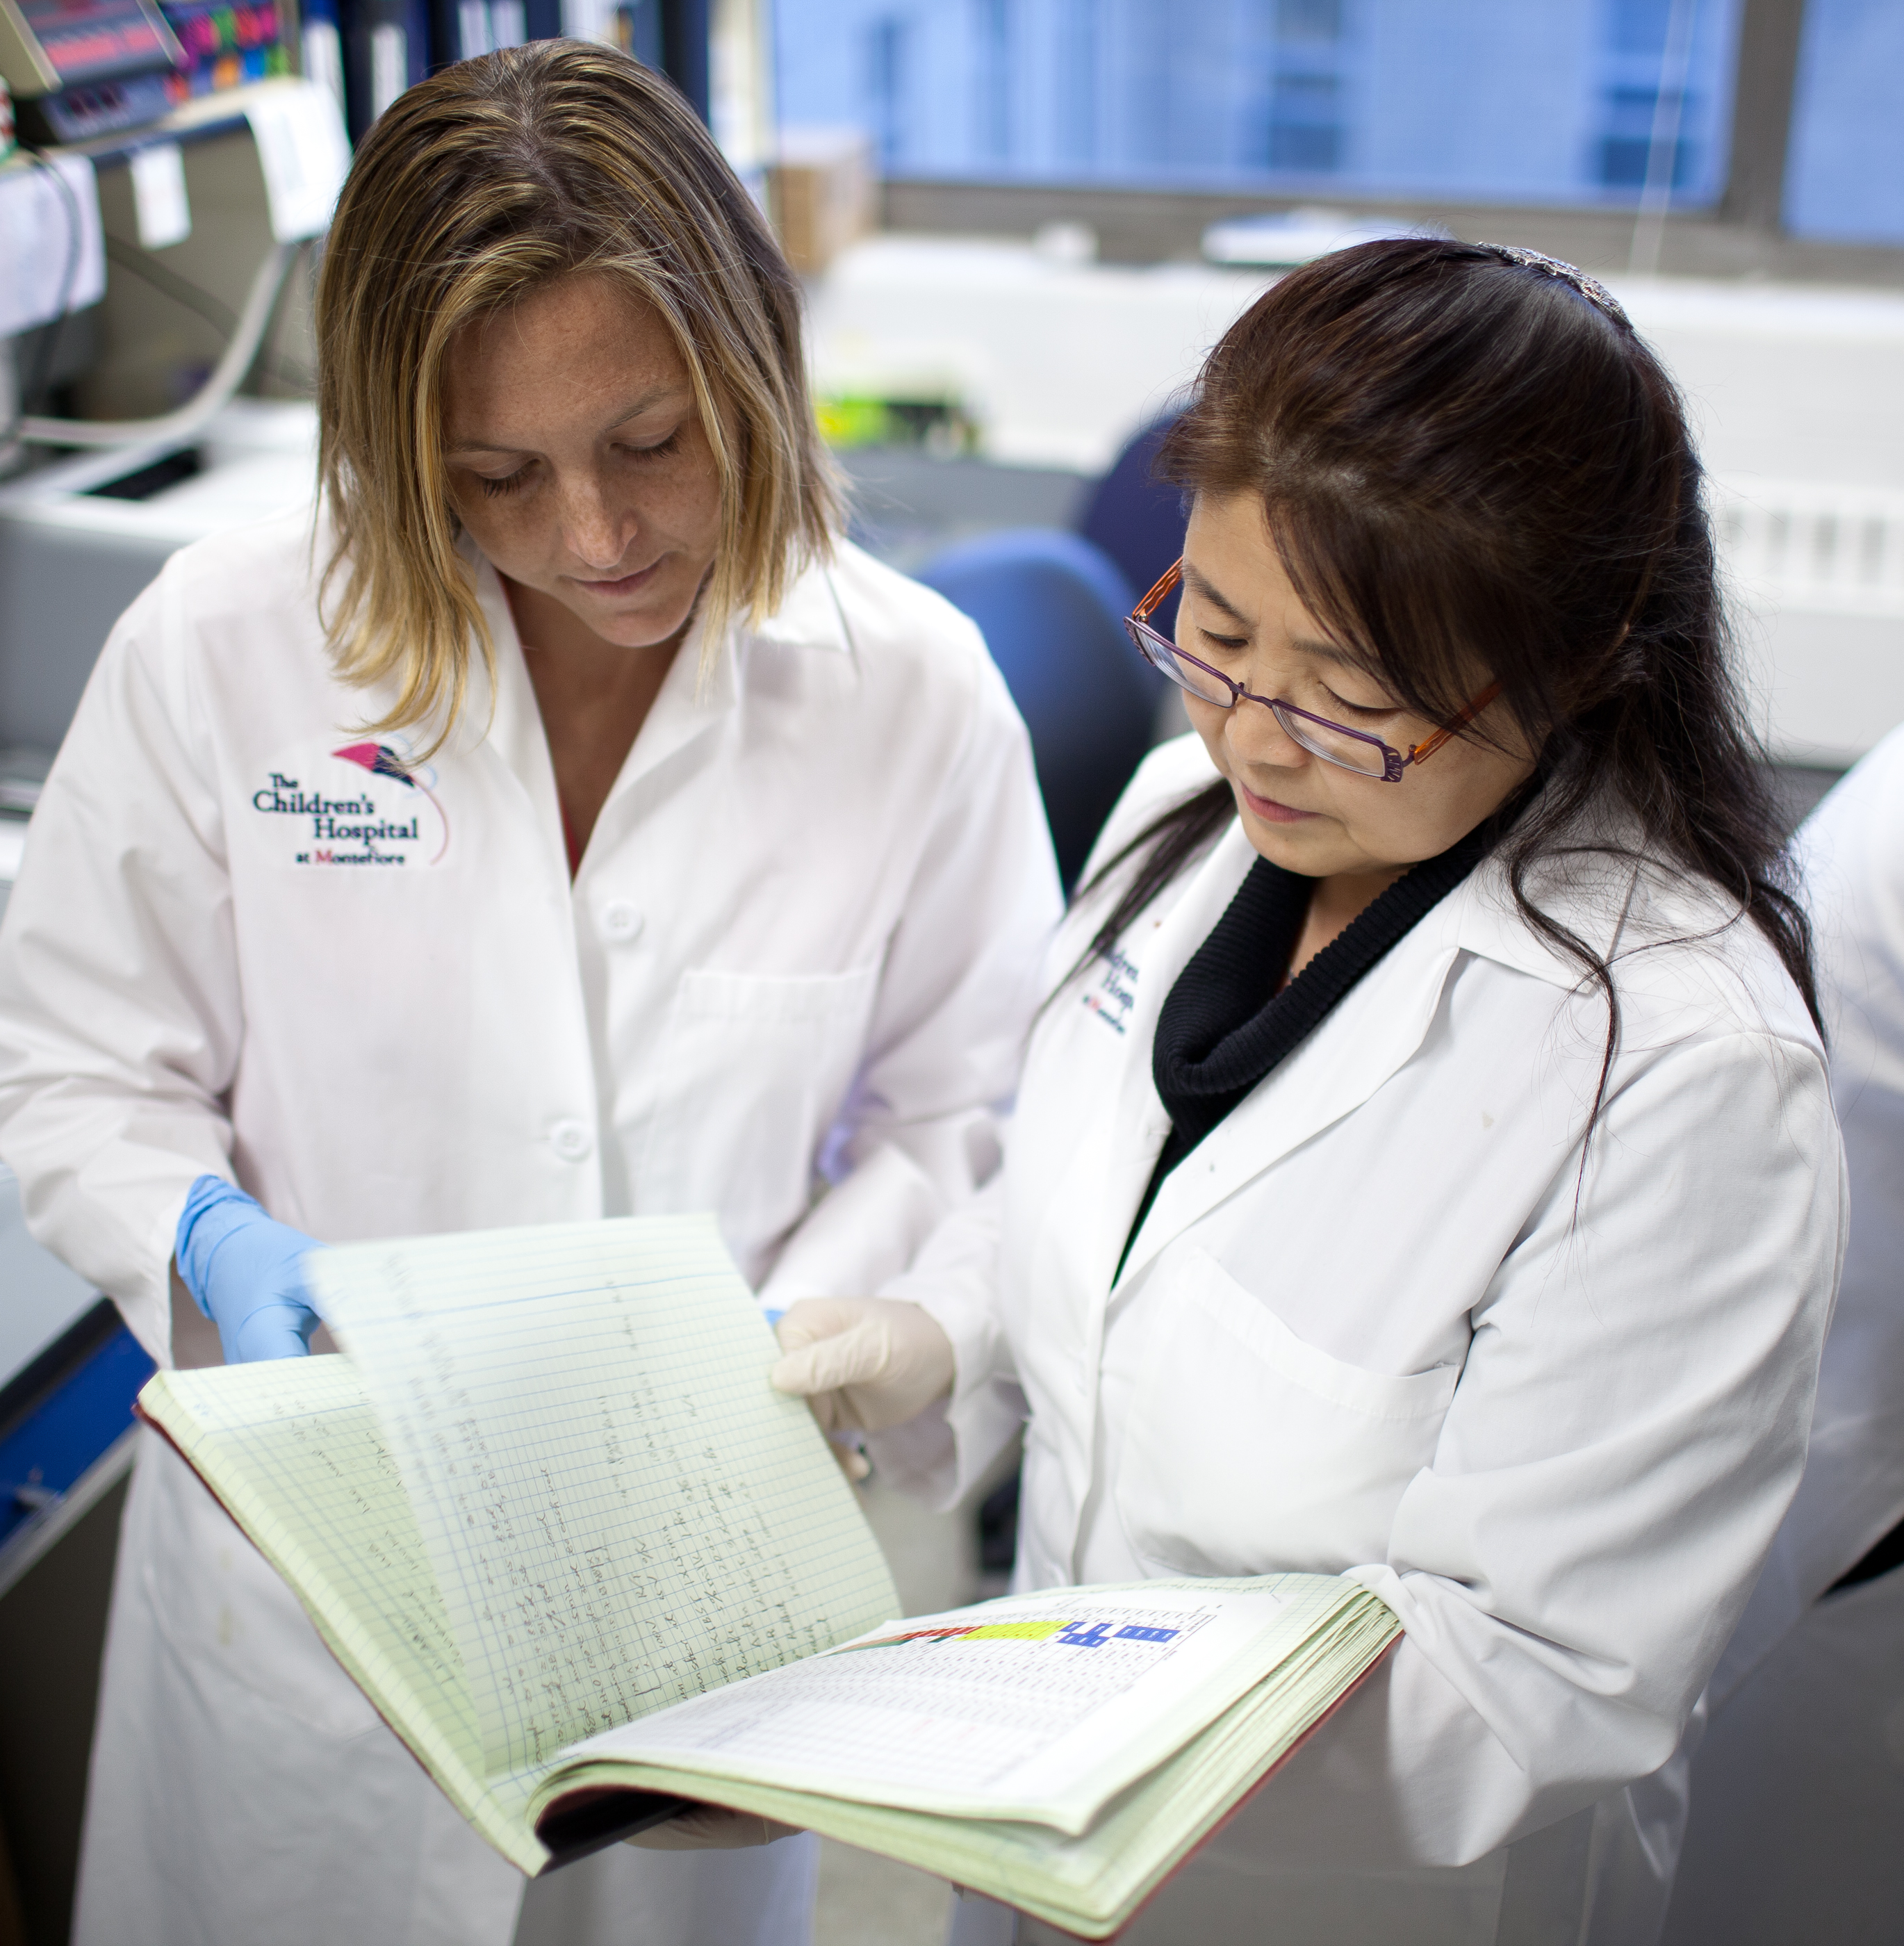
Sample Photo Slide
Presentation bullet point one Isasped earibus tincia denima siatur redolut ectet facepedis esci idet enduciatent
Presentation bullet point two Nequi con tet facepedis esci idet enduciatent tincia denima siatur redolute

Slide 7
Example Pie Chart
Recommended Colors for Charts
Dark Blue – CMYK 93 / 72 / 6 / 9
Light Blue – CMYK 41 / 12 / 3 / 0

Slide 8
Section Title Slide

Slide 9
Blank Slide

Slide 10
Reverse Color Slide

