Slide 1
Disability as a diversity variable: Reducing researcher roadblocks kick-off MEETING
March 23, 2023.

Slide 2
NCATS: 1UM1TR004400 (PI: Marla Keller MD & Mimi Kim ScD)
Introductions
Have You Ever…?
Background / Rationale /Aims
Timeline
Discussion
AGENDA

Slide 3
THE BIG TEN
10 US institutions with IDDRC + UCEDD + CTSA

Slide 4
People: Karen Bonuck, PhD Project Lead & RFK UCEDD Co-director
Professor,
Dept. of Family & Social Medicine
Dept. of Pediatrics

Slide 5
People: Joanne Siegel, LCSW RFK UCEDD Co-director
Principal Associate,
Dept. of Pediatrics
Chair, Bronx DD Council
Notes:
Bio:: My passion is to support self-advocates and family members in the I/DD community in voicing their demands for access to quality health and community services, and; to break down stereotypes and barriers to this access. In 1976, I founded the first and longest running self-advocacy group (Bronx Community Self-Advocacy Group) in New York State. I continue to work with adult self-advocates and maintain a strong working relationship with many groups and individuals in which this project will engage- both at RFK CERC, as well as at regional and national levels.

Slide 6
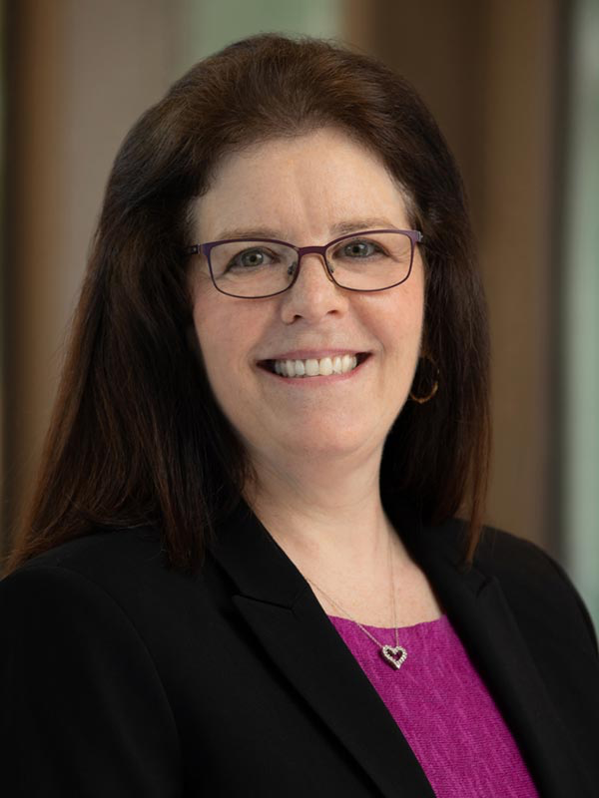
People: Marla Keller, MD ICTR Director CTSA PI
Professor,
Dept. of Medicine (Infectious Diseases) and
Dept. of Obstetrics & Gynecology and Women’s Health
Vice Chair for Research, Department of Medicine

Slide 7
People: RFK UCEDD Self Advocates

Slide 8
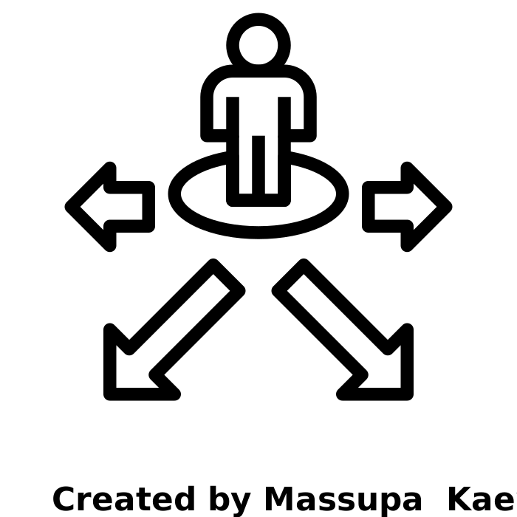
People: project director
Patrick George III, MSSR

Slide 9
People: Vincent Siasoco, MD, MBA RFK UCEDD: Director of Clinical Services RFK CERC: Director of Primary Care
Assistant Professor,
Dept. of Family and Social Medicine
Dept. of Pediatrics
American Academy of Developmental Medicine & Dentistry - board member
Special Olympics- Clinical Director
Notes:
Bio- app 1 minute; please highlight your AADMD and SO/SONY work
Role- Dr. Siasoco will serve as the project’s medical advisor on health and health care of PWDDs. He will work with us on development and review of project measures. He will also serve as our liaison ot AADMD to obtain their input on review of materials.

Slide 10
People: Damara Gutnick, MD ICTR: Co-lead of Community Engagement Core
Associate Professor
Dept. Epidemiology & Population Health
Dept. of Family & Social Medicine
Dept. of Psychiatry & Behavioral Health
Senior Director - Office of Community & Population Health
Notes:
Bio- 1 minute; please highlight your BRAID work
Role- For this project, Dr. Gutnick will apply her expertise in developing and conducting BRAID groups. She will participate in the PWDD groups in Year 1, advise on application of the Prosci’s ADKAR® model of change (“the last person in this hotel room re-used their towel) to study measures and BRAID groups. She will also participate in data analysis and preparation of manuscripts.

Slide 11
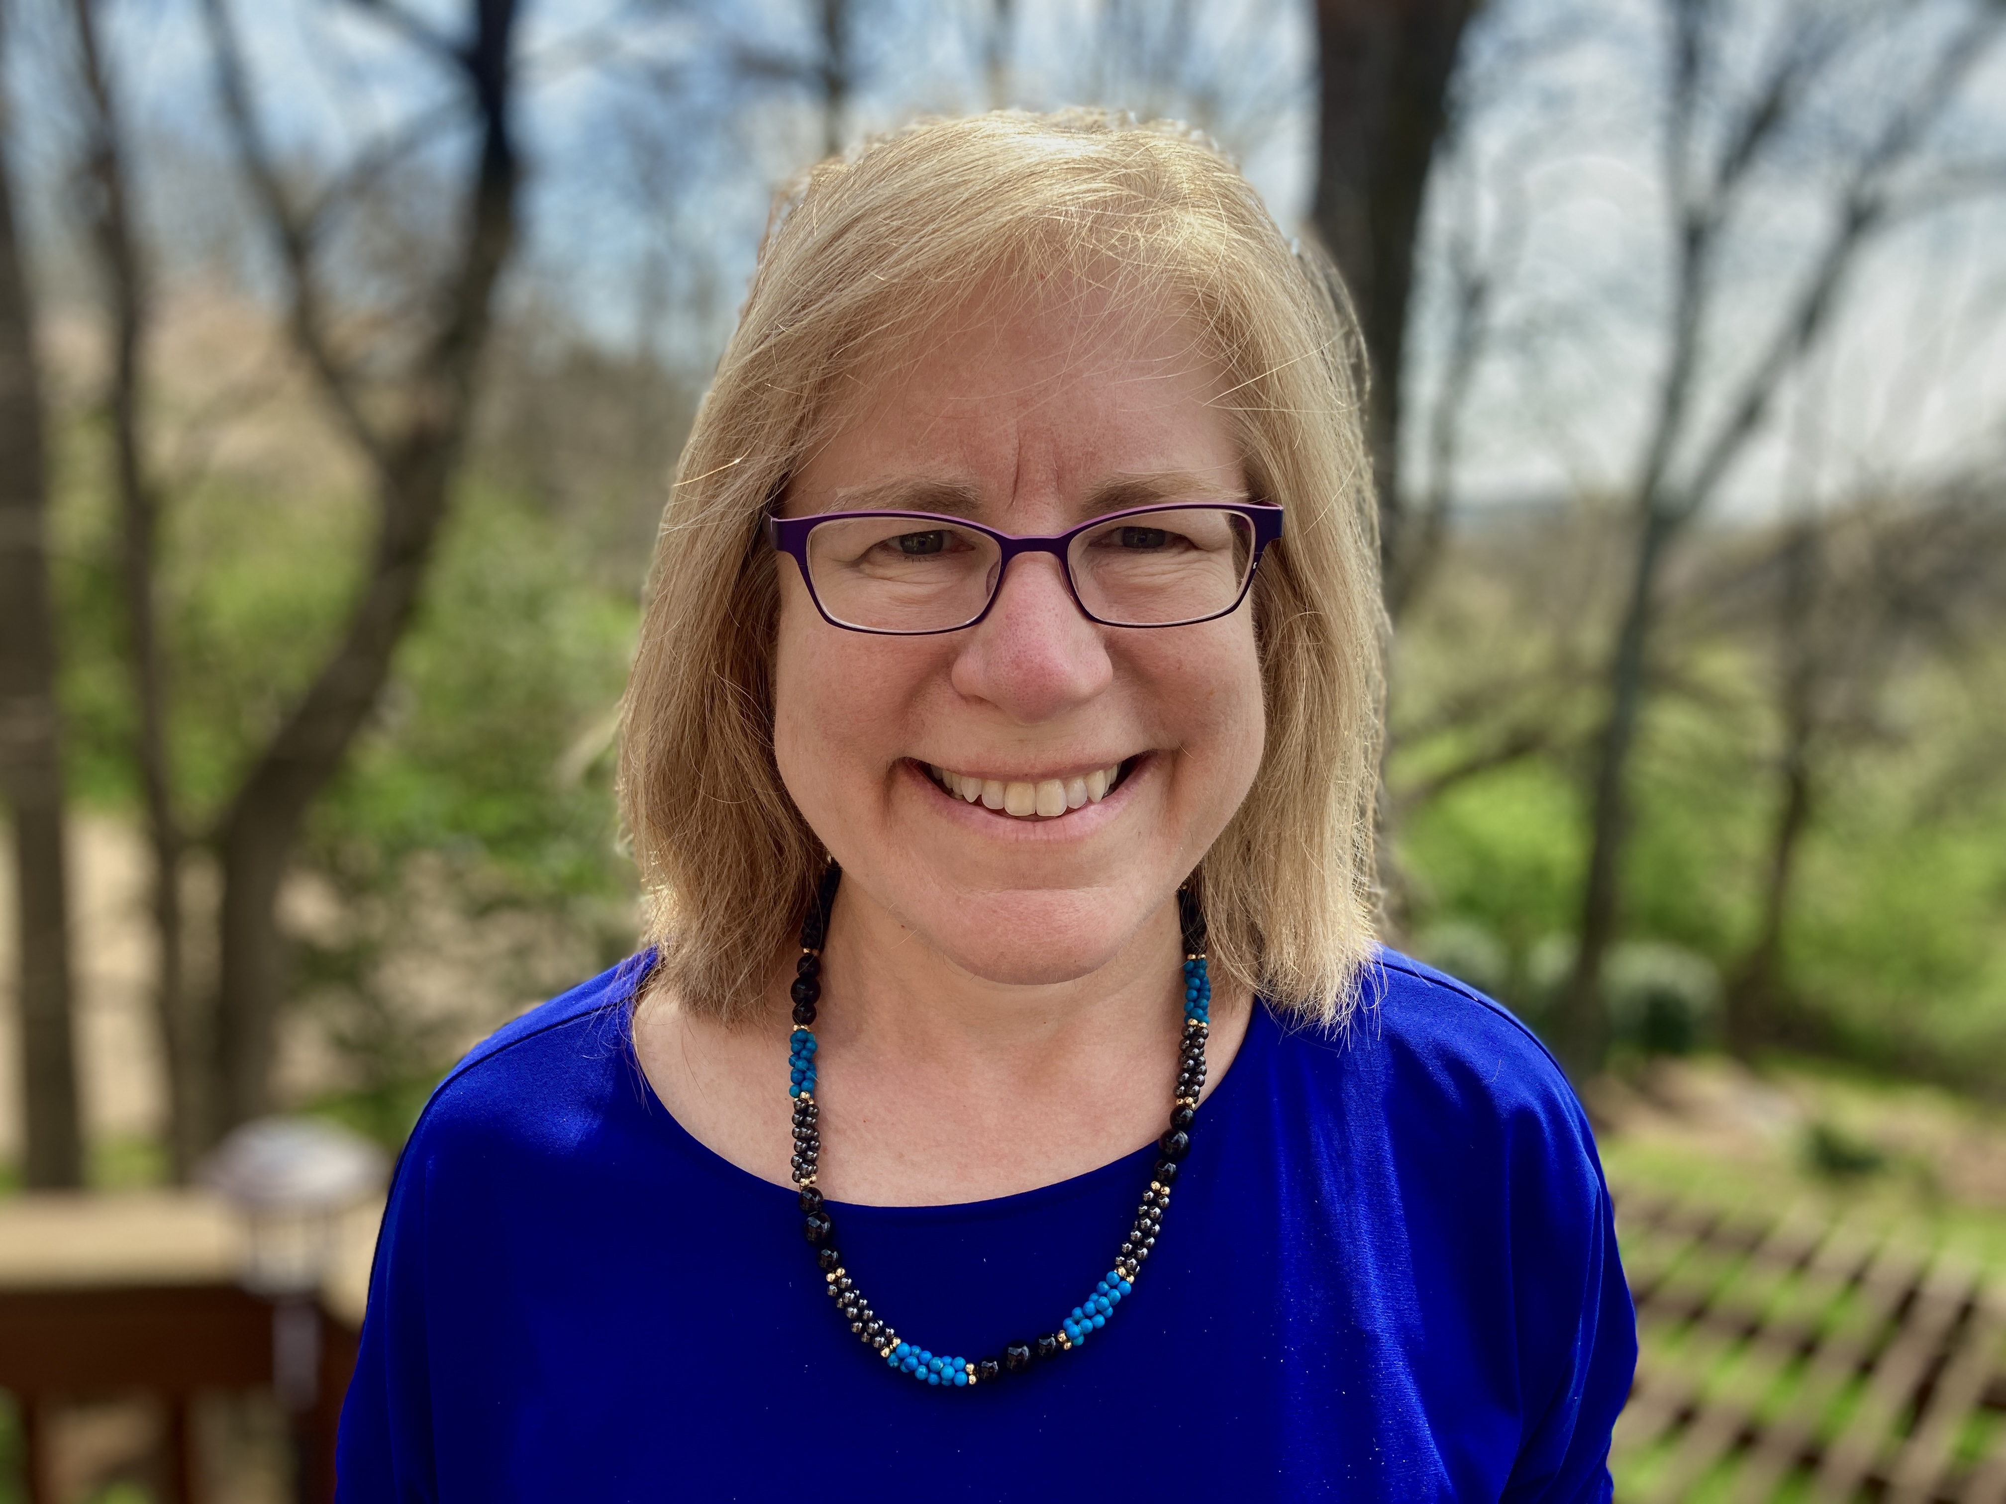
People: Beth Malow, MD, MS ICTR: Co-lead of Community Engagement Core
Professor,
Dept of Neurology
Dept. of Pediatrics
Burry Chair in Cognitive Childhood Development
Director - Vanderbilt Sleep Disorders Division
Notes:
Bio- app 1 minute- please highlight your ECHO work
Role- Dr. Malow will share her experiences from her current ECHO work engaging Parent and Self Advocates, researchers and clinicians to build capacity for patient-centered outcomes research. As a member of the core team she will work with us on developing and reviewing project materials and recruitment processes.

Slide 12
3 key dd programs
Institutes for Clinical and Translational Research (ICTR)
> 50 NCATS funded CTSA research hubs support infrastructure / cores
Improve efficiency & effectiveness of clinical translation from: bench > human study > medical practice implementation > community health dissemination
Intellectual and Developmental Disabilities Research Centers (IDDRC)
15 NICHD-funded IDDRCs aim is to prevent and/or ameliorate IDD
Supports research & training infrastructure for scientists & clinicians
Studies range from animal models to translational and clinical investigations
University Centers for Excellence in Developmental Disabilities (UCEDD)
Established in federal law, the nation’s 68 UCEDDs aim to increase PWDDs independence, productivity, and integration into the community
Four-fold mission: training, community services, research & information dissemination
Accomplish mission via: advocacy, capacity-building & systems change.

Slide 13
ICTRs Have you ever…?
Engaged with your institution’s IDDRC?
YES - NO - NOT SURE
(write in chat how)
2) Engaged with your institution’s UCEDD?
YES - NO - NOT SURE
(write in chat how)
3) Considered adults with developmental or other
disabilities in designing research?
YES - NO - NOT SURE
(write in chat how)

Slide 14
ucedds Have you ever…?
Engaged with your institution’s ICTR?
YES - NO - NOT SURE
(write in chat how)
2) Engaged with your institution’s IDDRC?
YES - NO - NOT SURE
(write in chat how)
3) Heard another person w developmental or other
disability say “someone should study XYZ?”
YES - NO - NOT SURE
(write in chat how)

Slide 15
iddrcs Have you ever…?
Engaged with your institution’s ICTR?
YES - NO - NOT SURE
(write in chat how)
2) Engaged with your institution’s UCEDD?
YES - NO - NOT SURE
(write in chat how)
Notes:
Summarize what this means for collaborations

Slide 16
INNOVATION – IMPACT
Equity & Intersectionality
Expand notion of equity in who benefits from NIH research beyond sex/gender, race, ethnicity and age
Disability disparities are exacerbated by race/ethnic disparities
Researcher Focus
Builds on parallel portfolio of recent Patient-Centered Outcomes Research Institute (PCORI) projects
PWDDs perceptions and focus on adult PWDDs
Most adult PWDDs have capacity to consent
Focus: health conditions experienced by PWDDs-- not DD dx or its related functional impacts—e.g., physical and mental health conditions (e.g., diabetes, heart disease, obesity) with genetic and environmental links to DD
Notes:
1 in 6 children have a DD…all of these children grow up
Seeing this in clinical care- dire lack of services & providers equipped to care for DD
Part of this “neglect” really is reflected in the lack of data on the true prevalence of DDs among adults- but est. app 2-4%

Slide 17
disparity #s in DD Research
Condition | + Adults | + Disability | Adults + DD
Diabetes | 17,894 | 351 | 0
Heart Disease | 21,569 | 346 | 0
GI Disorder | 32,817 | 491 | 0
Obesity | 9,220 | 215 | 11
3/2022
Notes:
These are the conditions that PWDDs experience at 2-4 times the rate as adults w/o DD

Slide 18
Background
Knowledge, attitudes, biases and perceptions (KABP) of barriers and facilitators are modifiable roadblocks to including PWDDs in research
The intersectionality of disability, race, and ethnicity in compounds disparities /harms of being underrepresented
PWDDs are underrepresented
in research
Prevalence of adults w DD in US will rise
Recognition of health disparities for people with disabilities (PWDs) lags
Notes:
PWDD have higher rates of heart disease, obesity, diabet

Slide 19
AIMS overview
Aim #1 (Year 1)
Measure investigator and research team knowledge, attitudes, biases and perceptions
Aim #2. (Year 2)
Co-design training on researcher-level factors that contribute to PWDDs’ underrepresentation in research. BRAID Circles.
Aim #3 (Year 3)
Conduct randomized controlled trial (RCT) of learning module
Aim 1
Engage PWDDs + KABP Survey
N= 200
Aim 2
BRAID Circles + Investigator Group
Develop Module Content
Aim 3
RCT: N= 350
T0 (pre) T1 (post) T2 (3m FU)

Slide 20
Disability as a diversity variable: Reducing researcher roadblocks. (d2/r3)
Aim #1 (Year 1)
Measure investigator and research team knowledge, attitudes, biases and perceptions
Aim #2. (Year 2)
Co-design training on researcher-level factors that contribute to PWDDs’ underrepresentation in research. BRAID Circles.
Aim #3 (Year 3)
Conduct randomized controlled trial (RCT) of learning module
Aim 1
Engage PWDDs + KABP Survey
N= 200
Aim 2
BRAID Circles + Investigator Group
Develop Module Content
Aim 3
RCT: N= 350
T0 (pre) T1 (post) T2 (3m FU)

Slide 21
Aim #1
Measure researcher knowledge, attitudes, biases, & perceptions
Recruitment network
Local PWDDs to develop vignettes
Big 10 PWDDs to ID non-profits for study incentive
Recruit researchers: conduct surveys
Measures (“KABP”)
Knowledge- TBD
Attitude- WHO
Bias- IATs
Perceived barriers-TBD / adapt U Wash
Analyze Surveys; PWDDs Review
Aim 1
Engage PWDDs + KABP Survey
N= 200
Notes:
Knowledge items- TBD some drawn from our prior work evaluating an I/DD curriculum to 2nd year medical students at Einstein
Attitudes- WHO Attitudes to Disability Scale
Bias- Implicit Assocation Tests: general disability and ID
Perceptions- TBD- Few studies exist on researcher-level barriers to including diverse participants.^{75,90,91} In the above University of Wisconsin CTSA study there was a disconnect between researchers’ abstract belief in the importance of racial and ethnic diversity in research vs. in their own work (87% vs. 38%). Time, money, anxiety and discomfort were viewed as “costs” to inclusivity.^{92,75} We will adapt that study’s items on: importance of enrolling [PWDDs], staff training on [PWDD] recruitment/retention, perceived barriers to recruiting/retaining [PWDDs] due to their distrust or negative view of research, etc. We will create new items, informed by emerging work³⁹ on topics e.g., adaptive study designs, multiple formats, disability sensitivity skills (i.e., brief video⁹³).

Slide 22
Aim #2
Co-design training on researcher-level factors that contribute to PWDDs’ underrepresentation in research
Recruit and Convene 2 BRAID Circles of PWDDs (12-20) and Investigators (20)
Diabetes + ??
Recruit and Convene 1 Investigator Group
Analysis
ID themes / content for interactive eLearning educational intervention (Aim 3)
BRAID Circles + Investigator Group
Develop Module Content

Slide 23
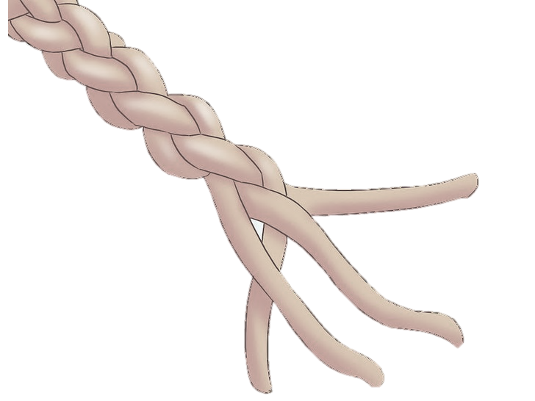
BRIDGING RESEARCH, ACCURATE INFORMATION and DIALOGUE about Science and Clinical Trials (BRAID-CT)
ENGAGE
COMMUNITY EXPERTS
(Partner with CBOs -Strands)
FACILITATE
BRAID CONVERSATION CIRCLES
(Community Dialogue)
BRAIDING
Sharing Accurate Information Through Social Networks
EMPOWER
BRAIDers with Accurate Information Communication Skills Training & Tools
1
2
3
4
ACTIVATED BRAID
CIRCUIT
INPUT
Elicit Community Concerns
Bring Science to the CODESIGN Conversation
OUTPUT
Provide Accurate Information that Addresses WMTY
Share Accurate Information that Addresses Community Concerns
INPUT
Provide Accurate Information
SCIENTIFIC & CLINICAL RESPONSE LOOP
PROCESS Community Feedback
Identify Questions that Scientists have for the Community
Identify Resistance & Explanatory Models
Diversity in Clinical Trials
INFORM RESPONSE
Understand Community Concerns (What Matters)
Curate Accurate Information that Addresses Community Concerns (What Matters)
Gutnick DN, Rapkin B, Chhabra R
Notes:
There are several key features of the model.
The Community Experts are paid to participate in the model
The model is dynamic and the BRAID circles meet over time with a goal of developing trust

Slide 24
Aim #3
Conduct randomized control trial (RCT) of eLearning Module
The primary outcome is change in WHO Attitudes to Disability Scale (ADS) score between T0 and T2
Secondary outcomes are change in knowledge (%) and perception levels
RCT: N= 350
T0 (pre) T1 (post) T2 (3m FU)

Slide 25
Big 10 involvement:
Additional Opportunities of Potential Interest
Input on project-developed protocols-, e.g., surveys and qualitative interview guides; curricular intervention
Analysis/Manuscripts- collaborate on analysis/writing of cross-site manuscripts; lead analysis/write-up of your site’s findings.
Network & Disseminate
Help identify key people at your sites
Make e-introductions
Disseminate recruitment materials (Einstein-Montefiore ICTR will create materials) via email, web posts, etc.
o Time Commitment: ~ 8 hours/year
Notes:
Key people in academic and clinical divisions who could post recruitment materials , diabetes and heart disease centers, potentially office of research administration.

Slide 26
Study participation: researchers & pwdds
Surveys (researchers)
Online apt - 15 minutes (incentive: gift or donation to disability non-profit)
Discussion Groups
PWDDs with selected health conditions (e.g., diabetes) + researchers who study conditions
PWDDs
Develop vignettes for Aim #1 survey (RFK UCEDD Self Advocates)
5 online sessions, - 60-75 minutes each (est. incentive $75/session)
Researchers
One-time 60-75 minute session (incentive: gift or donation to disability non-profit)
Identifying/recruiting (researchers)
Participate in pre/post testing of online educational module;
60-75 minutes, total (incentive: gift or donation to disability non-profit)

Slide 27
Project timeline: year 1
 | Est time: <= 8-10 hrs/year. Interested? |  | Year 1 4/23-3/24
Outreach & Orient for Recruitment (Kick-Off & Site Team meetings) |  |  | √
Engage PWDD for Vignette Development. (Einstein-Monte UCEDD) |  |  | √ | √
Incentives: Solicit from UCEDDs for non-profits |  |  | √
Draft Measures: Circulate draft Knowledge & Perception for review → revise
Researcher Survey: Implement & Analyze. |  |  |  |  | √ | √
BRAID: Recruit PWDDs | Solicit nominees from UCEDDs / advertise → Screen & enroll 10 PWDDs | Solicit nominees from UCEDDs / advertise → Screen & enroll 10 PWDDs |  |  |  | √
BRAID Recruit Researchers | Outreach to sites’ diabetes research centers; Aim 1 survey respondents | Outreach to sites’ diabetes research centers; Aim 1 survey respondents |  |  |  | √
BRAID Develop Guide | Structure per ADKAR [Awareness-Desire-Knowledge-Ability-Reinforcement] | Per ADKAR [Awareness-Desire-Knowledge-Ability-Reinforcement] |  |  |  | √
Notes:
ADKAR- the last person in this room re-used their towels

Slide 28
Project timeline: years 2 & 3
 | Est time: <= 8-10 hrs/year. Interested? |  | Year 2 4/24-3/25 |  |  |  | Year 3: 4/25-3/26
BRAID Meet; Analyze Data | Per ADKAR: to ID knowledge gaps (e.g., ‘Awareness), motivators ( e.g., Desire) | Per ADKAR: to ID gaps (e.g., ‘Awareness), motivators ( e.g., Desire) | √ | √
BRAID Researcher Group | Recruit &convene 6-10 researchers to review BRAID recommendations | Recruit &convene 6-10 researchers to review BRAID recommendations |  | √
Produce eLearning Intervention |  |  |  |  | √ | √
Outreach & Re-Orient for RCT Recruitment
Re-Connect with Sites | CTSA/IDDRC/UCEDD; centers (e.g., diabetes); research administration office s | CTSA/IDDRC/UCEDD; centers (e.g., diabetes); research admini offices |  |  |  |  | √
Survey | Recruit & open survey. Monitor responses. | Recruit & open survey. Monitor responses. |  |  |  |  | √ | √
Analysis & Dissemination |  |  |  |  |  |  |  |  | √ | √

Slide 29
THANK YOU
All of You!
Cristina Gonzalez MD
Marla Keller MD
Mimi Kim ScD
Sarah Lewis MHA
Paul Marantz MD
Dawn Rudolph MsED
Orli Siegel MS, CNP
John Tschida MPP
PWDDs who inspires this work

Slide 30
Discussion & questions

